Slide 2
Acts 19:1-7
¹ And it happened, while Apollos was at Corinth, that Paul, having passed through the upper regions, came to Ephesus. And finding some disciples ² he said to them, did you receive the Holy Spirit when you believed? So they said to him, we have not so much as heard whether there is a Holy Spirit. ³ And he said to them, into what then were you baptized? So they said, into John’s baptism. ⁴ Then Paul said, John indeed baptized with a baptism of repentance, saying to the people that they should believe on Him who would come after him, that is, on Christ Jesus. ⁵ When they heard this, they were baptized in the name of the Lord Jesus. ⁶ And when Paul had laid hands on them, the Holy Spirit came upon them, and they spoke with tongues and prophesied. ⁷ Now the men were about twelve in all.

Slide 4
?

Slide 5
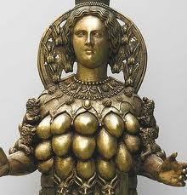
Ephesus:
1st Century Population estimated at 250,000
Located in the Roman province of Asia (minor) on the west coast of what today is Turkey.
Ephesus was large and cultured, and famous for its trade, art, and science. Along with Alexandria, Egypt and Antioch, Syria, Ephesus was a leader in international trade.
Ephesus was also a haven for Philosophers, poets, and artists.
As one might expect of a city steeped in Greek culture and philosophy; the religion of the people was also Greek.
The people worshiped the goddess Diana. Her temple was one of the seven wonders of the ancient world. Also the small idols of Diana were crafted in Ephesus, which became an important commercial industry.
“Into what then were you baptized?”
“So they said: into John’s baptism.”
“When they heard this they were baptized in the name of the Lord Jesus”

Slide 6
Baptism of John | Baptism of Jesus
An immersion in Water (Matt 3:6; Jn 3:23) | An immersion in Water (Mk 16:16; Acts 8:36)
A baptism of preparation (Acts 19:4) | A baptism of fulfillment (Acts 19:4)
A baptism of repentance (Lk 3:3; Mk 1:5) | A baptism of faith (Mk 16:16; Acts 8:37; Rom 6:3-4)
A baptism for the remission of sins (Mk 1:5; Lk 3:3) | A baptism for the remission of sins (Mk 16:16; Acts 2:32)
Looks forward to
Looks backward to

Slide 7
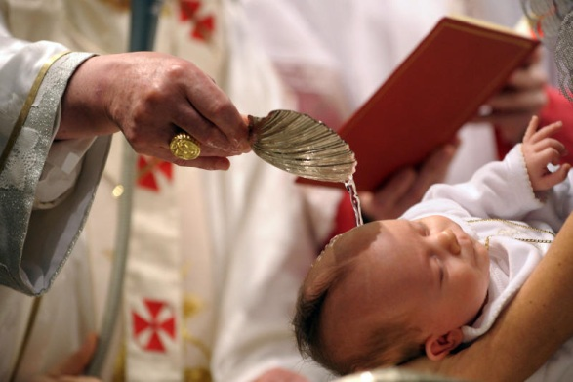
When it is not an Immersion

Slide 8
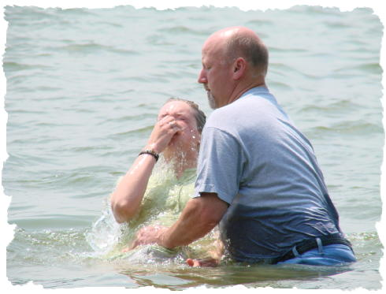
When it is not in the name of Christ
“. . . They were baptized in the name of the Lord Jesus.”

Slide 9
When it is not for the correct Purpose

Slide 10
When it is not based on Faith in Christ
“The Philip said, if you believe with all your heart, you man. And he answered and said, I believe that Jesus Christ is the Son of God” (Acts 8:37)

Slide 11
Into what were you baptized?
Body
1 Cor 12:13
Death
Rom 6:3-4
Christ
Gal 3:27
“Then those who gladly received his word were baptized; and that day about three thousand souls were added to them.” (Acts 2:41).
What about You?
“When they heard this, they were baptized in the name of the Lord Jesus” (Acts 19:5).

