Slide 2
Isaiah 6:1-8
1. In the year that King Uzziah died, I saw the Lord sitting on a throne, high and lifted up, and the train of His robe filled the temple. 2 Above it stood seraphim; each one had six wings: with two he covered his face, with two he covered his feet, and with two he flew. 3 And one cried to another and said: Holy, holy, holy is the LORD of hosts; the whole earth is full of His glory! 4 And the posts of the door were shaken by the voice of him who cried out, and the house was filled with smoke. 5 So I said: Woe is me, for I am undone! Because I am a man of unclean lips, and I dwell in the midst of a people of unclean lips; for my eyes have seen the King, the LORD of hosts. 6 Then one of the seraphim flew to me, having in his hand a live coal which he had taken with the tongs from the altar. 7 And he touched my mouth with it, and said: Behold, this has touched your lips; your iniquity is taken away, and your sin purged. 8 Also I heard the voice of the Lord, saying: Whom shall I send, and who will go for Us? Then I said, here am I! Send me.

Slide 4
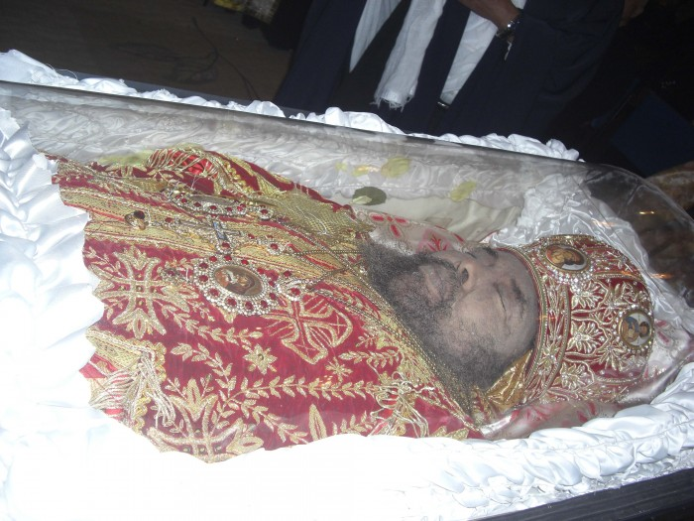
King Uzziah Died
740 B.C.

Slide 5
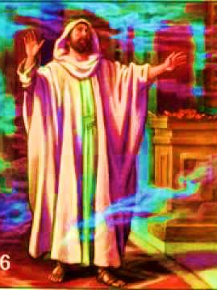
“In the year that King Uzziah died, I saw the Lord sitting on a throne, high and lifted up, and the train of His robe filled the temple” (Isaiah 6:1).

Slide 6
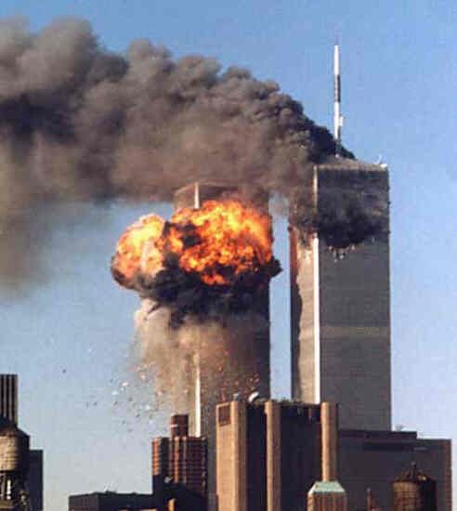
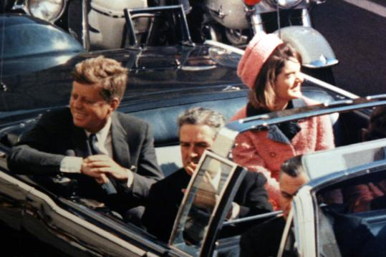
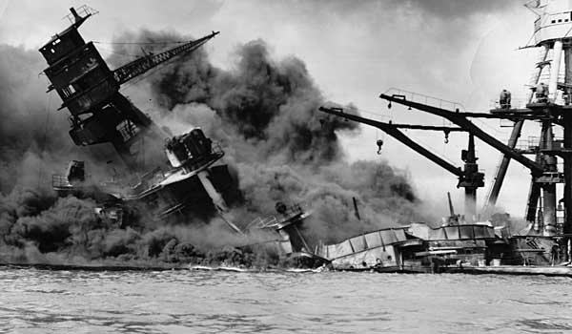
“In the world you will have tribulation; but be of good cheer, I have overcome the world.”
(John 16:33)
September 11, 2001
Personal Tragedies
Horrible Accident (Running over a child)
Death of a spouse / child
Terminal or crippling illness
Injustice
Slander
November 22, 1963
December 7, 1941

Slide 7
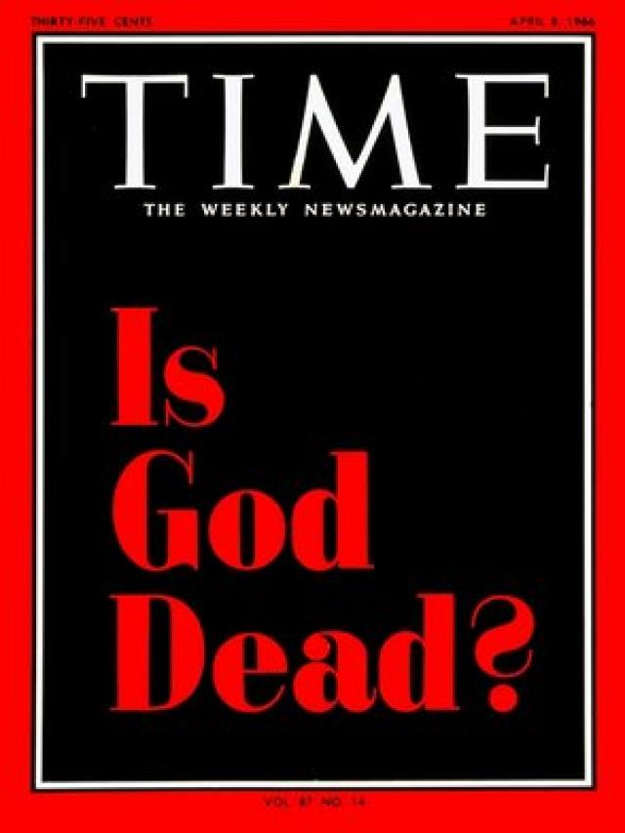
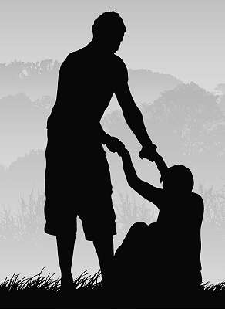
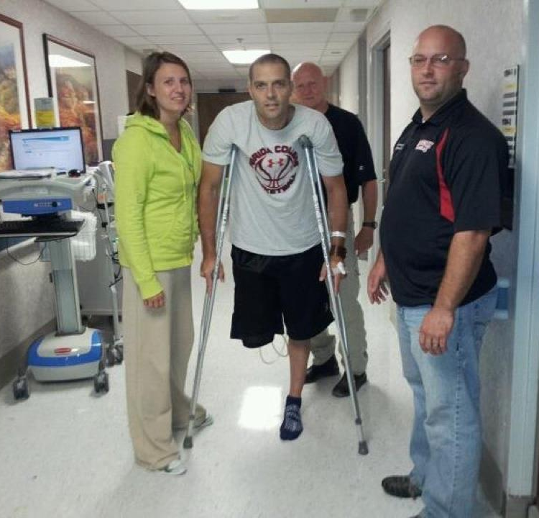
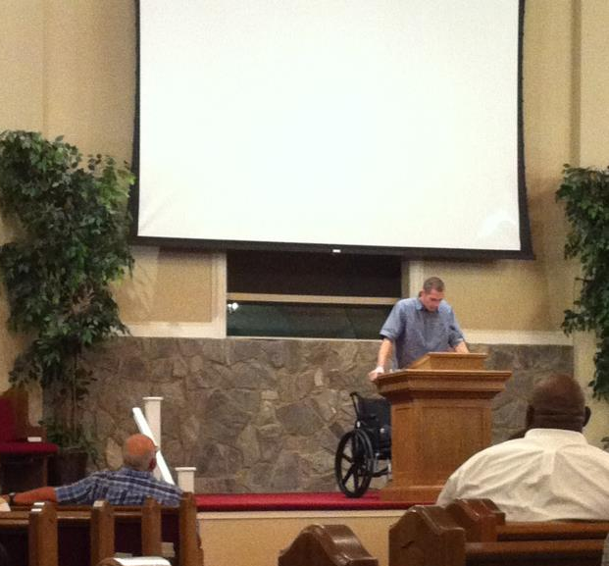
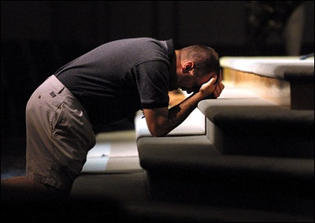
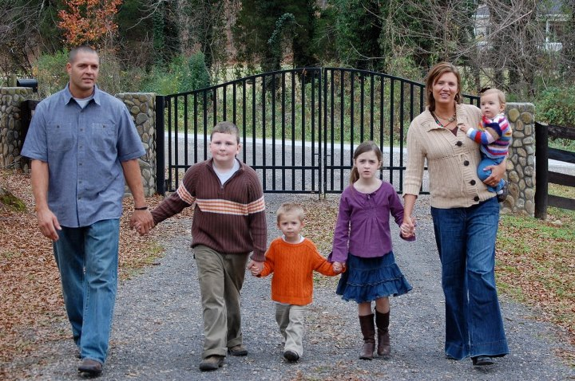
“I will lift up my eyes to the hills-- from whence comes my help? My help comes from the LORD, who made heaven and earth” (Psalm 121:1-2).
“Unto You I lift up my eyes, O You who dwell in the heavens” (Psalm 123:1).
See the Power & Holiness of God
See Yourself & Your Sin
See The Needs of Others

