Slide 2
Acts 11:19-26
¹⁹ Now those who were scattered after the persecution that arose over Stephen traveled as far as Phoenicia, Cyprus, and Antioch, preaching the word to no one but the Jews only. ²⁰ But some of them were men from Cyprus and Cyrene, who, when they had come to Antioch, spoke to the Hellenists, preaching the Lord Jesus. ²¹ And the hand of the Lord was with them, and a great number believed and turned to the Lord. ²² Then news of these things came to the ears of the church in Jerusalem, and they sent out Barnabas to go as far as Antioch. ²³ When he came and had seen the grace of God, he was glad, and encouraged them all that with purpose of heart they should continue with the Lord. ²⁴ For he was a good man, full of the Holy Spirit and of faith. And a great many people were added to the Lord. ²⁵ Then Barnabas departed for Tarsus to seek Saul. ²⁶ And when he had found him, he brought him to Antioch. So it was that for a whole year they assembled with the church and taught a great many people. And the disciples were first called Christians in Antioch.

Slide 5
What Does This Gospel Meeting Mean To You?

Slide 6
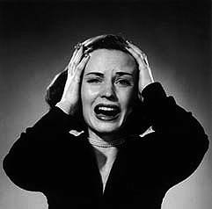
Oh No!
Another one, already?

Slide 7
What Does This Gospel Meeting Mean To You?
Gospel Meetings are no longer effective!
Gospel Meetings are a relic of the 1950’s!
Gospel Meetings are too long and boring!
Gospel Meetings are too hard busy people!
The only visitors we have are from other churches of Christ!
Gospel Meetings have become merely traditions!

Slide 8
What Does A Gospel Meeting Mean To Them ?
Hours of Travel
The Whole Day Was Consumed By The Meeting
Hours of Walking

Slide 9
What Does A Gospel Meeting Mean To Them ?
It meant they spent hours sitting on the ground

Slide 10
What Does A Gospel Meeting Mean To Them ?
It meant the children were excused from school

Slide 11
What Does A Gospel Meeting Mean To Them ?
It meant they came together with those they had not seen for a while

Slide 12
What Does A Gospel Meeting Mean To Them ?
It meant they witnessed conversions daily

Slide 13
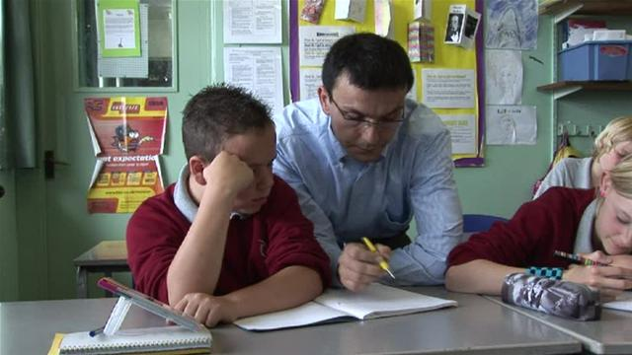
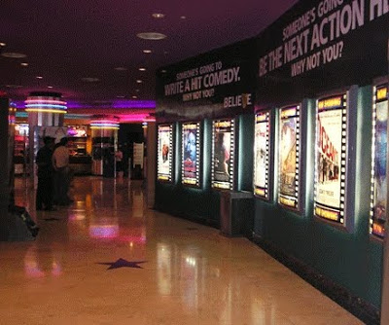
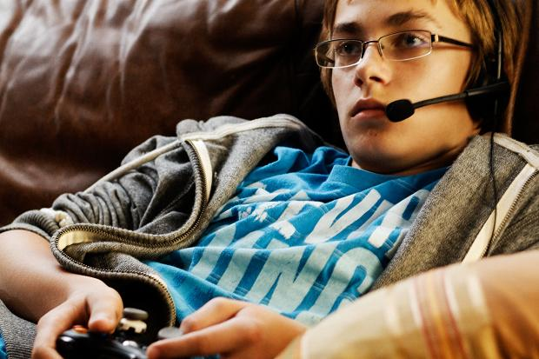
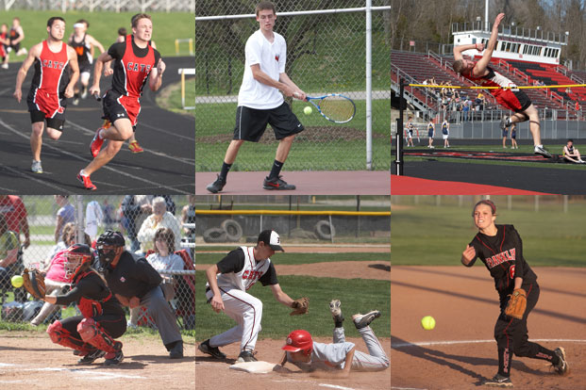
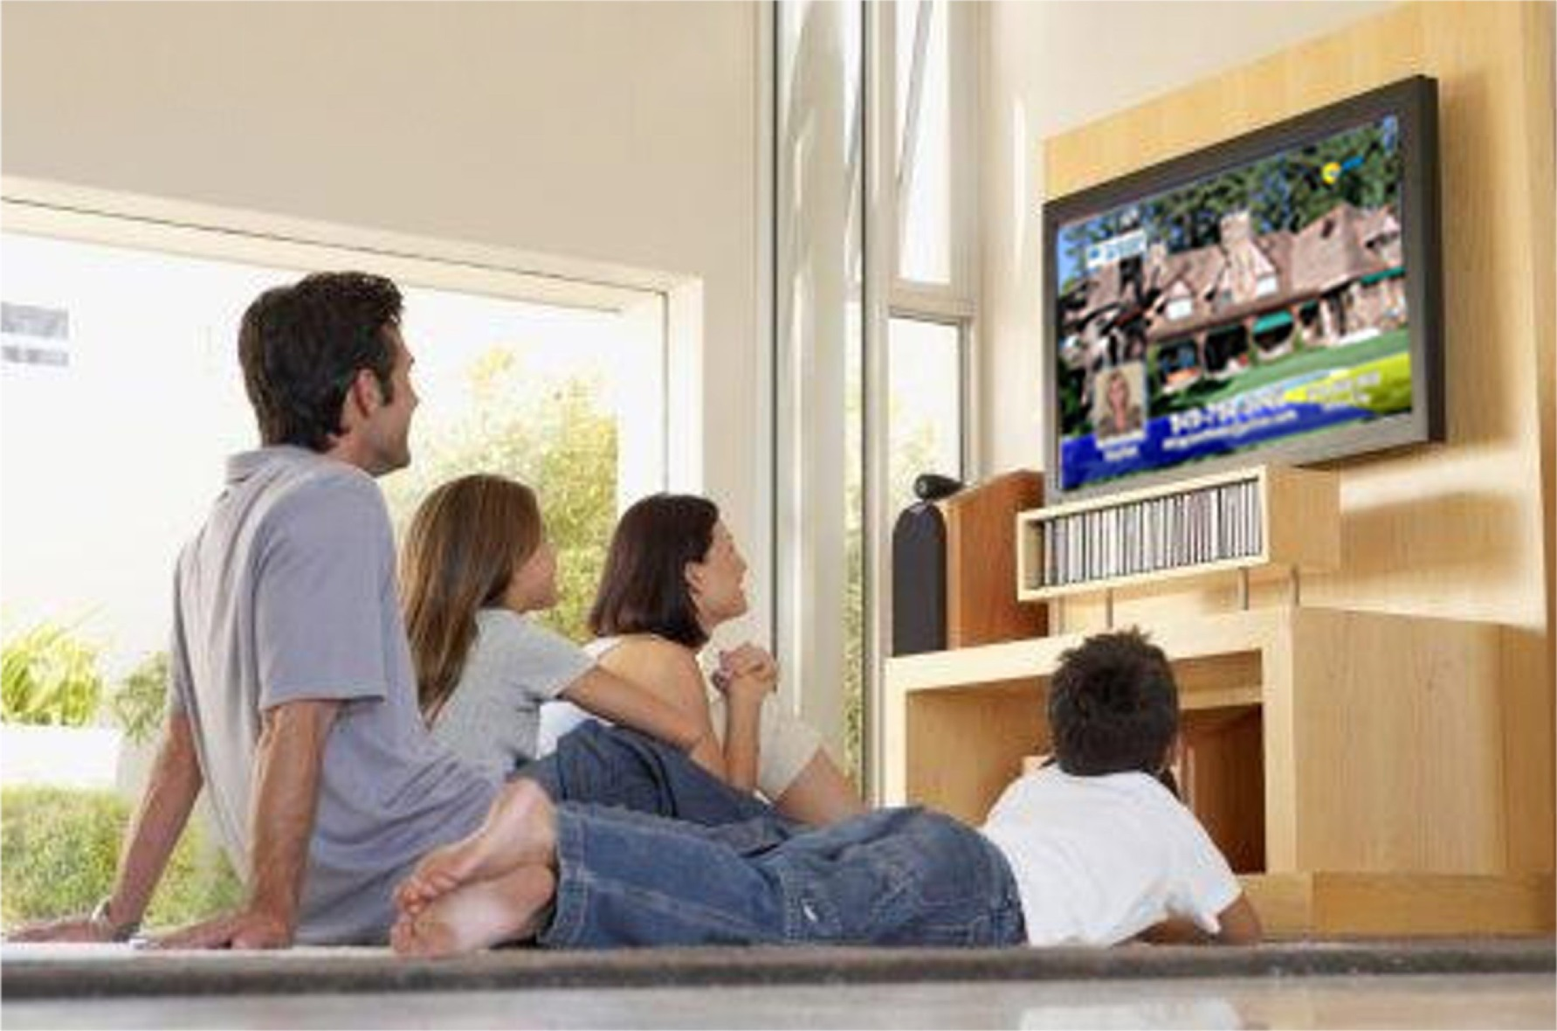
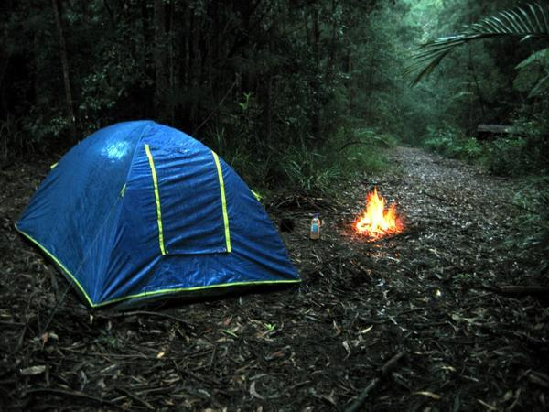
Now he who received seed among the thorns is he who hears the word, and the cares of this world and the deceitfulness of riches choke the word, and he becomes unfruitful. (Matthew 13:22)

Slide 14
For this meeting
to be a
Realign Your Priorities
Reach out and Invite the Lost
Restore the Fallen
Pray Diligently for the Meeting
Attend Every Assembly
And let us consider one another in order to stir up love and good works (Heb 10:24).
I was glad when they said to me, let us go into the house of the Lord (Psalm 122:1).
Go therefore and make disciples of all the nations . . . (Matthew 28:19).
Praying always . . . that I may speak boldly, as I ought to speak (Eph 6:18-20).
If a man is overtaken in any trespass . . . restore such a one . . . (Galatians 6:1)

