Slide 2
Galatians 6:5-10
5 For each one shall bear his own load. 6 Let him who is taught the word share in all good things with him who teaches. 7 Do not be deceived, God is not mocked; for whatever a man sows, that he will also reap. 8 For he who sows to his flesh will of the flesh reap corruption, but he who sows to the Spirit will of the Spirit reap everlasting life. 9 And let us not grow weary while doing good, for in due season we shall reap if we do not lose heart. 10 Therefore, as we have opportunity, let us do good to all, especially to those who are of the household of faith.

Slide 4
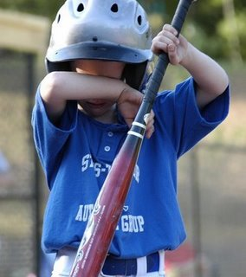
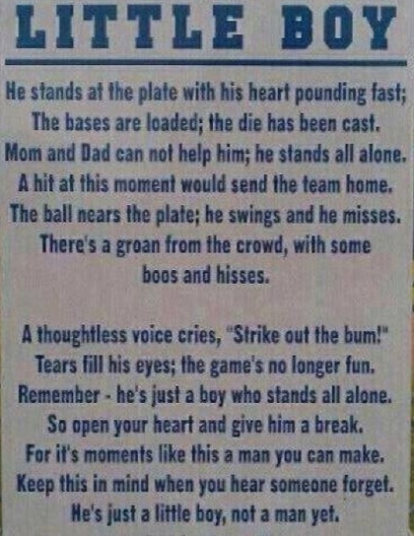
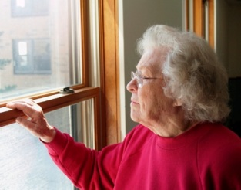
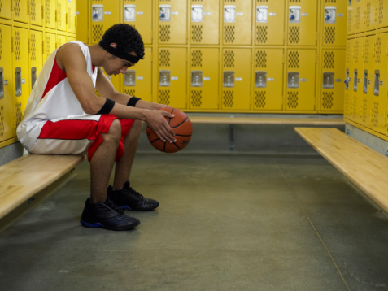
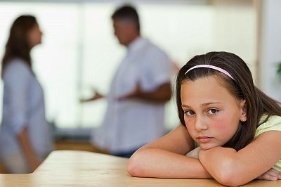
Discouragement

Slide 5
Do Christians Ever
Become Discouraged?
“To be utterly spiritless, to be (spiritually) exhausted”
Leads to discouragement
“And let us not grow weary while doing good, for in due season we shall reap if we do not lose heart”
(Galatians 6:9)
“For consider Him who endured such hostility from sinners against Himself, lest you become weary and discouraged in your souls”
(Hebrews 12:3)
“For consider Him who endured such hostility from sinners against Himself, lest you become weary and discouraged in your souls”
(Hebrews 12:3)
“Fathers, do not provoke your children, lest they become discouraged”
(Colossians 3:21)

Slide 6
Those Subject to Discouragement
Preachers, Elders
Christian Parents
Older Believers
Those who have experienced few results
Those who feel overwhelmed
The constantly criticized

Slide 7
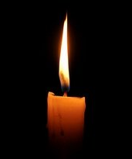
Overcoming Weariness
Renew your Determination
Increase your Faith
Pray Persistently
Love the Discouragers
Develop Patience
“Rejoice in Christ Jesus, and have no confidence in the flesh . . . but one thing I do, forgetting those things which are behind and reaching forward to those things which are ahead, I press toward the goal for the prize of the upward call of God in Christ Jesus”
(Philippians 3:3, 13-14)

