Slide 2
Hebrews 2:5-9
⁵ For He has not put the world to come, of which we speak, in subjection to angels. ⁶ But one testified in a certain place, saying: what is man that You are mindful of him, or the son of man that You take care of him? ⁷ You have made him a little lower than the angels; You have crowned him with glory and honor, and set him over the works of Your hands. ⁸ You have put all things in subjection under his feet. For in that He put all in subjection under him, He left nothing that is not put under him. But now we do not yet see all things put under him. ⁹ But we see Jesus, who was made a little lower than the angels, for the suffering of death crowned with glory and honor, that He, by the grace of God, might taste death for everyone.

Slide 4
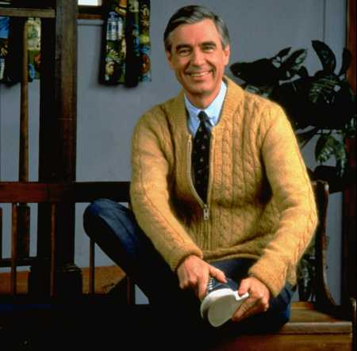
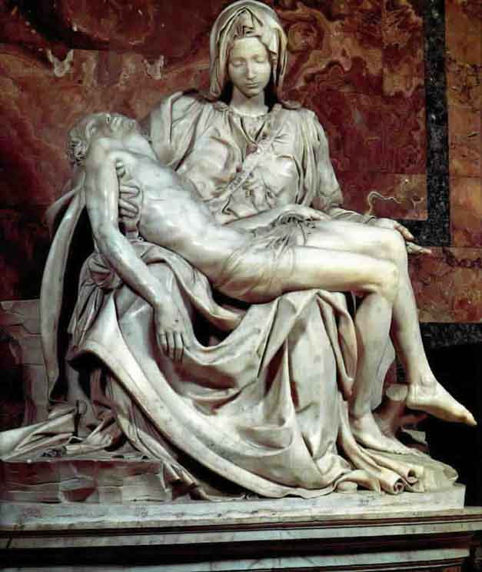
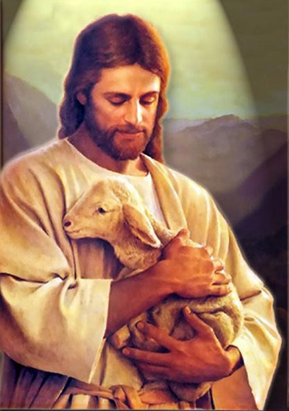
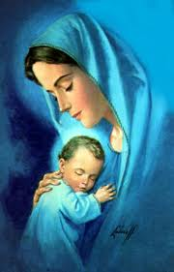
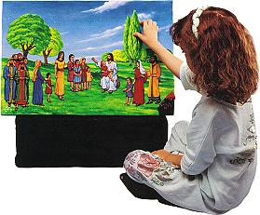
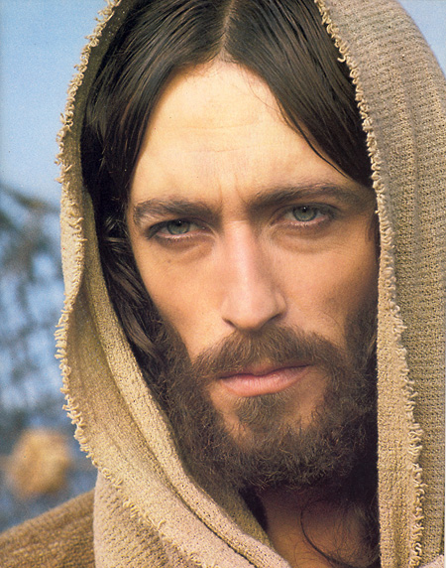
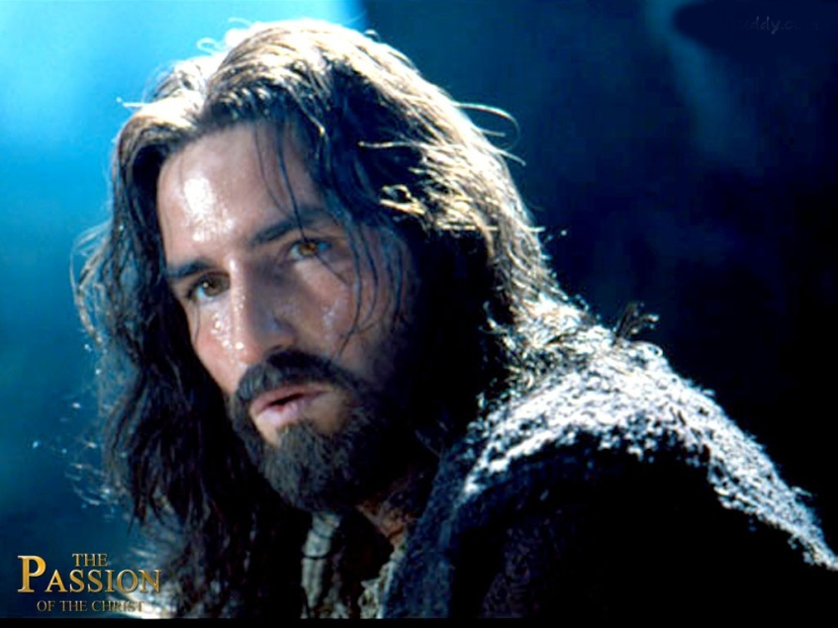
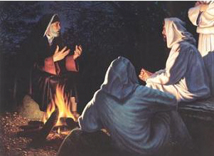
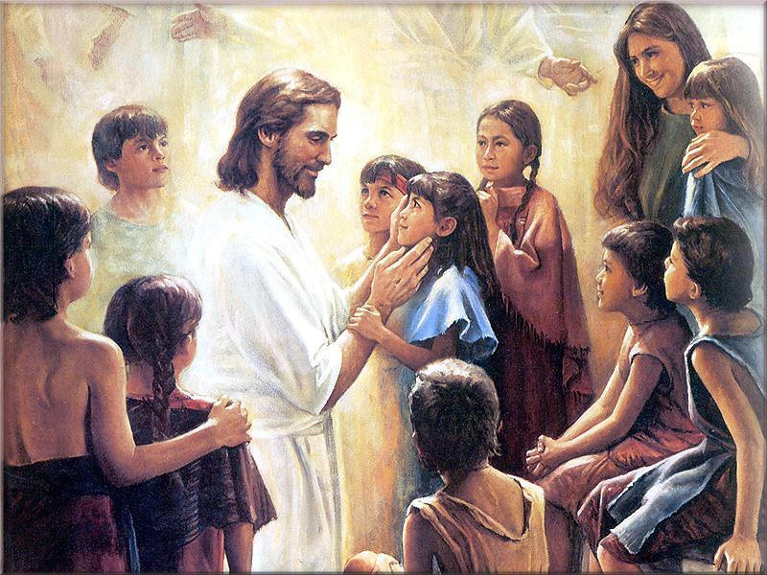
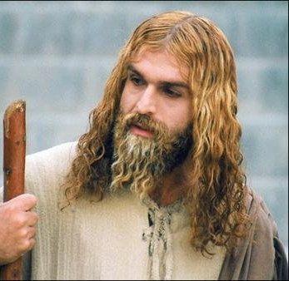
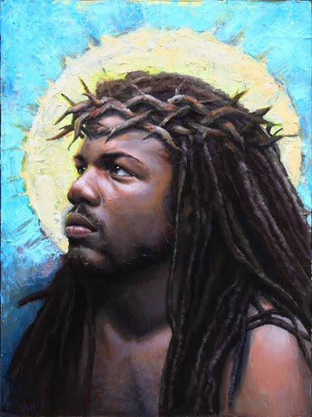
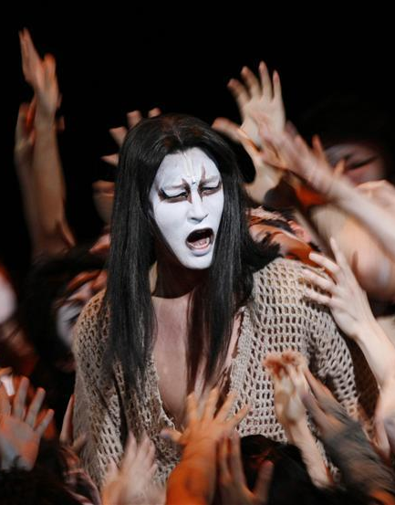
Hollywood Jesus
Scandinavian African Japanese
With Nicodemus and Children

Slide 5
We See Jesus
A Divine Revolutionary
A Friend of Sinners
A Spiritual Visionary

