Slide 2
Acts 17:1-9
¹ Now when they had passed through Amphipolis and Apollonia, they came to Thessalonica, where there was a synagogue of the Jews. ² Then Paul, as his custom was, went in to them, and for three Sabbaths reasoned with them from the Scriptures, ³ explaining and demonstrating that the Christ had to suffer and rise again from the dead, and saying, this Jesus whom I preach to you is the Christ. ⁴ And some of them were persuaded; and a great multitude of the devout Greeks, and not a few of the leading women, joined Paul and Silas. ⁵ But the Jews who were not persuaded, becoming envious, took some of the evil men from the marketplace, and gathering a mob, set all the city in an uproar and attacked the house of Jason, and sought to bring them out to the people. ⁶ But when they did not find them, they dragged Jason and some brethren to the rulers of the city, crying out, these who have turned the world upside down have come here too. ⁷ Jason has harbored them, and these are all acting contrary to the decrees of Caesar, saying there is another king—Jesus. ⁸ And they troubled the crowd and the rulers of the city when they heard these things. ⁹ So when they had taken security from Jason and the rest, they let them go.

Slide 4
These who have turned
the world upside down . . .

Slide 5
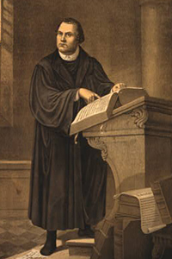
Nicolaus Copernicus
“The fool wants to turn the whole science of astronomy upside down”
(Martin Luther)

Slide 6
Now when they heard this, they were cut to the heart, and said to Peter and the rest of the apostles, men and brethren, what shall we do?
(Acts 2:37)
So they called them and commanded them not to speak at all nor teach in the name of Jesus.
(Acts 4:18)
When they heard these things they were cut to the heart, and they gnashed at him with their teeth.
(Acts 7:54)
And some of them were persuaded; and a great multitude of the devout Greeks, and not a few of the leading women, joined Paul and Silas. But the Jews who were not persuaded, becoming envious, took some of the evil men from the marketplace, and gathering a mob, set all the city in an uproar . . .
(Acts 17:4-5).
Now as they went down the road, they came to some water. And the eunuch said, see, here is water. What hinders me from being baptized?
(Acts 8:36).
So he, trembling and astonished, said, Lord, what do You want me to do?
(Acts 9:6).

Slide 7
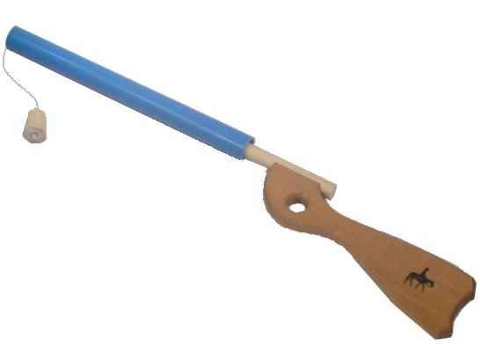
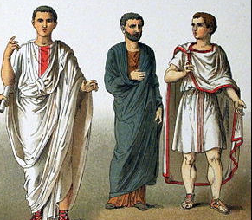
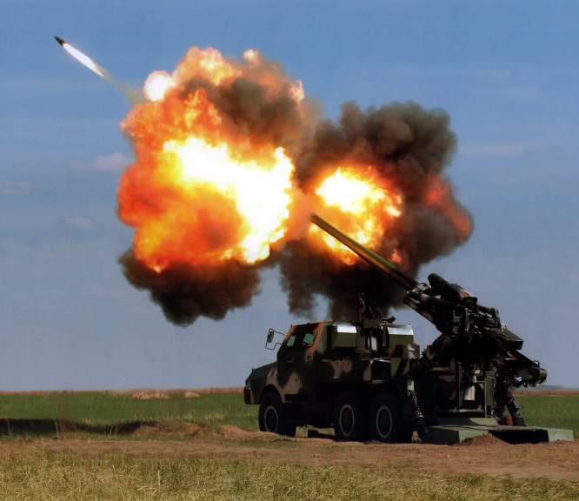
1st Century
21st Century
Evangelism

Slide 8
Attitudes

Slide 9
Attitude toward Christianity
Therefore, if anyone is in Christ, he is a new creation; old things have passed away; behold, all things have become new. (2 Cor 5:17)
I have been crucified with Christ; it is no longer I who live, but Christ lives in me; and the life which I now live in the flesh I live by faith in the Son of God, who loved me and gave Himself for me. (Gal 2:20)
To them God willed to make known what are the riches of the glory of this mystery among the Gentiles: which is Christ in you, the hope of glory. (Col 1:27)
Secular Life (Eph 6:6)
Home Life (Eph 5:22, 25)
Outlook on Life (Phil 4:6-7)
What Does Christianity Mean To YOU ?
Fleshly Bodies (1 Cor 6:12-20)
Earthly Possessions (Acts 4:34-35)
Relationships (Lk 14:26)
Lives (Acts 7:59; 12:2)

Slide 10
Therefore we were buried with Him through baptism into death, that just as Christ was raised from the dead by the glory of the Father, even so we also should walk in newness of life. (Rom 6:4)
And do not be conformed to this world, but be transformed by the renewing of your mind, that you may prove what is that good and acceptable and perfect will of God. (Rom 12:2)
. . . you put on the new man which was created according to God, in true righteousness and holiness. (Eph 4:24)
Has Christ made a difference in YOUR life ?
Attitude toward Life

Slide 11
What is YOUR attitude toward others ?
Attitude toward Others
By this all will know that you are My disciples, if you have love for one another. (John 13:35)
You shall love your neighbor as yourself. There is no other commandment greater than these. (Mark 12:31)
For if you love those who love you, what reward have you? (Matt 5:46)

Slide 12
Attitude toward Teaching
Have YOU filled your heart/home/world
with His word ?
And Jesus came and spoke to them, saying, all authority has been given to Me in heaven and on earth. Go therefore and make disciples of all the nations, baptizing them in the name of the Father and of the Son and of the Holy Spirit, teaching them to observe all things that I have commanded you; and lo, I am with you always, even to the end of the age. (Matt 28:18-20)

Slide 13
Then He spoke a parable to them, that men always ought to pray and not lose heart. (Luke 18:1)
So He said to them, this kind can come out by nothing but prayer and fasting. (Mark 9:29)
. . . for without Me you can do nothing. (John 15:5)
. . . praying always with all prayer and supplication in the Spirit (Ephesians 6:18)
So when they heard that, they raised their voice to God with one accord . . . Now, Lord, look on their threats, and grant to Your servants that with all boldness they may speak Your word (Acts 4:24, 29)
What is YOUR prayer life like ?
Attitude toward Prayer

