Slide 2
Hebrews 10:32-39
³² But recall the former days in which, after you were illuminated, you endured a great struggle with sufferings: ³³ partly while you were made a spectacle both by reproaches and tribulations, and partly while you became companions of those who were so treated; ³⁴ for you had compassion on me in my chains, and joyfully accepted the plundering of your goods, knowing that you have a better and an enduring possession for yourselves in heaven. ³⁵ Therefore do not cast away your confidence, which has great reward. ³⁶ For you have need of endurance, so that after you have done the will of God, you may receive the promise: ³⁷ For yet a little while, and He who is coming will come and will not tarry. ³⁸ Now the just shall live by faith; But if anyone draws back, my soul has no pleasure in him.
³⁹ But we are not of those who draw back to perdition, but of those who believe to the saving of the soul.

Slide 4
But now He has obtained a more excellent ministry, inasmuch as He is also Mediator of a better covenant, which was established on better promises. (Heb 8:6)
Now the just shall live by faith; But if anyone draws back, My soul has no pleasure in him. (Heb 10:38)

Slide 5
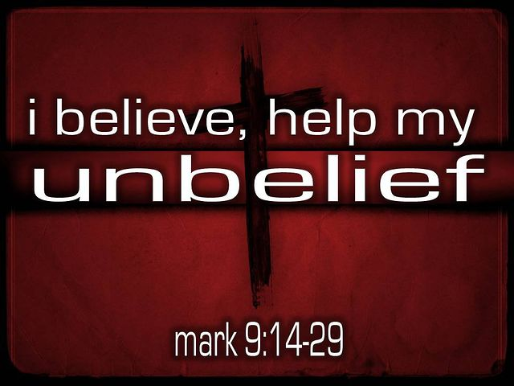
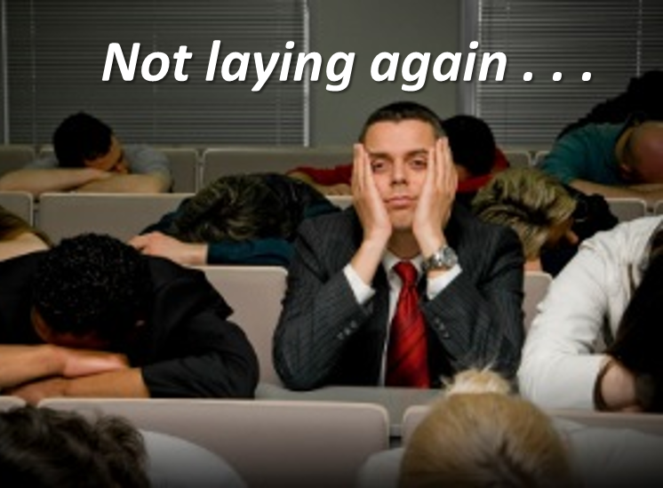
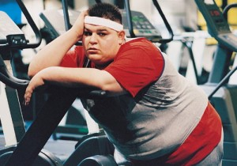
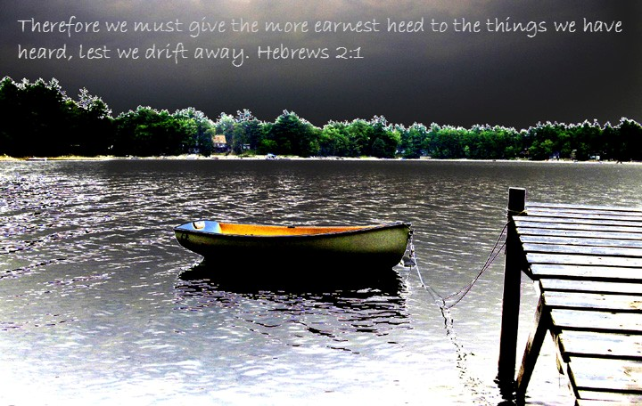
Unbelief ~ 3:12-13
Slothful ~ 6:11-12
Drifting ~ 2:1-3
Boredom ~ 6:1-2
Self-Pity ~ 12:3
But now He has obtained a more excellent ministry, inasmuch as He is also Mediator of a better covenant, which was established on better promises. (Heb 8:6)

Slide 6
Drifting Away
Developing Unbelief
Spiritual Boredom
Religious Laziness
Feelings of Self-Pity
For it is impossible for those who were once enlightened, and have tasted the heavenly gift, and have become partakers of the Holy Spirit, and have tasted the good word of God and the powers of the age to come, if they fall away, to renew them again to repentance, since they crucify again for themselves the Son of God, and put Him to an open shame. (Hebrews 6:4-6)

