Slide 2
Philippians 1:19-26
¹⁹ For I know that this will turn out for my deliverance through your prayer and the supply of the Spirit of Jesus Christ, ²⁰ according to my earnest expectation and hope that in nothing I shall be ashamed, but with all boldness, as always, so now also Christ will be magnified in my body, whether by life or by death. ²¹ For to me, to live is Christ, and to die is gain. ²² But if I live on in the flesh, this will mean fruit from my labor; yet what I shall choose I cannot tell. ²³ For I am hard-pressed between the two, having a desire to depart and be with Christ, which is far better. ²⁴ Nevertheless to remain in the flesh is more needful for you. ²⁵ And being confident of this, I know that I shall remain and continue with you all for your progress and joy of faith, ²⁶ that your rejoicing for me may be more abundant in Jesus Christ by my coming to you again.

Slide 4
52 AD
Now when they had gone through Phrygia and the region of Galatia, they were forbidden by the Holy Spirit to preach the word in Asia. After they had come to Mysia, they tried to go into Bithynia, but the Spirit did not permit them. So passing by Mysia, they came down to Troas. And a vision appeared to Paul in the night. A man of Macedonia stood and pleaded with him, saying, come over to Macedonia and help us. Now after he had seen the vision, immediately we sought to go to Macedonia, concluding that the Lord had called us to preach the gospel to them. (Acts 16:6-10)

Slide 5
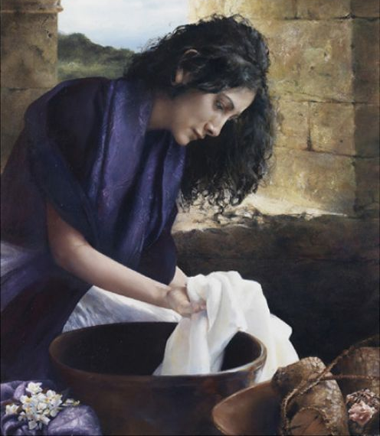
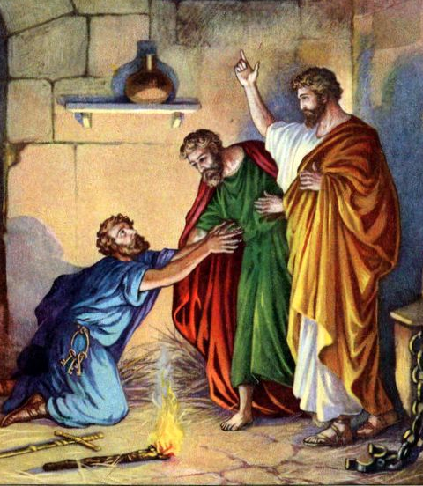
52 AD
Lydia of Thyatira
Philippian Jailer

Slide 6
64 AD
For to me, to live is Christ, and to die is gain. But if I live on in the flesh, this will mean fruit from my labor; yet what I shall choose I cannot tell. For I am hard-pressed between the two, having a desire to depart and be with Christ, which is far better. (Phil 1:21-23)
For to me, to live is Christ, and to die is gain. But if I live on in the flesh, this will mean fruit from my labor; yet what I shall choose I cannot tell. For I am hard-pressed between the two, having a desire to depart and be with Christ, which is far better. (Phil 1:21-23)

Slide 7
Life
Death

Slide 8
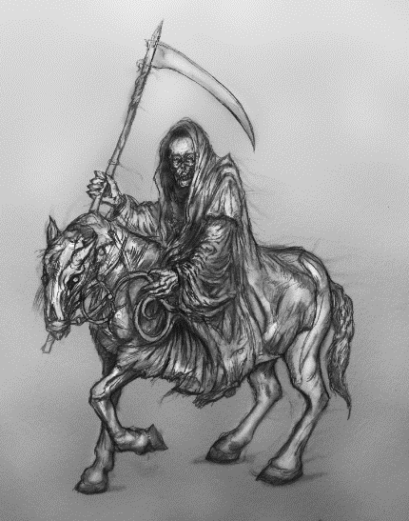
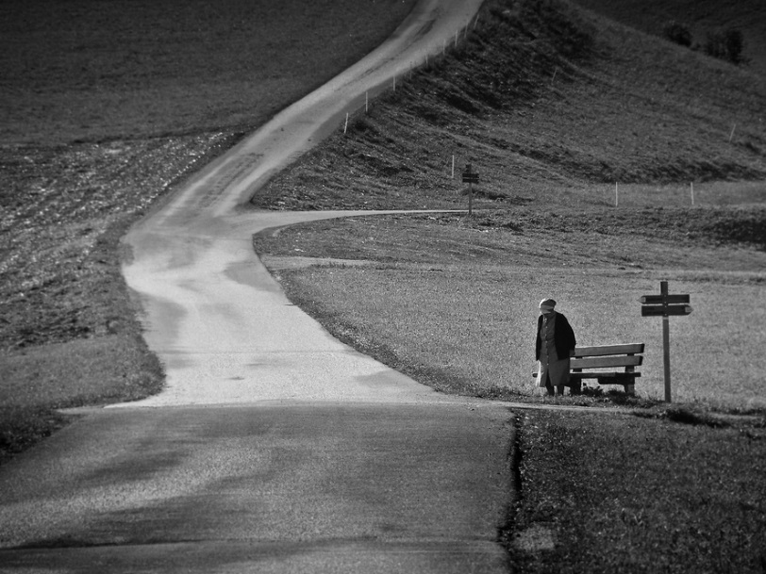
To Die is Gain
Death: Rider of the Pale Horse ~ Rev 6:8
Death: King of Terrors ~ Job 18:14
Death: An Enemy ~ 1 Cor 15:26
Death: A Terrible Separator ~ 2 Sam 12:23
Death: A Feared Adversary ~ Heb 2:15

Slide 9
Paul’s View
of Death
For I am hard-pressed between the two, having a desire to depart and be with Christ, which is far better.
Philippians 1:23
To Die is Gain

Slide 10
For to me, to live is Christ,
and to die is gain.
Acts 9:5
Acts 22:16
Gal 2:20
Phil 3:4-11
Reservation made then is realized
Rest from a lifetime of weary labor
Release from a body of sickness and decay
Recognition for a life of faith

Slide 11
For to me, to live is Money,
and to die is bankruptcy.

Slide 12
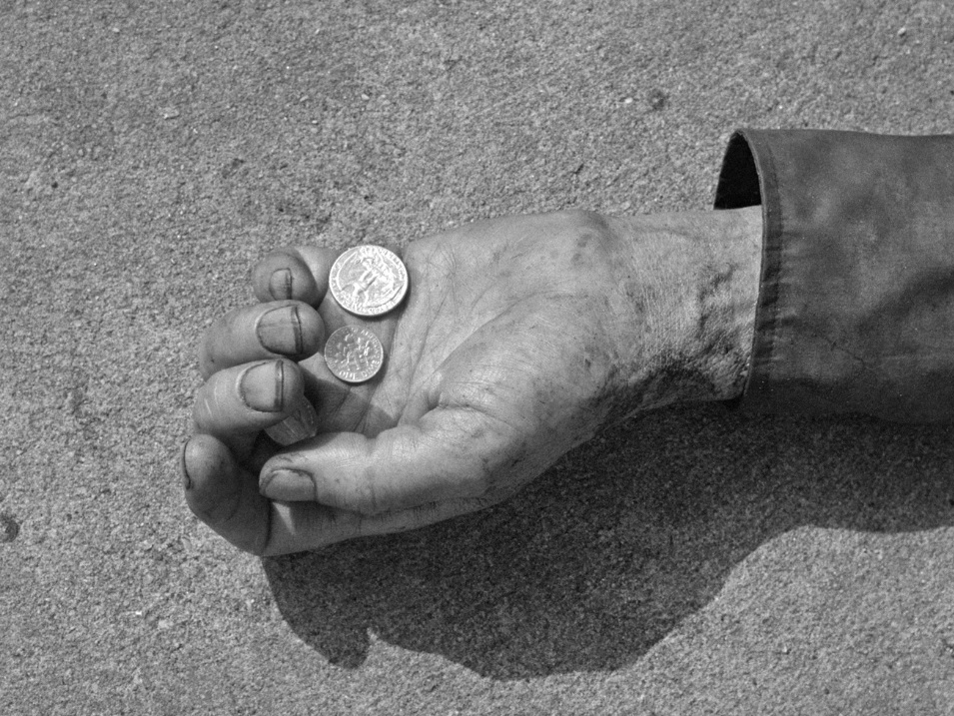
For to me, to live is Success,
and to die is failure.

Slide 13
For to me, to live is Fame,
and to die is anonymity.

Slide 14
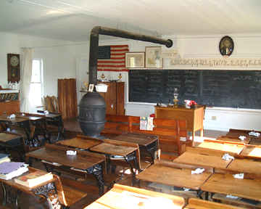
For to me, to live is Education,
and to die as a fool.

Slide 15
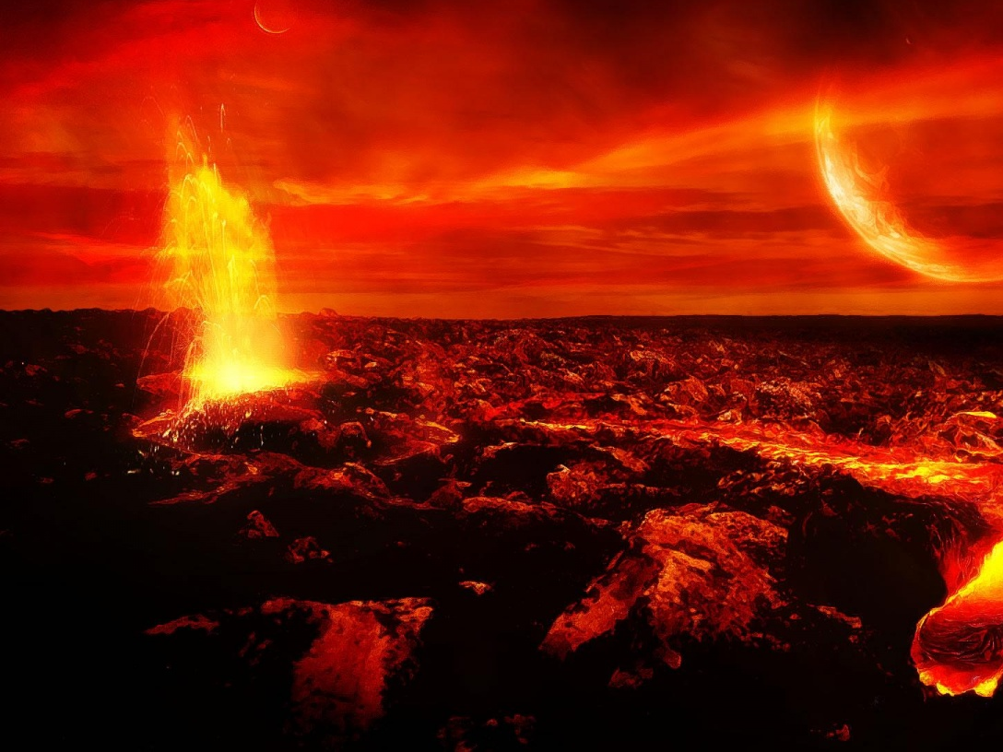
For to me, to live is Pleasure,
and to die is torment.

Slide 16
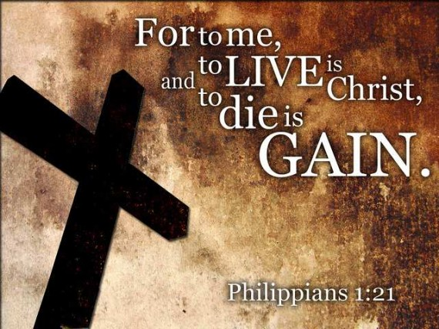
Ecclesiastes 12:13

