Slide 2
Acts 5:1-11
¹ But a certain man named Ananias, with Sapphira his wife, sold a possession. ² And he kept back part of the proceeds, his wife also being aware of it, and brought a certain part and laid it at the apostles’ feet. ³ But Peter said, Ananias, why has Satan filled your heart to lie to the Holy Spirit and keep back part of the price of the land for yourself? ⁴ While it remained, was it not your own? And after it was sold, was it not in your own control? Why have you conceived this thing in your heart? You have not lied to men but to God. ⁵ Then Ananias, hearing these words, fell down and breathed his last. So great fear came upon all those who heard these things. ⁶ And the young men arose and wrapped him up, carried him out, and buried him. ⁷ Now it was about three hours later when his wife came in, not knowing what had happened. ⁸ And Peter answered her, tell me whether you sold the land for so much? She said, yes, for so much. ⁹ Then Peter said to her, how is it that you have agreed together to test the Spirit of the Lord? Look, the feet of those who have buried your husband are at the door, and they will carry you out. ¹⁰ Then immediately she fell down at his feet and breathed her last. And the young men came in and found her dead, and carrying her out, buried her by her husband. ¹¹ So great fear came upon all the church and upon all who heard these things.

Slide 4
The Deadly Sin
Was not owning property (vs 4)
Was not selling the property (vs 4)
Was not in giving money to church (vs 2)
Was not in keeping part of the selling price (vs 2)
They lied to the church
They lied to the Apostles
They lied to God/Holy Spirit
They Tested the Spirit of God

Slide 5
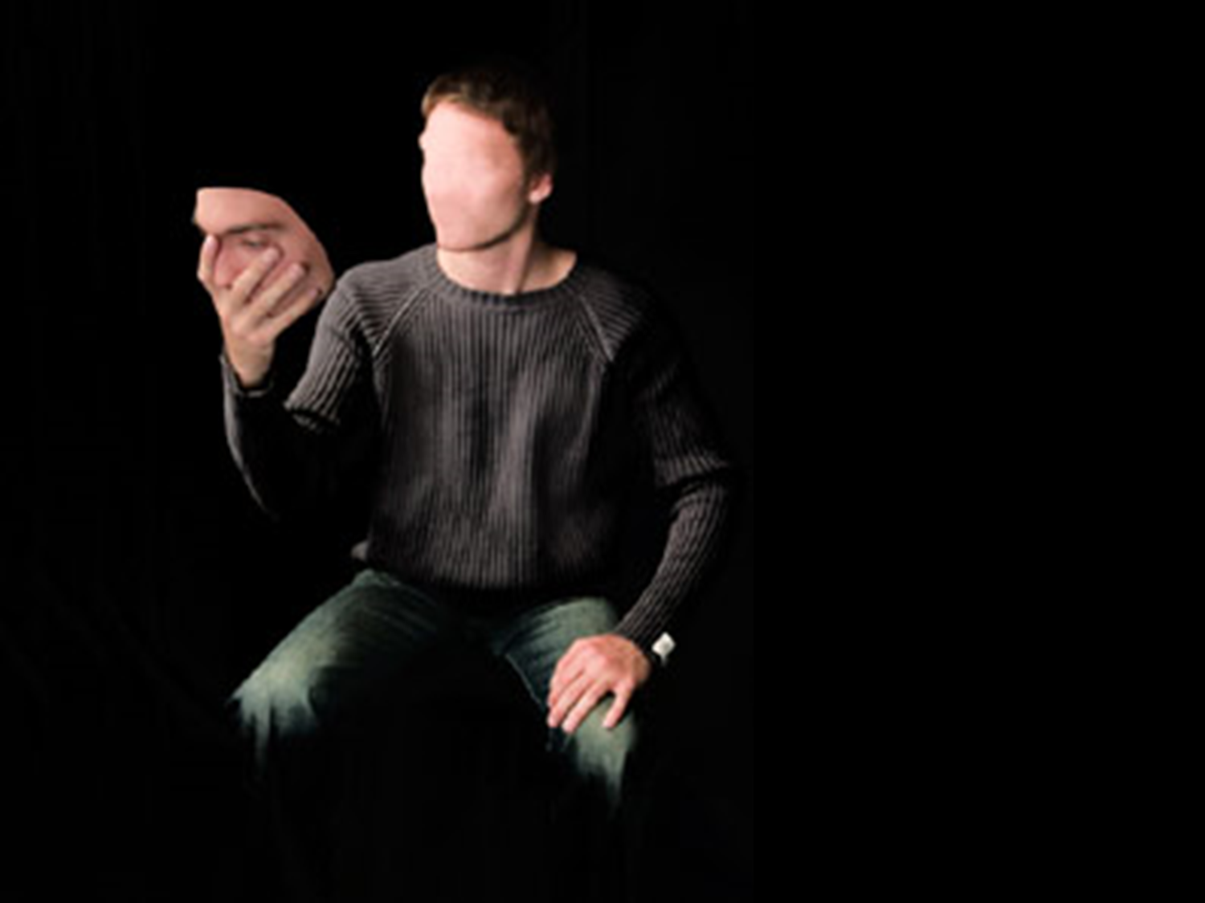
Hypocrite: From Greek hypokrisis:
Act of playing a part on the stage.
A dissembler, deceiver.
An intentional fake, a phony, a fraud.
Hypocrisy:
The Deadly Sin
of Ananias & Sapphira
Hypocrisy is deliberate deception—trying to convince people we are more spiritual than we really are.
A hypocrite is a person who is not himself on Sunday!
Hypocrisy is hiding things we do that we shouldn’t—not because they are sinful, but because we would be ashamed if they were known by our family and by others.
Hypocrisy is putting on a godly front in order to conceal sin.

Slide 6
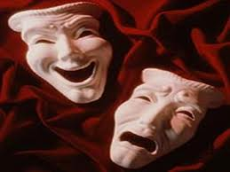
They attempted to Appear More Holy than they were!
The Foundation and Building Blocks of their hypocrisy!
The Short-Sightedness of their hypocrisy!

