Slide 2
2 Peter 1:16-21
¹⁶ For we did not follow cunningly devised fables when we made known to you the power and coming of our Lord Jesus Christ, but were eyewitnesses of His majesty. ¹⁷ For He received from God the Father honor and glory when such a voice came to Him from the Excellent Glory: This is My beloved Son, in whom I am well pleased. ¹⁸ And we heard this voice which came from heaven when we were with Him on the holy mountain. ¹⁹ And so we have the prophetic word confirmed, which you do well to heed as a light that shines in a dark place, until the day dawns and the morning star rises in your hearts; ²⁰ knowing this first, that no prophecy of Scripture is of any private interpretation, ²¹ for prophecy never came by the will of man, but holy men of God spoke as they were moved by the Holy Spirit.

Slide 4
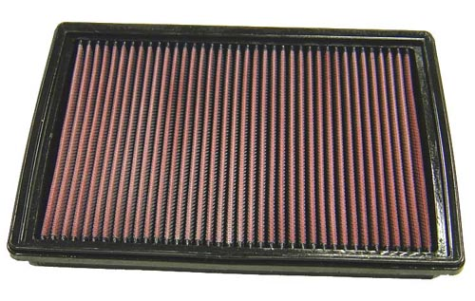
Understanding Filters
1: a porous article or mass (as of paper or sand) through which a gas or liquid is passed to separate out matter in suspension . . .
3: something that has the effect of a filter (as by holding back elements or modifying the appearance of something) . . .
Water Filters
Home Air Filters
Car Air Filters
Coffee Filters

Slide 5
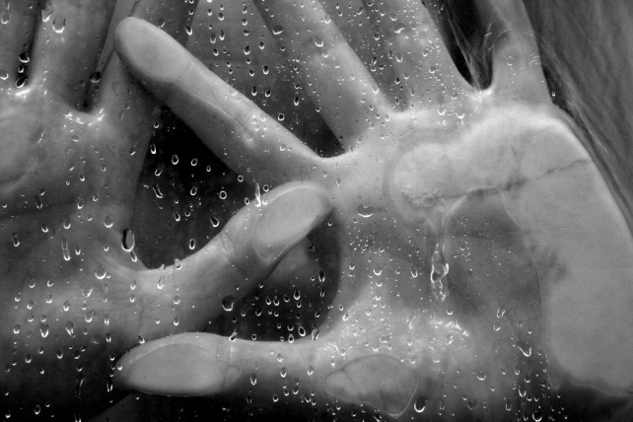
Dealing with Mental Filters
Mental Filters
Beliefs
Values
Memories
Prejudices
She didn’t mean it!
He only wanted something!
They never liked me!
It’s always going to be like this!
A Life Experience
“For as he thinks in his heart, so is he” (Prov 23:7).
“For out of the heart proceed evil thoughts, murders, adulteries, fornications, thefts, false witness, blasphemies” (Matt 15:19).

Slide 6
God’s Servant Job
Mental Filters
Beliefs
Values
Memories
Prejudices
Mental Filter
I’m a good man, but God set a target on me!
Job 7:20
God is punishing the innocent
God is hiding Himself from me
God regards me as an enemy
Job’s Life Experience
Richest in the East
Lost His Wealth
Lost His Children
Lost His Health

Slide 7
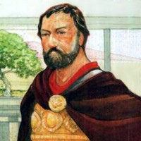
Naaman the Leper
Mental Filter
My cleansing will be strange and amazing
2 Ki 5:11-12
Mental Filters
Beliefs
Values
Memories
Prejudices
Elisha would call on the name of His God & waive his arms
Rivers of Damascus are better than Jordan
In anger he turned and departed
Naaman’s Life Experience
“Now Naaman, commander of the army of the king of Syria, was a great and honorable man in the eyes of his master, because by him the Lord had given victory to Syria. He was also a mighty man of valor, but a leper” (2 Ki 5:1).

Slide 8
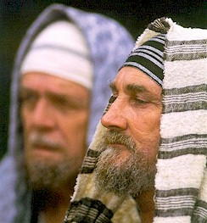
The Sect of the Sadducees
Mental Filters
Beliefs
Values
Memories
Prejudices
Mental Filter
Do not believe in the resurrection (Matt 22:23
In the “resurrection” things would be like they are now.
So, they believed since she could not be a wife to all seven, this proved there could be no resurrection.
They simply used Scripture to “prove” their mental filter right!
Sadducees’ Life Experience
They confronted Jesus with a dilemma based upon an O.T. text in Deut 25:5 (a man marrying his brother’s widow).

Slide 9
Honest and Good Hearts
Mental Filters
Beliefs
Values
Memories
Prejudices
“He said to him, what is written in the law? What is your reading of it?” (Lk 10:26)
Filter of Impossibility
Filter of Apprehension
Filter of Feelings
Filter of Adversarial
Filter of Over-Confidence

