Slide 2
2 Corinthians 12:7-10
⁷ And lest I should be exalted above measure by the abundance of the revelations, a thorn in the flesh was given to me, a messenger of Satan to buffet me, lest I be exalted above measure. ⁸ Concerning this thing I pleaded with the Lord three times that it might depart from me. ⁹ And He said to me, My grace is sufficient for you, for My strength is made perfect in weakness. Therefore most gladly I will rather boast in my infirmities, that the power of Christ may rest upon me. ¹⁰ Therefore I take pleasure in infirmities, in reproaches, in needs, in persecutions, in distresses, for Christ’s sake. For when I am weak, then I am strong.

Slide 4
Paul’s Thorn in the Flesh
Migraine Headaches
Epilepsy
Malarial Fever
Poor Eyesight
Temptations
False Teachers
Therefore I take pleasure in infirmities, in reproaches, in needs, in persecutions, in distresses, for Christ’s sake. For when I am weak, then I am strong.
(Verse 10)
Therefore I take pleasure in infirmities, in reproaches, in needs, in persecutions, in distresses, for Christ’s sake. For when I am weak, then I am strong.
(Verse 10)
Paul’s Weakness drove him to God

Slide 5
So He came to Nazareth, where He had been brought up. And as His custom was, He went into the synagogue on the Sabbath day, and stood up to read. And He was handed the book of the prophet Isaiah. And when He had opened the book, He found the place where it was written: “The Spirit of the Lord is upon Me, because He has anointed Me to preach the gospel to the poor; He has sent Me to heal the brokenhearted, to proclaim liberty to the captives and recovery of sight to the blind, to set at liberty those who are oppressed; to proclaim the acceptable year of the Lord.”
(Luke 4:16-19)
So He came to Nazareth, where He had been brought up. And as His custom was, He went into the synagogue on the Sabbath day, and stood up to read. And He was handed the book of the prophet Isaiah. And when He had opened the book, He found the place where it was written: “The Spirit of the Lord is upon Me, because He has anointed Me to preach the gospel to the poor; He has sent Me to heal the brokenhearted, to proclaim liberty to the captives and recovery of sight to the blind, to set at liberty those who are oppressed; to proclaim the acceptable year of the Lord.”
(Luke 4:16-19)

Slide 6
Luke 7:36-50
Then He turned to the woman and said to Simon, do you see this woman? I entered your house; you gave Me no water for My feet, but she has washed My feet with her tears and wiped them with the hair of her head. You gave Me no kiss, but this woman has not ceased to kiss My feet since the time I came in. You did not anoint My head with oil, but this woman has anointed My feet with fragrant oil. Therefore I say to you, her sins, which are many, are forgiven, for she loved much. But to whom little is forgiven, the same loves little. Then He said to her, your sins are forgiven . . . Your faith has saved you. Go in peace.
(Luke 7:44-50)
Brokenhearted

Slide 7
Do you not know that to whom you present yourselves slaves to obey, you are that one’s slaves whom you obey, whether of sin leading to death, or of obedience leading to righteousness?
(Romans 6:16)

Slide 8
Our Sins Must Drive us to God
This is a faithful saying and worthy of all acceptance, that Christ Jesus came into the world to save sinners, of whom I am chief. However, for this reason I obtained mercy, that in me first Jesus Christ might show all longsuffering, as a pattern to those who are going to believe on Him for everlasting life.
(1 Timothy 1:15-16)
O wretched man that I am! Who will deliver me from this body of death?
I thank God—through Jesus Christ our Lord!
(Romans 7:24-25)
Brokenhearted

Slide 9
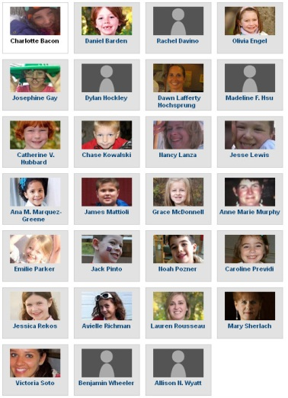
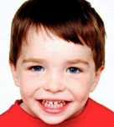
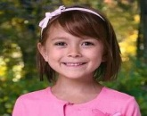
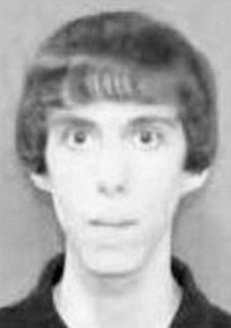
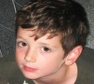
Romans 5:6-11
Adam Lanza

Slide 10
Romans 5:6-11
“The Spirit of the Lord is upon Me, because He has anointed Me to preach the gospel to the poor; He has sent Me to heal the brokenhearted, to proclaim liberty to the captives and recovery of sight to the blind, to set at liberty those who are oppressed; to proclaim the acceptable year of the Lord.”
(Luke 4:18-19)
Saul of Tarsus
Prodigal Son
Like my Sister
“Come to Me, all you who labor and are heavy laden, and I will give you rest. Take My yoke upon you and learn from Me, for I am gentle and lowly in heart, and you will find rest for your souls. For My yoke is easy and My burden is light.”
(Matthew 11:28-30)
Brokenhearted
“And the son said to him, Father, I have sinned against heaven and in your sight, and am no longer worthy to be called your son.”
(Luke 15:21)
“But by the grace of God I am what I am, and His grace toward me was not in vain; but I labored more abundantly than they all, yet not I, but the grace of God which was with me.” (1 Corinthians 15:10)
Like “Patricia”
Like Gerry S.
You & Me

Slide 11
Have a “Publican” Mind
God, be merciful to me a sinner!

