Slide 2
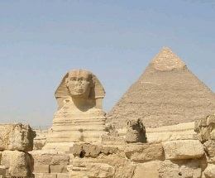
Genesis 39:1-7
¹ Now Joseph had been taken down to Egypt. And Potiphar, an officer of Pharaoh, captain of the guard, an Egyptian, bought him from the Ishmaelites who had taken him down there. ² The Lord was with Joseph, and he was a successful man; and he was in the house of his master the Egyptian. ³ And his master saw that the Lord was with him and that the Lord made all he did to prosper in his hand. ⁴ So Joseph found favor in his sight, and served him. Then he made him overseer of his house, and all that he had he put under his authority. ⁵ So it was, from the time that he had made him overseer of his house and all that he had, that the Lord blessed the Egyptian’s house for Joseph’s sake; and the blessing of the Lord was on all that he had in the house and in the field. ⁶ Thus he left all that he had in Joseph’s hand, and he did not know what he had except for the bread which he ate. Now Joseph was handsome in form and appearance. ⁷ And it came to pass after these things that his master’s wife cast longing eyes on Joseph, and she said, lie with me.

Slide 4
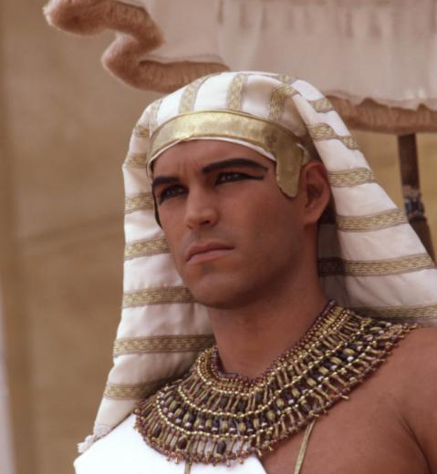
Sex
Lies
Lust
Passion In The Desert
Potiphar
Mrs. Potiphar
Joseph

Slide 5
Joseph: Young, Handsome, Well-built and Successful
The Lord was with Joseph, and he was a successful man; and he was in the house of his master the Egyptian . . . So Joseph found favor in his sight, and served him. Then he made him overseer of his house, and all that he had he put under his authority. So it was, from the time that he had made him overseer of his house and all that he had . . . Thus he left all that he had in Joseph’s hand, and he did not know what he had except for the bread which he ate. Now Joseph was handsome in form and appearance. (Genesis 39:2-6)

Slide 6
Mrs. Potiphar: Neglected (?), Immoral, Beguiling, & Persistent
⁷ And it came to pass after these things that his master’s wife cast longing (lustful) eyes on Joseph, and she said, “Lie with me.”
⁸ But he refused . . .
“Come and sleep with me,” she demanded.
WHY ?
“Come to bed with me!”
“Have sex with me.”

Slide 7
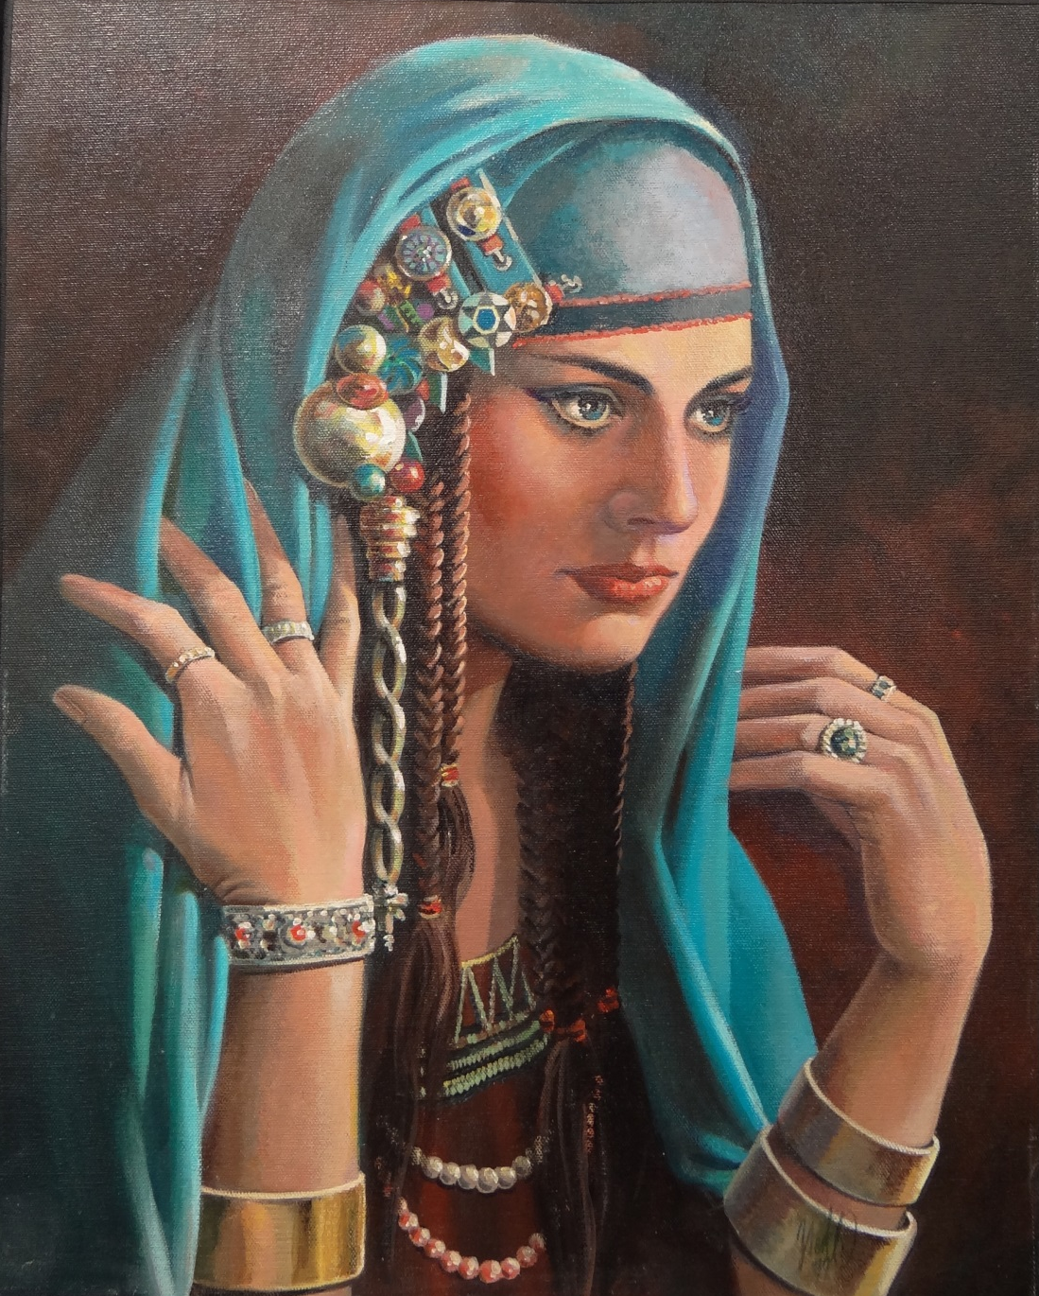
Look, my master does not know what is with me in the house, and he has committed all that he has to my hand. (Refused to betray the trust of Potiphar).
There is no one greater in this house than I, nor has he kept back anything from me but you, because you are his wife. (He refused to disrespect the sanctity of marriage).
How then can I do this great wickedness (He understood that adultery is evil),
and sin against God (He refused to sin AGAINST God).
But he refused . . .
(Genesis 39:8-9)

Slide 8
So it was, as she spoke to Joseph day by day, that he did not heed her, to lie with her or to be with her. (Temptations are persistent, but said NO!).
But it happened about this time, when Joseph went into the house to do his work, and none of the men of the house was inside, (Just the two of them) . . .
that she caught him by his garment, saying, lie with me. (Not a tease, but a turn-on).
But he left his garment in her hand, and fled and ran outside. (Prov 6:23-29; 1 Cor 6:18).
She didn’t give up!
(Genesis 39:10-12)

Slide 9
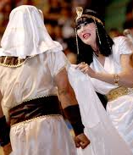
Joseph falsely accused of attempted rape
(Genesis 39:14-19)
Because of his refusal—Joseph lost a lot!
His Garment (Vs 12)
His Job (Vs 20)
His Freedom (Vs 20)
His Status (Vss 14-23)
Because of his refusal—Joseph kept a lot!
His Purity (Vs 9)
His Integrity (Pro 6:33)
His Conscience (Vs 8)
His Soul (Vss 21-23)

Slide 10
There is a difference between love & lust (lust will turn to hate, 2 Sam 13:2, 15)
You may lose some things when you choose righteousness (friends, popularity)
Never betray another’s trust (Matt 5:37)
Always respect the sanctity of marriage (yours and others)
Avoid conditions that might lead to sin (alone, touching, etc.)
Run if you must (1 Cor 10:13—look for the exit)
Develop some “backbone” and learn to just say NO! (Dan 1:8)
The young can be spiritually strong and resist temptation (2 Tim 2:22: Eccl 12:1)

Slide 11
But as for you, you meant evil against me; but God meant it for good, in order to bring it about as it is this day, to save many people alive. Now therefore, do not be afraid; I will provide for you and your little ones. And he comforted them and spoke kindly to them.
(Genesis 50:20-21)

