Slide 2
Deuteronomy 6:4-9
⁴ Hear, O Israel: The Lord our God, the Lord is one! ⁵ You shall love the Lord your God with all your heart, with all your soul, and with all your strength. ⁶ And these words which I command you today shall be in your heart. ⁷ You shall teach them diligently to your children, and shall talk of them when you sit in your house, when you walk by the way, when you lie down, and when you rise up. ⁸ You shall bind them as a sign on your hand, and they shall be as frontlets between your eyes. ⁹ You shall write them on the doorposts of your house and on your gates.

Slide 4
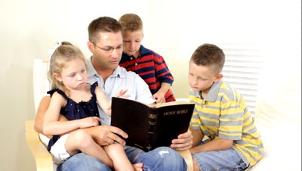
Walk about Zion, and go all around her. Count her towers; mark well her bulwarks; consider her palaces; that you may tell it to the generation following. For this is God, our God forever and ever; He will be our guide even to death.
(Psalm 48:12-14)

Slide 5
Hear, my children, the instruction of a father, and give attention to know understanding; for I give you good doctrine: Do not forsake my law. When I was my father’s son, tender and the only one in the sight of my mother, he also taught me, and said to me: Let your heart retain my words; keep my commands, and live. (Proverbs 4:1-4)

Slide 6
My son, pay attention to my wisdom; lend your ear to my understanding, that you may preserve discretion, and your lips may keep knowledge. (Proverbs 5:1-2)

Slide 7
My son, keep my words, and treasure my commands within you. Keep my commands and live, and my law as the apple of your eye. Bind them on your fingers; write them on the tablet of your heart. (Proverbs 7:1-3)

Slide 8
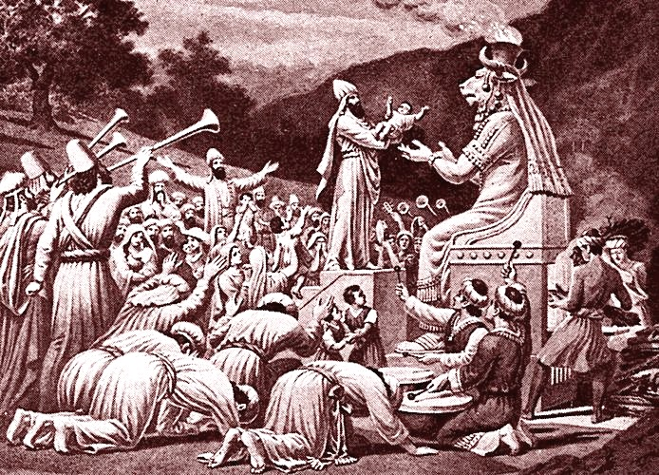
When all that generation had been gathered to their fathers, another generation arose after them who did not know the Lord nor the work which He had done for Israel. Israel’s Unfaithfulness. Then the children of Israel did evil in the sight of the Lord, and served the Baals; and they forsook the Lord God of their fathers, who had brought them out of the land of Egypt; and they followed other gods from among the gods of the people who were all around them, and they bowed down to them; and they provoked the Lord to anger.
(Judges 2:10-12)

Slide 9
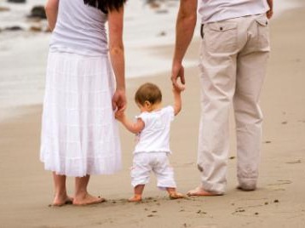
“Let The Little Children Come To Me”
Matthew 19:14
Children, obey your parents in the Lord, for this is right. Honor your father and mother, which is the first commandment with promise: that it may be well with you and you may live long on the earth. And you, fathers, do not provoke your children to wrath, but bring them up in the training and admonition of the Lord.
(Ephesians 6:1-4)

Slide 10
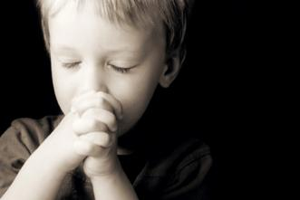
God expects the young to serve Him
“and that from childhood you have known the Holy Scriptures, which are able to make you wise for salvation through faith which is in Christ Jesus”
(2 Tim 3:15)

Slide 11
God expects whole-hearted conviction

Slide 12
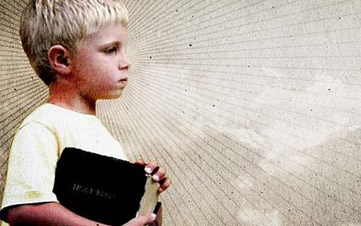
God demands Bible authority for all we do
And whatever you do in word or deed, do all in the name of the Lord Jesus, giving thanks to God the Father through Him. (Col 3:17)

Slide 13
God demands moral purity
Flee also youthful lusts; but pursue righteousness, faith, love, peace with those who call on the Lord out of a pure heart. (2 Tim 2:22)

Slide 14
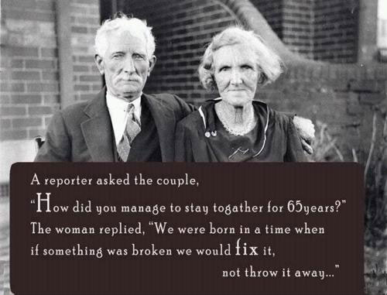
God insists that marriage is for a lifetime
Therefore what God has joined together, let not man separate. (Matthew 19:6)

