Slide 2
Genesis 2:18-25
¹⁸ And the Lord God said, it is not good that man should be alone; I will make him a helper comparable to him. ¹⁹ Out of the ground the Lord God formed every beast of the field and every bird of the air, and brought them to Adam to see what he would call them. And whatever Adam called each living creature, that was its name. ²⁰ So Adam gave names to all cattle, to the birds of the air, and to every beast of the field. But for Adam there was not found a helper comparable to him. ²¹ And the Lord God caused a deep sleep to fall on Adam, and he slept; and He took one of his ribs, and closed up the flesh in its place. ²² Then the rib which the Lord God had taken from man He made into a woman, and He brought her to the man. ²³ And Adam said: This is now bone of my bones and flesh of my flesh; she shall be called woman, because she was taken out of man. ²⁴ Therefore a man shall leave his father and mother and be joined to his wife, and they shall become one flesh. ²⁵ And they were both naked, the man and his wife, and were not ashamed.

Slide 4
Successful Home Building
Unless the Lord builds the house, they labor in vain who build it (Psalm 127:1)

Slide 5
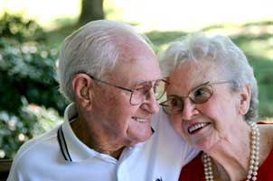
Successful
Home Building

Slide 6
Marriage is between a man and a woman
After leaving there is “joining” (cleaving, KJV)—Acts 11:23
Become united as one—spouse is not a disposable trinket
God (yokes / unites) a man and woman together
No divorce (with one exception, verse 19)
“Have you not read that He who made them at the beginning made them male and female, and said, for this reason a man shall leave his father and mother and be joined to his wife, and the two shall become one flesh? So then, they are no longer two but one flesh. Therefore what God has joined together, let not man separate.”
(Matthew 19:4-6)

Slide 7
Successful Home Building
Both be faithful/active Christians
Apply the bond of Christian Love
Expect Great Things in the Home
Always Emphasize the Spiritual
Be Willing to Sacrifice

Slide 8
Successful Home Building
“Success in marriage does not come merely through finding the right mate, but through being the right mate.”

