Slide 2
Acts 7:54-60
⁵⁴ When they heard these things they were cut to the heart, and they gnashed at him with their teeth. ⁵⁵ But he, being full of the Holy Spirit, gazed into heaven and saw the glory of God, and Jesus standing at the right hand of God, ⁵⁶ and said, look! I see the heavens opened and the Son of Man standing at the right hand of God! ⁵⁷ Then they cried out with a loud voice, stopped their ears, and ran at him with one accord; ⁵⁸ and they cast him out of the city and stoned him. And the witnesses laid down their clothes at the feet of a young man named Saul. ⁵⁹ And they stoned Stephen as he was calling on God and saying, Lord Jesus, receive my spirit. ⁶⁰ Then he knelt down and cried out with a loud voice, Lord, do not charge them with this sin. And when he had said this, he fell asleep.

Slide 4
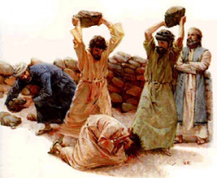
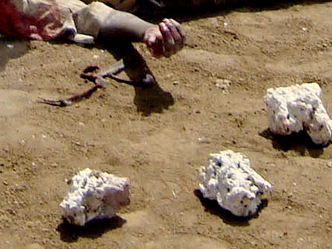
Stoning of Stephen
Skin Slashed
Gaping Wounds
Bones Crushed
Vital Organs Ruptured
Then he knelt down and cried out with a loud voice, Lord, do not charge them with this sin. And when he had said this, he fell asleep.
Acts 7:60

Slide 5
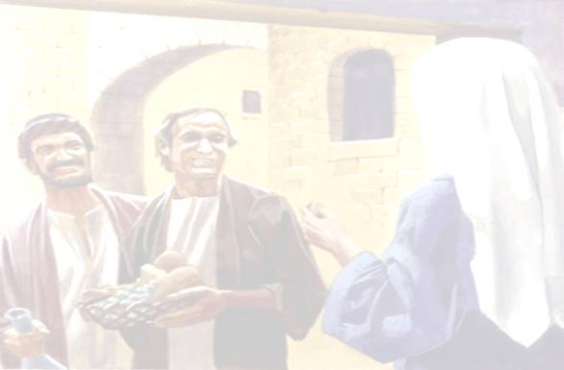
A Man of Faith – Rom 10:17
Reputation Pure – Acts 11:23
Displayed Fruit of the Spirit – Gal 5:22-24
A Man of Wisdom – Jas 1:5
A Servant’s Heart – Jn 13:15-17
Then the twelve summoned the multitude of the disciples and said, it is not desirable that we should leave the word of God and serve tables. Therefore, brethren, seek out from among you seven men of good reputation, full of the Holy Spirit and wisdom, whom we may appoint over this business; but we will give ourselves continually to prayer and to the ministry of the word. And the saying pleased the whole multitude. And they chose Stephen, a man full of faith and the Holy Spirit . . .
(Acts 6:2-5)
Then the twelve summoned the multitude of the disciples and said, it is not desirable that we should leave the word of God and serve tables. Therefore, brethren, seek out from among you seven men of good reputation, full of the Holy Spirit and wisdom, whom we may appoint over this business; but we will give ourselves continually to prayer and to the ministry of the word. And the saying pleased the whole multitude. And they chose Stephen, a man full of faith and the Holy Spirit . . .
(Acts 6:2-5)
Then the twelve summoned the multitude of the disciples and said, it is not desirable that we should leave the word of God and serve tables. Therefore, brethren, seek out from among you seven men of good reputation, full of the Holy Spirit and wisdom, whom we may appoint over this business; but we will give ourselves continually to prayer and to the ministry of the word. And the saying pleased the whole multitude. And they chose Stephen, a man full of faith and the Holy Spirit . . .
(Acts 6:2-5)
Then the twelve summoned the multitude of the disciples and said, it is not desirable that we should leave the word of God and serve tables. Therefore, brethren, seek out from among you seven men of good reputation, full of the Holy Spirit and wisdom, whom we may appoint over this business; but we will give ourselves continually to prayer and to the ministry of the word. And the saying pleased the whole multitude. And they chose Stephen, a man full of faith and the Holy Spirit . . .
(Acts 6:2-5)
Then the twelve summoned the multitude of the disciples and said, it is not desirable that we should leave the word of God and serve tables. Therefore, brethren, seek out from among you seven men of good reputation, full of the Holy Spirit and wisdom, whom we may appoint over this business; but we will give ourselves continually to prayer and to the ministry of the word. And the saying pleased the whole multitude. And they chose Stephen, a man full of faith and the Holy Spirit . . .
(Acts 6:2-5)
Then the twelve summoned the multitude of the disciples and said, it is not desirable that we should leave the word of God and serve tables. Therefore, brethren, seek out from among you seven men of good reputation, full of the Holy Spirit and wisdom, whom we may appoint over this business; but we will give ourselves continually to prayer and to the ministry of the word. And the saying pleased the whole multitude. And they chose Stephen, a man full of faith and the Holy Spirit . . .
(Acts 6:2-5)

Slide 6
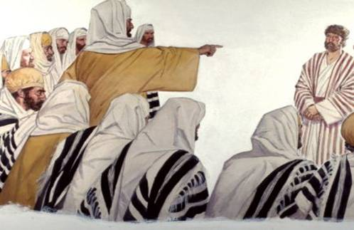
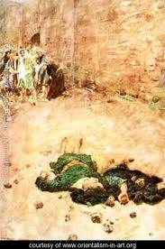
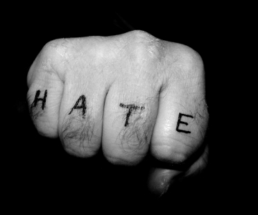
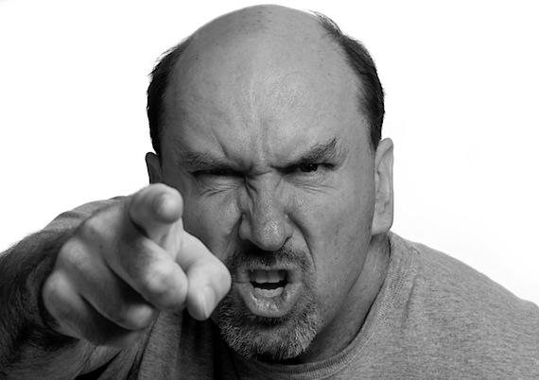
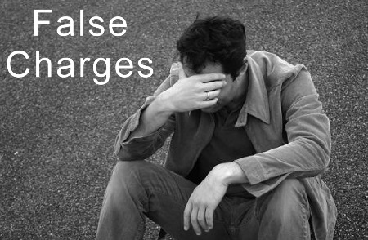
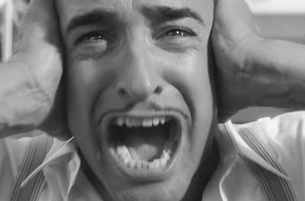
Arguing with the Truth (Ac 6:9)
Attack the Character w/lies (Ac 6:10-14)
Anger gives way to Hate (Ac 7:54-60)

