Slide 2
Acts 20:25-32
²⁵ And indeed, now I know that you all, among whom I have gone preaching the kingdom of God, will see my face no more. ²⁶ Therefore I testify to you this day that I am innocent of the blood of all men. ²⁷ For I have not shunned to declare to you the whole counsel of God. ²⁸ Therefore take heed to yourselves and to all the flock, among which the Holy Spirit has made you overseers, to shepherd the church of God which He purchased with His own blood. ²⁹ For I know this, that after my departure savage wolves will come in among you, not sparing the flock. ³⁰ Also from among yourselves men will rise up, speaking perverse things, to draw away the disciples after themselves. ³¹ Therefore watch, and remember that for three years I did not cease to warn everyone night and day with tears. ³² So now, brethren, I commend you to God and to the word of His grace, which is able to build you up and give you an inheritance among all those who are sanctified.

Slide 4
Steps of Salvation
Baptized
Ac 2:38; 22:16
1 Pet 3:21
Lost
Confess
Mt 10:32-33
Rom 10:10
Repent
Ac 2:38; 17:30
Lk 24:47
Believe
Ac 16:31; 18:8
Mk 16:16
Hear
Rom 10:14, 17
Ac 2:37; 18:8

Slide 5
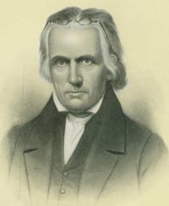
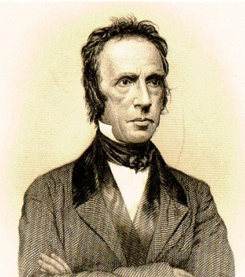
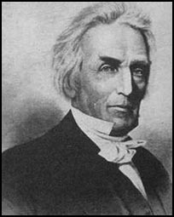
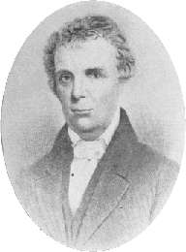
Steps of Salvation
Four Pioneers
Thomas Campbell
Walter Scott
Alexander Campbell
Barton W. Stone
Restoration Movement

Slide 6
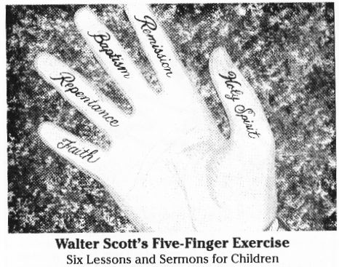
Steps of Salvation
Baptized
Baptized
Ac 2:38; 22:16
1 Pet 3:21
Continue confessing for a lifetime / Matt 10:32-33
Lost
Confess
Mt 10:32-33
Rom 10:10
Continue to repent for a lifetime / Luke 3:8-14; 2 Cor 7:11
Repent
Ac 2:38; 17:30
Lk 24:47
Continue believing for a lifetime / Matt 6:33; Acts 27:25
Believe
Ac 16:31; 18:8
Mk 16:16
Continue hearing for a lifetime / 2 Tim 2:15; Matt 13:9
Hear
Rom 10:14, 17
Ac 2:37; 18:8
Being Faithful until Death ~ Rev 2:10

