Slide 2
John 11:20-27
²⁰ Now Martha, as soon as she heard that Jesus was coming, went and met Him, but Mary was sitting in the house. ²¹ Now Martha said to Jesus, Lord, if You had been here, my brother would not have died. ²² But even now I know that whatever You ask of God, God will give You. ²³ Jesus said to her, your brother will rise again. ²⁴ Martha said to Him, I know that he will rise again in the resurrection at the last day. ²⁵ Jesus said to her, I am the resurrection and the life. He who believes in Me, though he may die, he shall live. ²⁶ And whoever lives and believes in Me shall never die. Do you believe this? ²⁷ She said to Him, yes, Lord, I believe that You are the Christ, the Son of God, who is to come into the world.

Slide 4
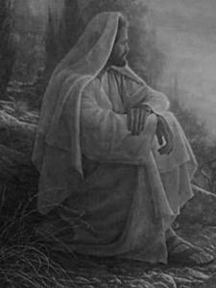
I am the Resurrection and the Life

Slide 5
Plot—Betrayal—Arrest
Then Judas, having received a detachment of troops, and officers from the chief priests and Pharisees, came there with lanterns, torches, and weapons . . . Then the detachment of troops and the captain and the officers of the Jews arrested Jesus and bound Him. And they led Him away to Annas first, for he was the father-in-law of Caiaphas who was high priest that year.
(John 18:3, 12-13)

Slide 6
Scourging and Crucifixion
Then they crucified Him, and divided His garments, casting lots, that it might be fulfilled which was spoken by the prophet: They divided My garments among them,
And for My clothing they cast lots. Sitting down, they kept watch over Him there. And they put up over His head the accusation written against Him:
THIS IS JESUS THE KING OF THE JEWS.
(Matthew 27:35-37)

Slide 7
Jesus Died on that Cross
So when Jesus had received the sour wine, He said, it is finished! And bowing His head, He gave up His spirit. Therefore, because it was the Preparation Day, that the bodies should not remain on the cross on the Sabbath (for that Sabbath was a high day), the Jews asked Pilate that their legs might be broken, and that they might be taken away. Then the soldiers came and broke the legs of the first and of the other who was crucified with Him. But when they came to Jesus and saw that He was already dead, they did not break His legs. But one of the soldiers pierced His side with a spear, and immediately blood and water came out.
(John 19:30-34)

Slide 8
After this, Joseph of Arimathea, being a disciple of Jesus, but secretly, for fear of the Jews, asked Pilate that he might take away the body of Jesus; and Pilate gave him permission. So he came and took the body of Jesus. And Nicodemus, who at first came to Jesus by night, also came, bringing a mixture of myrrh and aloes, about a hundred pounds. Then they took the body of Jesus, and bound it in strips of linen with the spices, as the custom of the Jews is to bury. Now in the place where He was crucified there was a garden, and in the garden a new tomb in which no one had yet been laid.
(John 19:38-41)
Jesus’ Body was Buried

Slide 9
Therefore command that the tomb be made secure until the third day, lest His disciples come by night and steal Him away, and say to the people, he has risen from the dead. So the last deception will be worse than the first. Pilate said to them, you have a guard; go your way, make it as secure as you know how. So they went and made the tomb secure, sealing the stone and setting the guard.
(Matthew 27:64-65)
The grave was sealed and guarded

Slide 10
Resurrection of Jesus
Acts 2:29-31
Acts 3:14-15
Acts 4:10-11
Acts 5:30-32
Acts 10:39-41
Acts 17:2-3
Acts 17:30-31

Slide 11
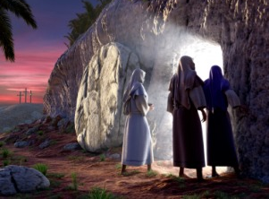
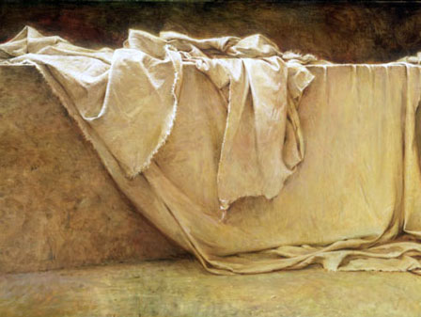
6 ½ Weeks
But Peter and the other apostles answered and said: we ought to obey God rather than men. The God of our fathers raised up Jesus whom you murdered by hanging on a tree. Him God has exalted to His right hand to be Prince and Savior, to give repentance to Israel and forgiveness of sins.
(Acts 5:29-31)
The former account I made, O Theophilus, of all that Jesus began both to do and teach, until the day in which He was taken up, after He through the Holy Spirit had given commandments to the apostles whom He had chosen, to whom He also presented Himself alive after His suffering by many infallible proofs, being seen by them during forty days and speaking of the things pertaining to the kingdom of God.
(Acts 1:1-3)

Slide 12
Do You Believe This?

