Slide 2
Psalm 51:1-4
Have mercy upon me, O God, according to Your lovingkindness; according to the multitude of Your tender mercies, blot out my transgressions.
Wash me thoroughly from my iniquity, and cleanse me from my sin.
For I acknowledge my transgressions, and my sin is always before me.
Against You, You only, have I sinned, and done this evil in Your sight-- that You may be found just when You speak, and blameless when You judge.

Slide 4
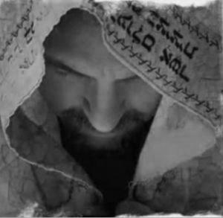
DAVID’S

Slide 5
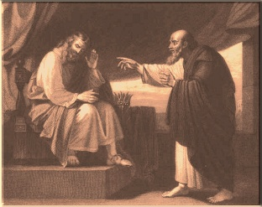
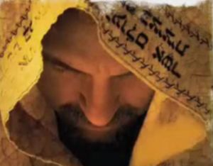
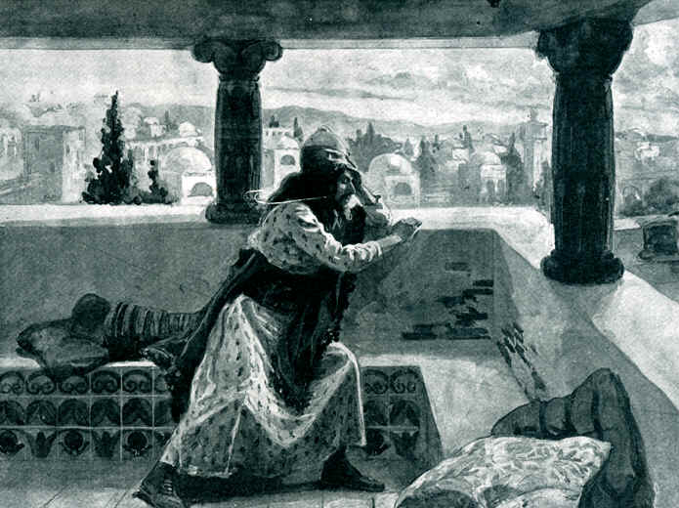
2 Samuel 12:13
So David said to Nathan,
I have sinned against the LORD.
2 Samuel 12:13
So David said to Nathan,
I have sinned against the LORD.
Psalm 51:1-4
1 Have mercy upon me, O God, according to Your lovingkindness; according to the multitude of Your tender mercies, blot out my transgressions.
2 Wash me thoroughly from my iniquity, and cleanse me from my sin.
3 For I acknowledge my transgressions, and my sin is always before me.
4 Against You, You only, have I sinned, and done this evil in Your sight . . .
2 Samuel 12:1-9
. Then the LORD sent Nathan to David. And he came to him, and said to him . . .
Then Nathan said to David, you are the man! Thus says the LORD God of Israel: I anointed you king over Israel, and I delivered you from the hand of Saul.
I gave you your master's house and your master's wives into your keeping, and gave you the house of Israel and Judah. And if that had been too little, I also would have given you much more!
Why have you despised the commandment of the LORD, to do evil in His sight? You have killed Uriah the Hittite with the sword; you have taken his wife to be your wife, and have killed him with the sword of the people of Ammon.
2 Samuel 11:2-4
2 Then it happened one evening that David arose from his bed and walked on the roof of the king's house. And from the roof he saw a woman bathing, and the woman was very beautiful to behold.
3 So David sent and inquired about the woman. And someone said, is this not Bathsheba, the daughter of Eliam, the wife of Uriah the Hittite?
4 Then David sent messengers, and took her; and she came to him, and he lay with her, for she was cleansed from her impurity; and she returned to her house.
Acts 17:30
God
Sin
1 Thess 1:9

Slide 6
Sincere Repentance
Stop blaming others
Stop lying to ‘selves
Stop covering-up sin
Acquires a need for God
Brings inner peace/joy
Seeks to help others

