Slide 2
Matthew 23:23-28
²³ Woe to you, scribes and Pharisees, hypocrites! For you pay tithe of mint and anise and cummin, and have neglected the weightier matters of the law: justice and mercy and faith. These you ought to have done, without leaving the others undone. ²⁴ Blind guides, who strain out a gnat and swallow a camel! ²⁵ Woe to you, scribes and Pharisees, hypocrites! For you cleanse the outside of the cup and dish, but inside they are full of extortion and self-indulgence. ²⁶ Blind Pharisee, first cleanse the inside of the cup and dish, that the outside of them may be clean also. ²⁷ Woe to you, scribes and Pharisees, hypocrites! For you are like whitewashed tombs which indeed appear beautiful outwardly, but inside are full of dead men’s bones and all uncleanness. ²⁸ Even so you also outwardly appear righteous to men, but inside you are full of hypocrisy and lawlessness.

Slide 4
Woe to you, scribes and Pharisees, hypocrites! For you pay tithe of mint and anise and cummin, and have neglected the weightier matters of the law: justice and mercy and faith. These you ought to have done, without leaving the others undone. Blind guides, who strain out a gnat and swallow a camel!
Matthew 23:23-24

Slide 5
He has shown you, O man, what is good; and what does the Lord require of you but to do justly, to love mercy, and to walk humbly with your God?
Micah 6:8
Woe to you, scribes and Pharisees, hypocrites! For you pay tithe of mint and anise and cummin, and have neglected the weightier matters of the law: justice and mercy and faith. These you ought to have done, without leaving the others undone. Blind guides, who strain out a gnat and swallow a camel!
Matthew 23:23-24
Inward determination to behave honorably before God & Man, Proverbs 21:3.
Internal love of tenderness and compassion toward others, Ephesians 4:32.
Being faithful to God in all things, humbling submitting to God’s word, Hebrews 5:8-9.

Slide 6
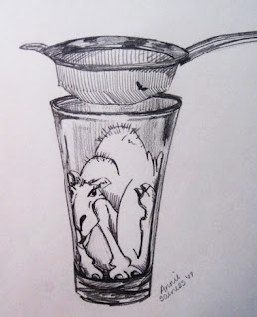
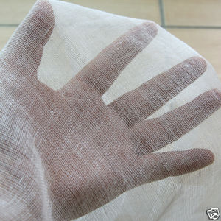
Woe to you, scribes and Pharisees, hypocrites! For you pay tithe of mint and anise and cummin, and have neglected the weightier matters of the law: justice and mercy and faith. These you ought to have done, without leaving the others undone. Blind guides, who strain out a gnat and swallow a camel!
Matthew 23:23-24
Muslin Gauze

Slide 7
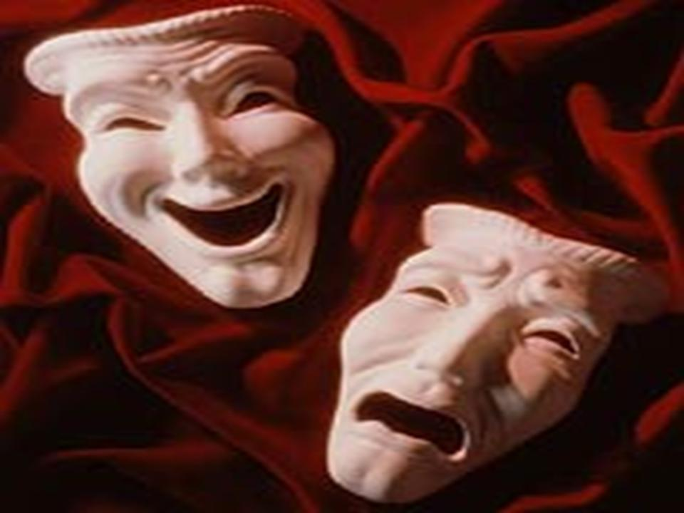
Selective Morality
Woe to you, scribes and Pharisees, hypocrites! For you pay tithe of mint and anise and cummin, and have neglected the weightier matters of the law: justice and mercy and faith. These you ought to have done, without leaving the others undone. Blind guides, who strain out a gnat and swallow a camel!
Matthew 23:23-24
Woe to you, scribes and Pharisees, hypocrites! For you pay tithe of mint and anise and cummin, and have neglected the weightier matters of the law: justice and mercy and faith. These you ought to have done, without leaving the others undone. Blind guides, who strain out a gnat and swallow a camel!
Matthew 23:23-24
Woe to you, scribes and Pharisees, hypocrites!
Vs 13
Vs 14
Vs 15
Vs 25
Vs 27
Vs 29

Slide 8
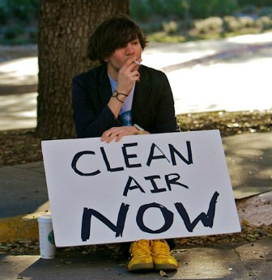
Selective Morality

Slide 9
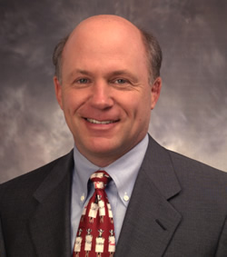
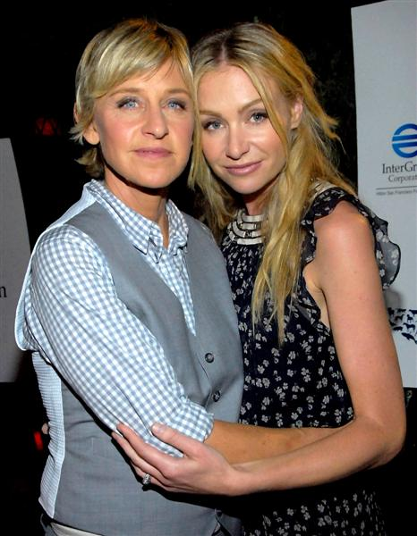
Selective Morality
Dan Cathy
Ellen DeGeneres

Slide 10
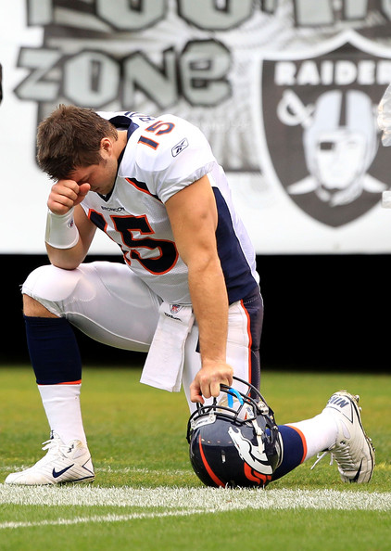
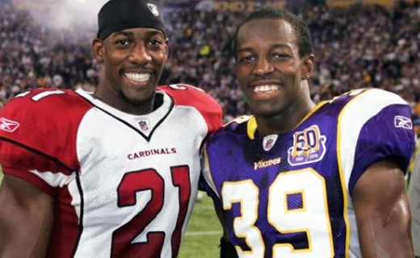
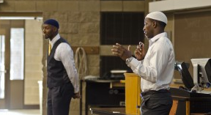
Selective Morality
Pro-Abortion
Tim Tebow
Hamza & Husain Abdullah
Anti-Death
Penalty

Slide 11
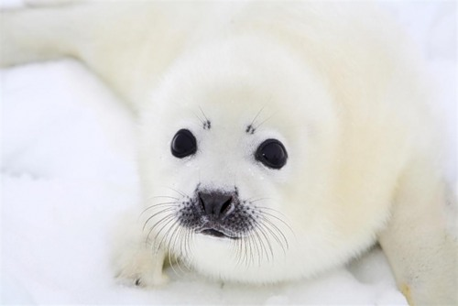
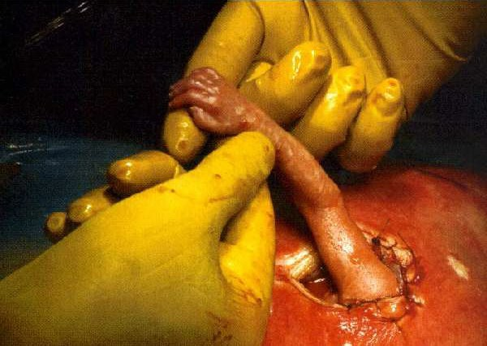
Selective Morality
Protect Baby Seals
Abort Baby Humans

Slide 12
Selective Morality
Condemns church “food pantries” but never helps the needy—Jas 1:27, Gal 6:10
Refuses to attend weddings or funerals in a denominational building but has no problem with using tobacco—1 Cor 6:19-20
Never permit children to participate in “religious” music programs at school but is addicted to pornography, gambling, prescription drugs or alcohol—Gal 5:19-21
Opposed to divorce but treats spouse with contempt, verbally abusive, no love or kindness at home, makes selfish decisions—Eph 4:25-32; Eph 5:22-33
Believes homosexuality and abortion are sinful but supports politically those who promote both—Rom 1:32
Would at no time allow a daughter to attend the “Prom” but never once talked to her boyfriend about becoming a Christian—Col 1:28
Never miss a called assembly of the church but displays an out of control temper and tongue—2 Pet 1:5-7
“These you ought to have done,
without leaving the others undone”
—Matt 23:23

Slide 13
Selective Morality
Would never think of not teaching a Bible class but has no problem with treating a server or cashier with verbal contempt—Matt 5:16
Is gossiping about a brother instead of reaching out to help him in his struggles—Prov 20:19, 1 Tim 5:13; Gal 6:2
Always attends every service of a gospel meeting but never once invites a friend or neighbor to attend—Matt 28:19-20
Would never use profanity but has no misgivings about sitting through a two-hour movie filled with profanities—Phil 4:8
Refuses to engage in lewdness but will tell jokes or laugh at jokes with sexual content or innuendos—Eph 5:4
Believes the use of instruments of music is sinful but will NOT sing or does so without enthusiasm—1 Cor 14:15
Would not think of cheating on a spouse but will flirt with someone, and make inappropriate comments, getting as “close” as possible—1 Thess 5:22
“These you ought to have done,
without leaving the others undone”
—Matt 23:23

Slide 14
No Moral Ambiguity
Selective Morality
“Exceeds” does not refer to quantity but to quality.
Their “moral ambiguity” of right & wrong annulled the Law of God—Matt 15:6. They “picked and chose” to obey what they believed important.
Their faith was in their “obedience,” our obedience is to be because of our faith in Christ—Heb 11:6.
Their deeds were motivated by self-glorification (Matt 6:1), ours are to be motivated by our love of God and for His glorification—Matt 22:37-40; Matt 5:16.
For I say to you, that unless your righteousness exceeds the righteousness of the scribes and Pharisees, you will by no means enter the kingdom of heaven.
(Matthew 5:20)

