Slide 2
1 Corinthians 1:18-25
¹⁸ For the message of the cross is foolishness to those who are perishing, but to us who are being saved it is the power of God. ¹⁹ For it is written: I will destroy the wisdom of the wise, and bring to nothing the understanding of the prudent. ²⁰ Where is the wise? Where is the scribe? Where is the disputer of this age? Has not God made foolish the wisdom of this world? ²¹ For since, in the wisdom of God, the world through wisdom did not know God, it pleased God through the foolishness of the message preached to save those who believe. ²² For Jews request a sign, and Greeks seek after wisdom; ²³ but we preach Christ crucified, to the Jews a stumbling block and to the Greeks foolishness, ²⁴ but to those who are called, both Jews and Greeks, Christ the power of God and the wisdom of God. ²⁵ Because the foolishness of God is wiser than men, and the weakness of God is stronger than men.

Slide 4
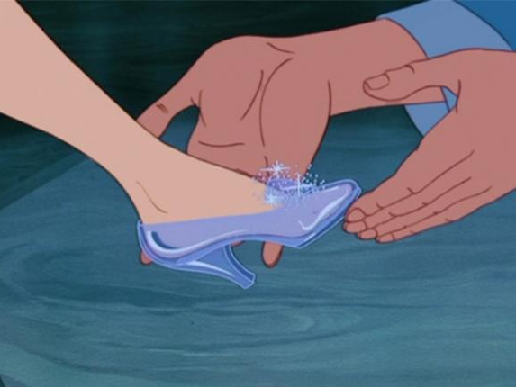
And they lived happily ever after

Slide 5
And all these, having obtained a good testimony through faith, did not receive the promise, (Hebrews 11:39)

Slide 6
1 Corinthians 1:18-25
¹⁸ For the message of the cross is foolishness to those who are perishing, but to us who are being saved it is the power of God. ¹⁹ For it is written: I will destroy the wisdom of the wise, and bring to nothing the understanding of the prudent. ²⁰ Where is the wise? Where is the scribe? Where is the disputer of this age? Has not God made foolish the wisdom of this world? ²¹ For since, in the wisdom of God, the world through wisdom did not know God, it pleased God through the foolishness of the message preached to save those who believe. ²² For Jews request a sign, and Greeks seek after wisdom; ²³ but we preach Christ crucified, to the Jews a stumbling block and to the Greeks foolishness, ²⁴ but to those who are called, both Jews and Greeks, Christ the power of God and the wisdom of God. ²⁵ Because the foolishness of God is wiser than men, and the weakness of God is stronger than men.
moria / moros
[ridiculous, ignorant, stupid, contemptible]
MORON

Slide 7
Message Of The Cross
Is Complete Foolishness
Is Absolutely Brilliant
Is Unbelievably Powerful
Is The Only Way To Heaven

