Slide 2
Judges 16:1-6
¹ Now Samson went to Gaza and saw a harlot there, and went in to her. ² When the Gazites were told, Samson has come here! they surrounded the place and lay in wait for him all night at the gate of the city. They were quiet all night, saying, in the morning, when it is daylight, we will kill him. ³ And Samson lay low till midnight; then he arose at midnight, took hold of the doors of the gate of the city and the two gateposts, pulled them up, bar and all, put them on his shoulders, and carried them to the top of the hill that faces Hebron. ⁴ Afterward it happened that he loved a woman in the Valley of Sorek, whose name was Delilah. ⁵ And the lords of the Philistines came up to her and said to her, entice him, and find out where his great strength lies, and by what means we may overpower him, that we may bind him to afflict him; and every one of us will give you eleven hundred pieces of silver. ⁶ So Delilah said to Samson, please tell me where your great strength lies, and with what you may be bound to afflict you.

Slide 4
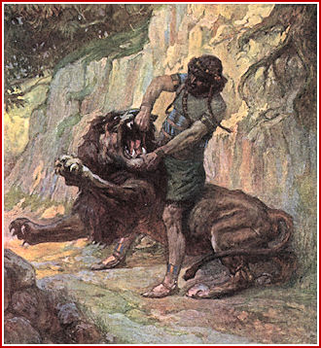
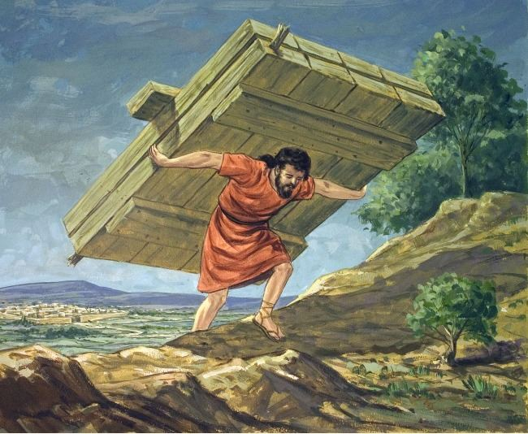
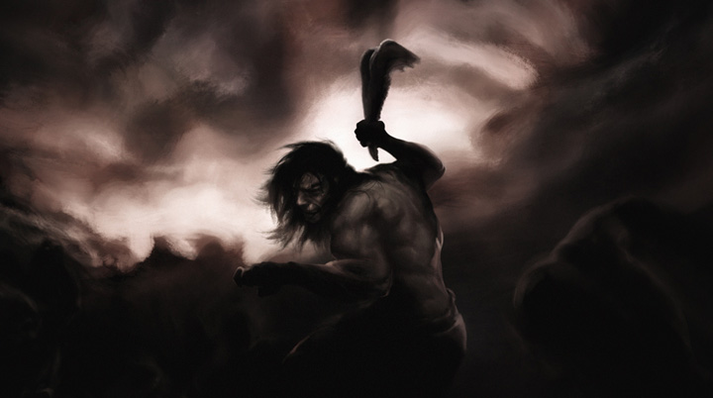
Strength of Samson
Then Samson called to the Lord, saying, O Lord God, remember me, I pray! Strengthen me, I pray, just this once, O God, that I may with one blow take vengeance on the Philistines for my two eyes! And Samson took hold of the two middle pillars which supported the temple, and he braced himself against them, one on his right and the other on his left. Then Samson said, let me die with the Philistines! And he pushed with all his might, and the temple fell on the lords and all the people who were in it. So the dead that he killed at his death were more than he had killed in his life. (Judges 16:28-30)
Judges 14:5-6
Judges 16:3
Judges 16:21
Judges 15:15

Slide 5
Then she said to him, how can you say, I love you, when your heart is not with me? You have mocked me these three times, and have not told me where your great strength lies. And it came to pass, when she pestered him daily with her words and pressed him, so that his soul was vexed to death,
Judges 16:15-16
Where Does Your Weakness Lie?

Slide 6
Where Does Your Weakness Lie?
Then she lulled him to sleep on her knees, and called for a man and had him shave off the seven locks of his head. Then she began to torment him, and his strength left him. And she said, the Philistines are upon you, Samson! So he awoke from his sleep, and said, I will go out as before, at other times, and shake myself free! But he did not know that the Lord had departed from him. (Judges 16:19-20)
Then she lulled him to sleep on her knees, and called for a man and had him shave off the seven locks of his head. Then she began to torment him, and his strength left him. And she said, the Philistines are upon you, Samson! So he awoke from his sleep, and said, I will go out as before, at other times, and shake myself free! But he did not know that the Lord had departed from him. (Judges 16:19-20)

Slide 7
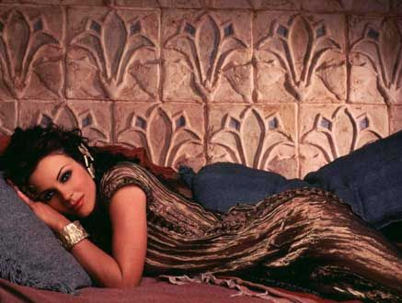
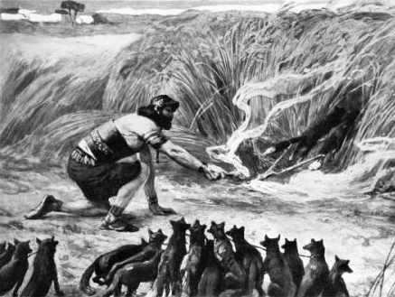
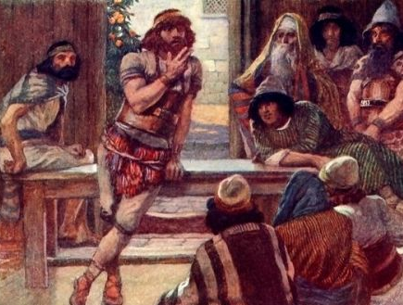
Where Does Your Weakness Lie?
In His Lust
In His Anger
In His Pride

