Slide 2
Ephesians 6:10-18
¹⁰ Finally, my brethren, be strong in the Lord and in the power of His might. ¹¹ Put on the whole armor of God, that you may be able to stand against the wiles of the devil. ¹² For we do not wrestle against flesh and blood, but against principalities, against powers, against the rulers of the darkness of this age, against spiritual hosts of wickedness in the heavenly places. ¹³ Therefore take up the whole armor of God, that you may be able to withstand in the evil day, and having done all, to stand. ¹⁴ Stand therefore, having girded your waist with truth, having put on the breastplate of righteousness, ¹⁵ and having shod your feet with the preparation of the gospel of peace; ¹⁶ above all, taking the shield of faith with which you will be able to quench all the fiery darts of the wicked one. ¹⁷ And take the helmet of salvation, and the sword of the Spirit, which is the word of God; ¹⁸ praying always with all prayer and supplication in the Spirit, being watchful to this end with all perseverance and supplication for all the saints—

Slide 4
Finally, my brethren, be strong in the Lord and in the power of His might. Put on the whole armor of God, that you may be able to stand against the wiles of the devil. For we do not wrestle against flesh and blood, but against principalities, against powers, against the rulers of the darkness of this age, against spiritual hosts of wickedness in the heavenly places. (Ephesians 6:10-12)

Slide 5
Death of Decency
Your elder sister is Samaria, who dwells with her daughters to the north of you; and your younger sister, who dwells to the south of you, is Sodom and her daughters. You did not walk in their ways nor act according to their abominations; but, as if that were too little, you became more corrupt than they in all your ways.
(Ezek 16:46-47)
And you, Capernaum, who are exalted to heaven, will be brought down to Hades; for if the mighty works which were done in you had been done in Sodom, it would have remained until this day. But I say to you that it shall be more tolerable for the land of Sodom in the day of judgment than for you.
(Matt 11:23-24)

Slide 6
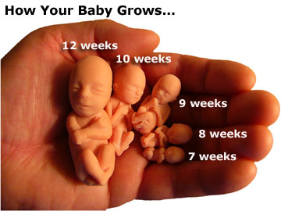

Slide 8
Rob Bell, former “pastor” and founder of Mars Hill Bible Church in Michigan:
“I am for fidelity. I am for love, whether it's a man and woman, a woman and a woman, a man and a man.”
“let God be true but every man a liar” (Romans 3:4)
Rob Bell

Slide 9
Genesis 19:1-24
Leviticus 18:22
Jude 1:7
Leviticus 20:13
1 Kings 14:24
Deuteronomy 23:17
1 Corinthians 6:9
Romans 1:24-29
1 Timothy 1:9-10

Slide 10
The Forces of Evil

Slide 11
Marriage (A hyphenated word)
Homosexuality (An act not an orientation)
Family (Parent A and Parent B)
Born homosexual—not Choose
Redefining
Marriage can only be defined as between a man and woman:
“And Adam said: This is now bone of my bones and flesh of my flesh; she shall be called woman, because she was taken out of man. Therefore a man shall leave his father and mother and be joined to his wife, and they shall become one flesh.” (Genesis 2:23-24)
Marriage can only be defined as between a man and woman:
“Have you not read that He who made them at the beginning made them male and female, and said, for this reason a man shall leave his father and mother and be joined to his wife, and the two shall become one flesh? So then, they are no longer two but one flesh.”(Matthew 19:4-6)
Paul addresses the orientation (thoughts):
For this reason God gave them up to vile passions. For even their women exchanged the natural use for what is against nature. Likewise also the men, leaving the natural use of the woman, burned in their lust for one another, men with men committing what is shameful, and receiving in themselves the penalty of their error which was due. (Romans 1:26-27)
Children are to be raised by a father and a mother:
So God created man in His own image; in the image of God He created him; male and female He created them. Then God blessed them, and God said to them, be fruitful and multiply; fill the earth and subdue it . . . (Genesis 1:27-28)
Homosexuality is a Choice that can be Repented of:
Do you not know that the unrighteous will not inherit the kingdom of God? Do not be deceived. Neither fornicators, nor idolaters, nor adulterers, nor homosexuals, nor sodomites, nor thieves, nor covetous, nor drunkards, nor revilers, nor extortioners will inherit the kingdom of God. And such were some of you. But you were washed, but you were sanctified, but you were justified in the name of the Lord Jesus and by the Spirit of our God. (1 Corinthians 6:9-11)

Slide 12
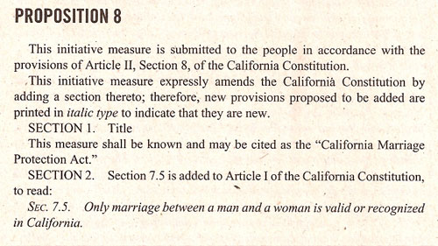
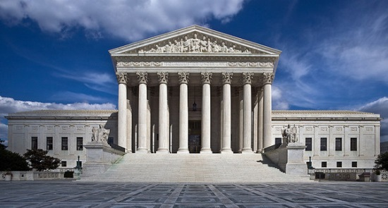
Are You For It, Against It, Or Nonaligned?
As of January 2013, nine states—Connecticut, Iowa, Maine, Maryland, Massachusetts, New Hampshire, New York, Vermont, and Washington—and the District of Columbia. Also three Indian tribes have legalized same-sex marriage, representing 15.7% of the U.S. population.
Additionally, Rhode Island recognizes same-sex marriages performed in other jurisdictions.

Slide 13
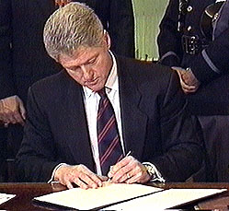
Are You For It, Against It, Or Nonaligned?
September 21, 1996
SEC. 3. DEFINITION OF MARRIAGE.
(a) IN GENERAL- Chapter 1 of title 1, United States Code, is amended by adding at the end the following:
`Sec. 7. Definition of `marriage' and `spouse'
“In determining the meaning of any Act of Congress, or of any ruling, regulation, or interpretation of the various administrative bureaus and agencies of the United States, the word ‘marriage’ means only a legal union between one man and one woman as husband and wife, and the word ‘spouse’ refers only to a person of the opposite sex who is a husband or a wife.”
Editorial 3-26-2013
The two big cases being argued this week could turn out to be landmarks that confirm the nation’s progress toward marriage equality -- or speed bumps that impede it. Either way, the destination is clear: Six out of 10 Americans approve of gay marriage, according to a Washington Post poll, including 80 percent of adults under 30. That looks less like a question than a decision.
Defense of Marriage Act
Even though the federal government does not issue marriage licenses, there are over 1,000 federal laws that take marriage into account. For example, Social Security provides survivor benefits to spouses of deceased beneficiaries.

Slide 14
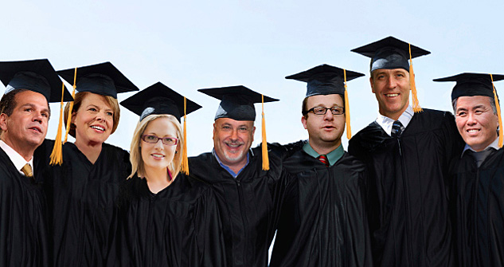
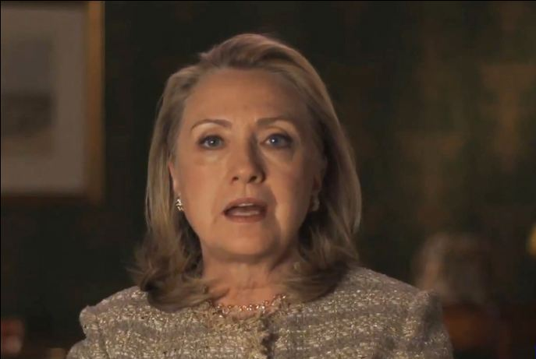
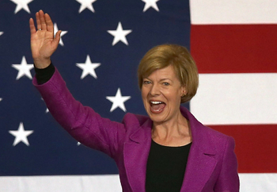
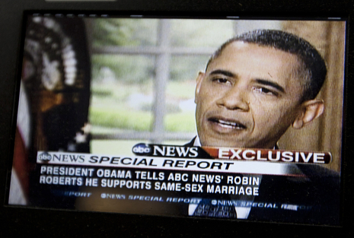
Are You For It, Against It, Or Nonaligned?
2013 Homosexual Members of Congress
By Executive order to date, the Obama-Biden Administration has appointed more than 250 openly LGBT (lesbian, gay, bisexual, transgender) professionals to full-time and advisory positions in the executive branch; more than all known LGBT appointments of other presidential administrations combined.
Hillary Clinton (March 18, 2013).
Announced in an online video that she now supports same-sex marriage.
She says in the six-minute video that gays and lesbians are “full and equal citizens and deserve the rights of citizenship. That includes marriage . . .”
Adding that she backs same-sex marriage both “personally and as a matter of policy and law.”
Senator Tammy Baldwin, D. Wisconsin (Lesbian)
David Cicilline (RI), Tammy Baldwin (WI), Kyrsten Sinema (AZ), Mark Pocan (WI)
Jared Polis (CO), Sean Patrick Maloney (NY), Mark Takano (CA).

Slide 15
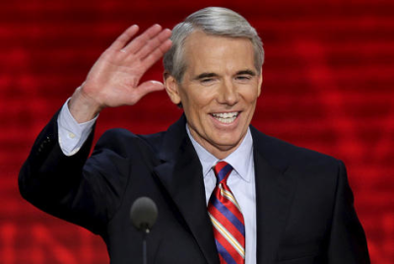
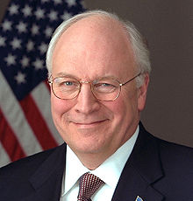
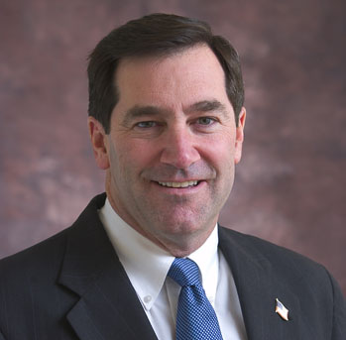
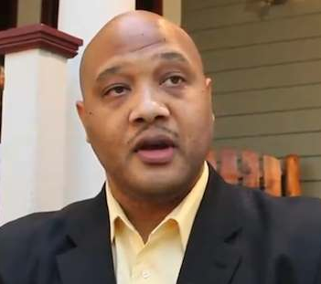
Are You For It, Against It, Or Nonaligned?
Rob Portman, (R) Ohio
Dick Cheney, Former VP
53 out of 100 U.S. Senators support same-sex marriage
177 out of 435 Members of the U.S. House of Representatives support same-sex marriage
Joe Donnelly
Andre Carson

Slide 16
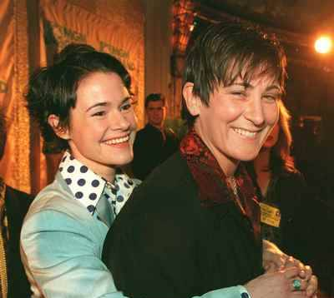
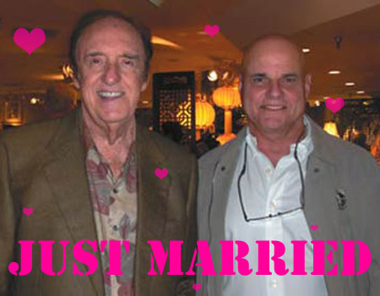
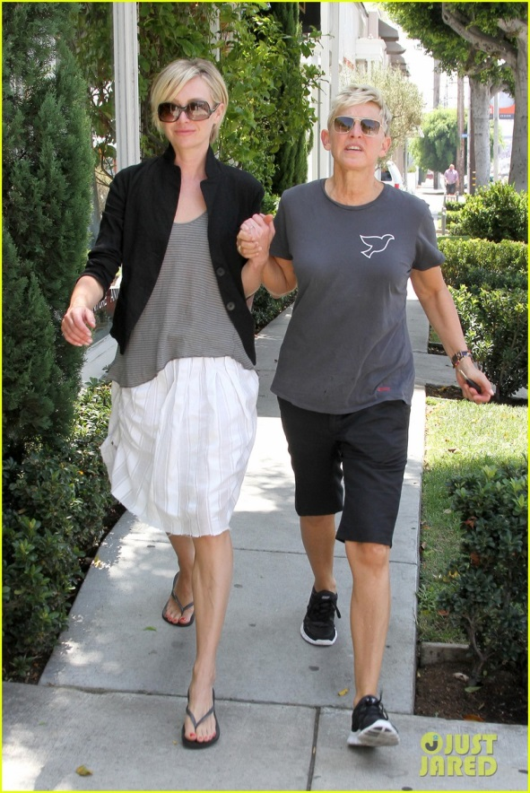
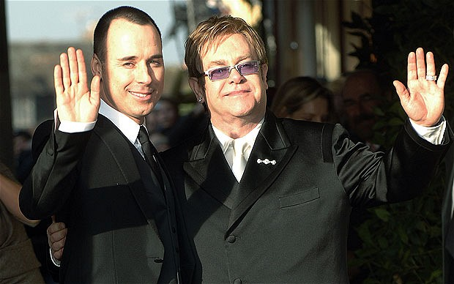
Are You For It, Against It, Or Nonaligned?
Lady Sovereign

Slide 17
A strong majority of younger Americans now support same-sex marriage. In a Gallup Poll conducted last month, 73 percent of people between 18 and 29 years old said they favored it, while only 39 percent of people older than 65 did.
Gay Marriage USA
312,964 “likes”

Slide 18
The Law of the Land
It’s the Law: (Massachusetts)
In 2009, a deputy manager at a Brookstone store in Boston was fired from his job for mentioning his belief to another manager who had kept bringing up the subject with him that day. Brookstone's letter of termination (quoted on local TV news) said his comment was "inappropriate" because "in the State of Massachusetts, same-sex marriage is legal."
It’s the Law:
Elane Photography in New Mexico were approached by a same sex couple looking to hire a wedding photographer. Elane Photography politely declined citing their religious faith and were sued by the couple under the state’s anti-discriminatory laws, and won.
It’s the Law:
In Lexington, Kentucky, a t-shirt shop called Hands On Originals was approached by the Gay and Lesbian Services Organization about printing shirts for the group. The t-shirt company politely declined and even sought out quotes and gave the group referrals to other t-shirt printers along with comparable prices.
Authorities said: “Hands On Originals” will be “required by law to participate in the investigation. We have subpoena power and have the backing of the law. We are a law enforcement agency and people have to comply.”

Slide 19
The Law of the Land
It’s the Law:
A same sex couple from California sued a Hawaiian bed and breakfast privately owned by a Christian woman for not allowing them to rent a room.
A bed and breakfast in Alton privately owned by a Christian couple was sued when they would not host a same sex civil union ceremony.
Owners of a small, privately-owned inn in Vermont declined to host a same sex wedding reception due to their religious views and were sued.
An employee of Allstate insurance wrote an essay online disagreeing with same sex marriage and was reportedly fired from his job as a result.
It’s the Law:
On November 7, 2008, a Carmel, Indiana bus driver lectured her student passengers about toleration. She then called one of the students “a stupid little bigot” for telling others that she could not have voted for Obama as president because she is against abortion and gay marriage. “I don’t want to hear one more word about anyone going to hell if they are gay . . .”
The bus’ surveillance video also caught the driver saying that she would “eat the girl alive.” According to the American Family Association, when the girl’s father complained to the school about the bus driver’s actions, he was told that the behavior of the driver fell within the scope of her employment.

Slide 20
The Law of the Land
Churches:
A Methodist church in New Jersey was sued for not offering its facility for use during same sex weddings. A judge ruled against them.
In 2009 angry homosexual activists terrorized the Park Street Church in Boston while it was holding an ex-gay religious training session inside. They demonstrated next to the doors and windows with signs, screaming homosexual slogans. One of them held a bullhorn against the window outside the meeting, bellowing at the participants inside. Police did nothing to stop them . . .
It could one day be illegal for the Danville church of Christ to refuse membership to homosexuals!
It could one day be illegal (hate speech) to teach against homosexuality; subjecting the teacher, preacher, elders to arrest.
It could mean we lose our tax-exempt status and be fined!
It could mean that we could have our church building confiscated and closed.
“It’s the law and people have to comply”

Slide 21
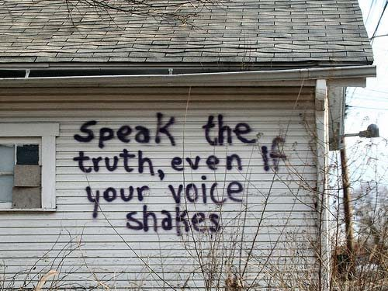
And when they had brought them, they set them before the council. And the high priest asked them, saying, did we not strictly command you not to teach in this name? And look, you have filled Jerusalem with your doctrine, and intend to bring this Man’s blood on us! But Peter and the other apostles answered and said:
We ought to obey God rather than men.
(Acts 5:27-29)

Slide 22
Marriage: One Man + One Woman For Life

