Slide 2
Galatians 6:1-5
¹ Brethren, if a man is overtaken in any trespass, you who are spiritual restore such a one in a spirit of gentleness, considering yourself lest you also be tempted. ² Bear one another’s burdens, and so fulfill the law of Christ. ³ For if anyone thinks himself to be something, when he is nothing, he deceives himself. ⁴ But let each one examine his own work, and then he will have rejoicing in himself alone, and not in another. ⁵ For each one shall bear his own load.

Slide 4
A Painful Reality
“But we command you, brethren, in the name of our Lord Jesus Christ, that you withdraw from every brother who walks disorderly and not according to the tradition which he received from us.” (2 Thessalonians 3:6).
“And if anyone does not obey our word in this epistle, note that person and do not keep company with him, that he may be ashamed. ” (2 Thessalonians 3:14).
“But if he refuses even to hear the church, let him be to you like a heathen and a tax collector” (Matthew 18:17).

Slide 5
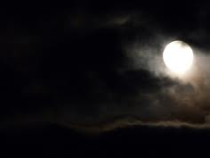
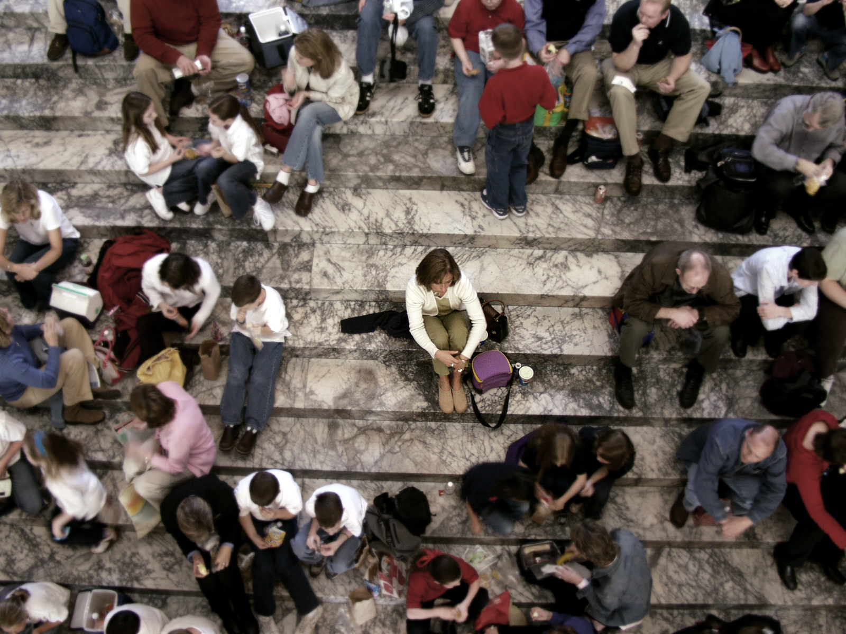
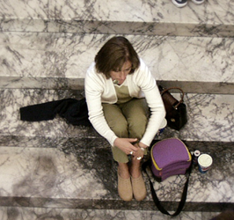
“I, therefore, the prisoner of the Lord, beseech you to walk worthy of the calling with which you were called, with all lowliness and gentleness, with longsuffering, bearing with one another in love, endeavoring to keep the unity of the Spirit in the bond of peace.” (Ephesians 4:1-3)
“Brethren, if a man is overtaken in any trespass, you who are spiritual restore such a one in a spirit of gentleness, considering yourself lest you also be tempted. Bear one another’s burdens, and so fulfill the law of Christ.”
(Galatians 6:1-2)
Ignore them?
Brush them off?
Give them the Cold-shoulder?
Hide them?
Pretend they don’t exist?
Let the elders handle them?

Slide 6
We Have Often Seen The Signs
Spotty / Inconsistent / Lack of Attendance
Hurry in and out without talking to others
Habitually refuse invitations to socialize
Distancing oneself from others at church
Lack of interest in Bible classes
Unwillingness to make spiritual choices
Comes forward often and confesses sins

Slide 7
What Can We Do?
Admit That Restoration Is Possible And Preferred (Gal 6:1)

Slide 8
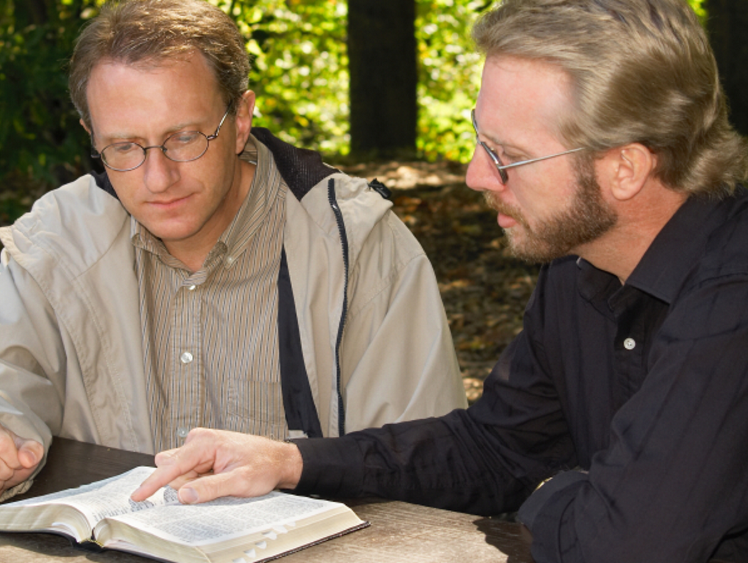
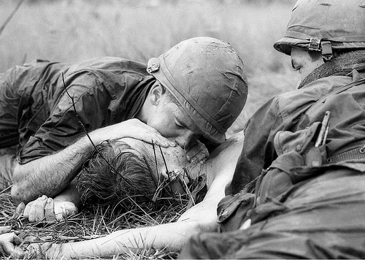
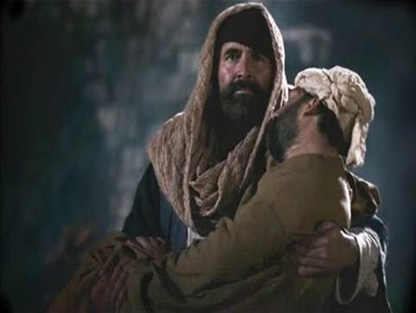
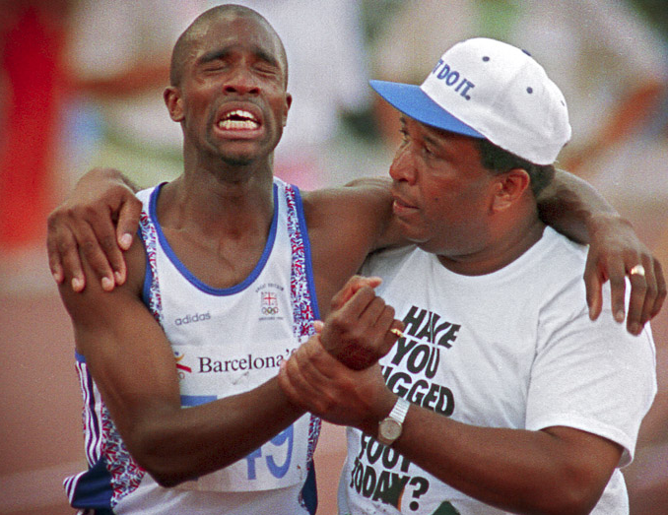
Ezekiel 34:1-6
So he went to him and bandaged his wounds, pouring on oil and wine; and he set him on his own animal, brought him to an inn, and took care of him. On the next day, when he departed, he took out two denarii, gave them to the innkeeper, and said to him, take care of him; and whatever more you spend, when I come again, I will repay you. So which of these three do you think was neighbor to him who fell among the thieves? And he said, he who showed mercy on him. Then Jesus said to him, go and do likewise.
(Luke 10:34-37)
So which of these three do you think was neighbor to him who fell among the thieves? And he said, he who showed mercy on him. Then Jesus said to him, go and do likewise.
(Luke 10:34-37)
So which of these three do you think was neighbor to him who fell among the thieves? And he said, he who showed mercy on him. Then Jesus said to him, go and do likewise.
(Luke 10:34-37)
So which of these three do you think was neighbor to him who fell among the thieves? And he said, he who showed mercy on him. Then Jesus said to him, go and do likewise.
(Luke 10:34-37)
What man of you, having a hundred sheep, if he loses one of them, does not leave the ninety-nine in the wilderness, and go after the one which is lost until he finds it? And when he has found it, he lays it on his shoulders, rejoicing. And when he comes home, he calls together his friends and neighbors, saying to them, rejoice with me, for I have found my sheep which was lost! I say to you that likewise there will be more joy in heaven over one sinner who repents than over ninety-nine just persons who need no repentance.
(Luke 15:4-7)

Slide 9
What Can We Do?
Do So While Always Evaluating Your Own Life (Gal 6:1)
Admit That Restoration Is Possible And Preferred (Gal 6:1)

Slide 10
“Considering yourself lest you also be tempted . . . For if anyone thinks himself to be something, when he is nothing, he deceives himself”
(Gal 6:1, 3).

Slide 11
What Can We Do?
Restoration Takes Face-To-Face Communication (Eph 4:2)
Do So While Always Evaluating Your Own Life (Gal 6:1)
Admit That Restoration Is Possible And Preferred (Gal 6:1)

Slide 12
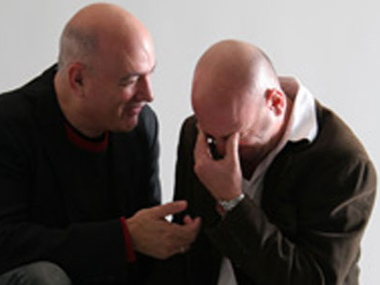
“You who are spiritual restore such a one in a spirit of gentleness,” (Gal 6:1).
“With all lowliness and gentleness, with longsuffering, bearing with one another in love,” (Eph 4:2).

Slide 13
What Can We Do?
Do Not Doubt The Returning Sinner’s Sincerity (Lk 17:3-4)
Restoration Takes Face-To-Face Communication (Eph 4:2)
Do So While Always Evaluating Your Own Life (Gal 6:1)
Admit That Restoration Is Possible And Preferred (Gal 6:1)

Slide 14
“Then Peter came to Him and said, Lord, how often shall my brother sin against me, and I forgive him? Up to seven times? Jesus said to him, I do not say to you, up to seven times, but up to seventy times seven.”
(Matt 18:21-22)
Pornography
Adultery
Drunkenness
Drug Use

Slide 15
What Can We Do?
Remember Sin, Not The Sinner, Is The Enemy (2 Thes 3:15)
Do Not Doubt The Returning Sinner’s Sincerity (Lk 17:3-4)
Restoration Takes Face-To-Face Communication (Eph 4:2)
Do So While Always Evaluating Your Own Life (Gal 6:1)
Admit That Restoration Is Possible And Preferred (Gal 6:1)

Slide 16
“You ought rather to forgive and comfort him, lest perhaps such a one be swallowed up with too much sorrow. Therefore I urge you to reaffirm your love to him.”
(2 Cor 2:7-8)

Slide 17
What Can We Do?
Must Be Hard-working, Unwavering, And Urgent (Eph 4:3)
Remember Sin, Not The Sinner, Is The Enemy (2 Thes 3:15)
Do Not Doubt The Returning Sinner’s Sincerity (Lk 17:3-4)
Restoration Takes Face-To-Face Communication (Eph 4:2)
Do So While Always Evaluating Your Own Life (Gal 6:1)
Admit That Restoration Is Possible And Preferred (Gal 6:1)

Slide 18
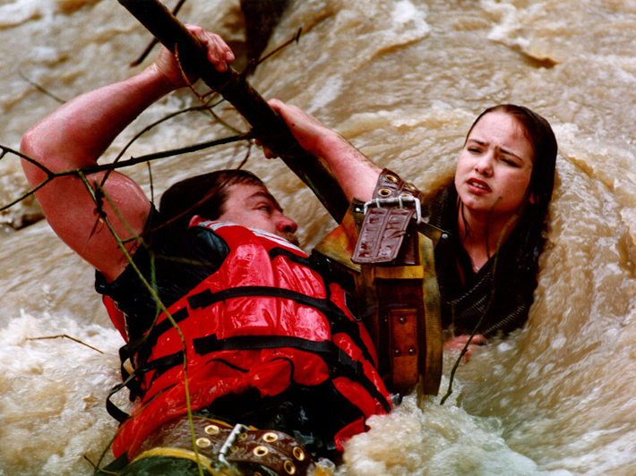
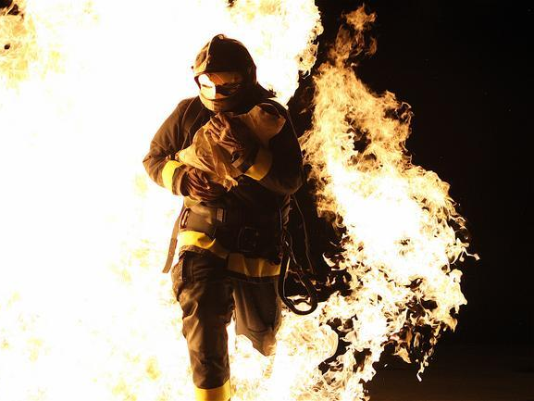
Rescue The Perishing
1 Rescue the perishing, care for the dying, Snatch them in pity from sin and the grave; Weep o'er the erring one, lift up the fallen, Tell them of Jesus, the mighty to save.
4 Rescue the perishing, duty demands it Strength for your labor the Lord will provide; Back to the narrow way patiently win them, Tell the poor wand'rer a Savior has died.
“And on some have compassion, making a distinction; but others save with fear, pulling them out of the fire, hating even the garment defiled by the flesh.”
(Jude 22-23)

Slide 19
What Can We Do?
Let’s Get Busy
Must Be Hard-working, Unwavering, And Urgent (Eph 4:3)
Remember Sin, Not The Sinner, Is The Enemy (2 Thes 3:15)
Do Not Doubt The Returning Sinner’s Sincerity (Lk 17:3-4)
Restoration Takes Face-To-Face Communication (Eph 4:2)
Do So While Always Evaluating Your Own Life (Gal 6:1)
Admit That Restoration Is Possible And Preferred (Gal 6:1)

