Slide 2
Matthew 7:1-6
¹ Judge not, that you be not judged. ² For with what judgment you judge, you will be judged; and with the measure you use, it will be measured back to you. ³ And why do you look at the speck in your brother’s eye, but do not consider the plank in your own eye? ⁴ Or how can you say to your brother, let me remove the speck from your eye; and look, a plank is in your own eye? ⁵ Hypocrite! First remove the plank from your own eye, and then you will see clearly to remove the speck from your brother’s eye. ⁶ Do not give what is holy to the dogs; nor cast your pearls before swine, lest they trample them under their feet, and turn and tear you in pieces.

Slide 4
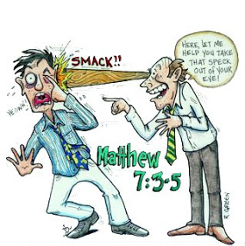
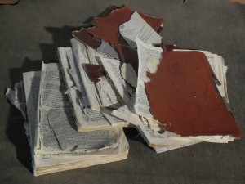
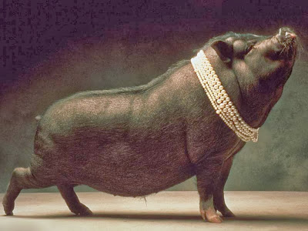
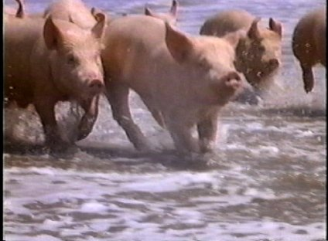
Word Pictures Of Jesus
Do not give what is holy to the dogs
Nor cast your pearls before swine . . .
lest they trample them under their
feet, and turn and tear you in pieces.

Slide 5
Removing the Plank

Slide 11
For we must all appear before the judgment seat of Christ, that each one may receive the things done in the body, according to what he has done, whether good or bad.
(2 Corinthians 5:10)
For with what judgment you judge, you will be judged; and with the measure you use, it will be measured back to you.

