Slide 2
Matthew 19:16-22
¹⁶ Now behold, one came and said to Him, good teacher, what good thing shall I do that I may have eternal life? ¹⁷ So He said to him, why do you call Me good? No one is good but One, that is, God. But if you want to enter into life, keep the commandments. ¹⁸ He said to Him, which ones? Jesus said, you shall not murder, you shall not commit adultery, you shall not steal, you shall not bear false witness, ¹⁹ honor your father and your mother, and, you shall love your neighbor as yourself. ²⁰ The young man said to Him, all these things I have kept from my youth. What do I still lack? ²¹ Jesus said to him, if you want to be perfect, go, sell what you have and give to the poor, and you will have treasure in heaven; and come, follow Me. ²² But when the young man heard that saying, he went away sorrowful, for he had great possessions.

Slide 4
What Should Be The Goal Of Christian Parents?
To become
a good
person
To have
good
ethics
To raise a
good kid

Slide 5
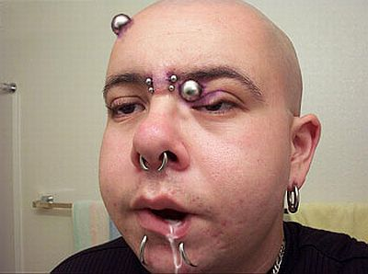
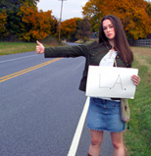

Slide 6
What Should Be The Goal Of Christian Parents?
Don’t just raise good kids—raise godly kids
To become
a good
person
To have
good
ethics
To raise a
good kid

Slide 7
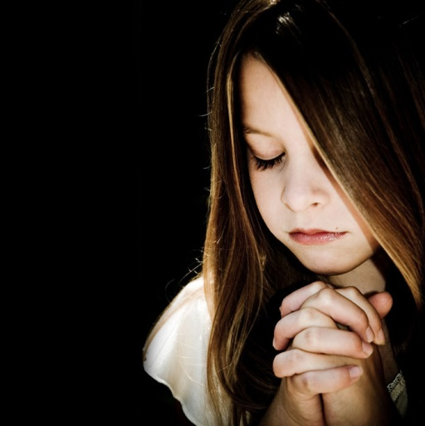
Godliness
Is an attitude of seeking to please the Lord (not other people, including parents, the church)!
For the grace of God that brings salvation has appeared to all men, teaching us that, denying ungodliness and worldly lusts, we should live soberly, righteously, and godly in the present age, (Titus 2:11-12).
Therefore we make it our aim, whether present or absent, to be well pleasing to Him (2 Cor 5:9).
Walk as children of light . . . finding out what is acceptable to the Lord (Eph 5:8-10).
Which is the first commandment of all? Jesus answered him, the first of all the commandments is: Hear, O Israel, the Lord our God, the Lord is one. And you shall love the Lord your God with all your heart, with all your soul, with all your mind, and with all your strength. This is the first commandment (Mk 12:28-30).
“. . . exercise yourself toward godliness” (1 Tim 4:7).
eusebeia
(seb—to have awe at something)
(eu—an abundance)
“awesome respect of God, devoutness, fear, piety”
The awesome respect given to God!!!

Slide 8
Establish and Live by
God’s Standards
Deuteronomy 6:1
Now this is the commandment, and these are the statutes and judgments which the Lord your God has commanded to teach you, that you may observe them in the land which you are crossing over to possess,

Slide 9
Pass it on to the next
generation
Deuteronomy 6:2
that you may fear the Lord your God, to keep all His statutes and His commandments which I command you, you and your son and your grandson, all the days of your life, and that your days may be prolonged.

Slide 10
Be completely convinced
God’s way brings
blessings
Deuteronomy 6:3
Therefore hear, O Israel, and be careful to observe it, that it may be well with you, and that you may multiply greatly as the Lord God of your fathers has promised you—a land flowing with milk and honey.

Slide 11
Have undivided trust in
God despite life’s
difficulties
Deuteronomy 6:4-5
Hear, O Israel: The Lord our God, the Lord is one! You shall love the Lord your God with all your heart, with all your soul, and with all your strength.

Slide 12
Have true passion for
And devotion to
God’s Word
Deuteronomy 6:6
And these words which I command you today shall be in your heart.

Slide 13
Have a commitment to
teach God’s Word to
your children
Deuteronomy 6:7
You shall teach them diligently to your children, and shall talk of them when you sit in your house, when you walk by the way, when you lie down, and when you rise up.

Slide 14
God is always on display
in the home
Deuteronomy 6:8-9
You shall bind them as a sign on your hand, and they shall be as frontlets between your eyes. You shall write them on the doorposts of your house and on your gates.

Slide 15
Raising Children to be Godly, not just “good!”
Make the Word of God the standard for all you do as a family!
Be committed to passing that Word on to the next generation!
Know without doubt that God blesses those who keep His Word!
Have unyielding trust in all that the Word says despite difficulties!
Develop a passion and devotion to reading God’s Word!
Become diligent in teaching God’s Word to your children—daily!
Decorate your home with the righteousness of His Word!

