Slide 2
2 Timothy 4:1-5
¹ I charge you therefore before God and the Lord Jesus Christ, who will judge the living and the dead at His appearing and His kingdom: ² Preach the word! Be ready in season and out of season. Convince, rebuke, exhort, with all longsuffering and teaching. ³ For the time will come when they will not endure sound doctrine, but according to their own desires, because they have itching ears, they will heap up for themselves teachers; ⁴ and they will turn their ears away from the truth, and be turned aside to fables. ⁵ But you be watchful in all things, endure afflictions, do the work of an evangelist, fulfill your ministry.

Slide 4
Hebrews 4:12
For the word of God is living and powerful, and sharper than any two-edged sword, piercing even to the division of soul and spirit, and of joints and marrow, and is a discerner of the thoughts and intents of the heart.
Hebrews 4:12
For the word of God is living and powerful, and sharper than any two-edged sword, piercing even to the division of soul and spirit, and of joints and marrow, and is a discerner of the thoughts and intents of the heart.
Preach the Word

Slide 5
“By the word of the Lord the heavens were made, and all the host of them by the breath of His mouth” (Psalm 33:6).
“For He spoke, and it was done; He commanded, and it stood fast.”
(Psalm 33:9).
“By faith we understand that the worlds were framed by the word of God, so that the things which are seen were not made of things which are visible” (Hebrews 11:3).

Slide 6
“(Jesus) who being the brightness of His glory and the express image of His person, and upholding all things by the word of His power . . .” (Hebrews 1:3).
“For what man knows the things of a man except the spirit of the man which is in him? Even so no one knows the things of God except the Spirit of God . . . These things we also speak, not in words which man’s wisdom teaches but which the Holy Spirit teaches, comparing spiritual things with spiritual” (1 Cor 2:11, 13).

Slide 7
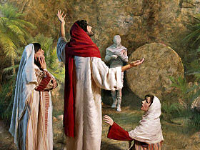
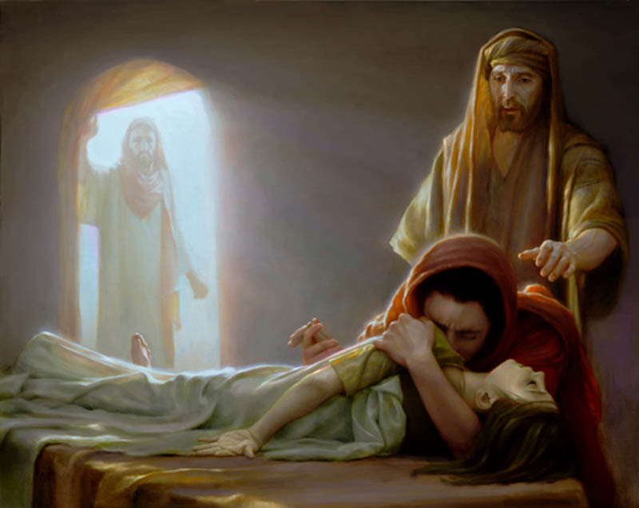
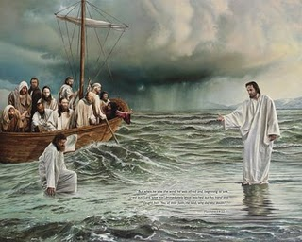
Spoken
Spoken
The Power comes from Him who spoke; whether oral or written (John 9:6-7, 30)
Spoken
Spoken

Slide 8
“For I am not ashamed of the gospel of Christ, for it is the power of God to salvation for everyone who believes, for the Jew first and also for the Greek. For in it the righteousness of God is revealed from faith to faith; as it is written, the just shall live by faith”
(Romans 1:16-17).
Therefore I said to you that you will die in your sins; for if you do not believe that I am He, you will die in your sins (John 8:24).
Unless you repent you will all likewise perish (Luke 13:3).
Therefore whoever confesses Me before men, him I will also confess before My Father who is in heaven (Matthew 10:32).
He who believes and is baptized will be saved; but he who does not believe will be condemned (Mark 16:16).
Therefore lay aside all filthiness and overflow of wickedness, and receive with meekness the implanted word, which is able to save your souls (James 1:21).

