Slide 2
Ezekiel 18:19-24
¹⁹ Yet you say, why should the son not bear the guilt of the father? Because the son has done what is lawful and right, and has kept all My statutes and observed them, he shall surely live. ²⁰ The soul who sins shall die. The son shall not bear the guilt of the father, nor the father bear the guilt of the son. The righteousness of the righteous shall be upon himself, and the wickedness of the wicked shall be upon himself. ²¹ But if a wicked man turns from all his sins which he has committed, keeps all My statutes, and does what is lawful and right, he shall surely live; he shall not die. ²² None of the transgressions which he has committed shall be remembered against him; because of the righteousness which he has done, he shall live. ²³ Do I have any pleasure at all that the wicked should die? says the Lord God, and not that he should turn from his ways and live? ²⁴ But when a righteous man turns away from his righteousness and commits iniquity, and does according to all the abominations that the wicked man does, shall he live? All the righteousness which he has done shall not be remembered; because of the unfaithfulness of which he is guilty and the sin which he has committed, because of them he shall die.

Slide 4
Personal Accountability
But if a man is just and does what is lawful and right . . . He shall surely live (Ezek 18:5, 9).
If he begets a son who is a robber or a shedder of blood . . . He shall surely die (Ezek 18:10, 13).
If, however, he begets a son who sees all the sins which his father has done . . . but does not do likewise . . . He shall surely live (Ezek 18:14, 17).
The soul who sins shall die. The son shall not bear the guilt of the father, nor the father bear the guilt of the son. The righteousness of the righteous shall be upon himself, and the wickedness of the wicked shall be upon himself.
(Ezek 18:20)

Slide 5
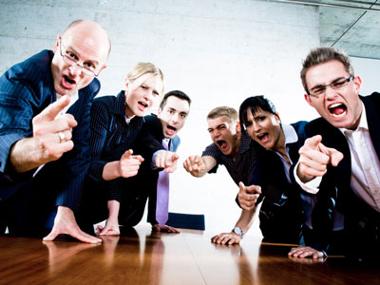
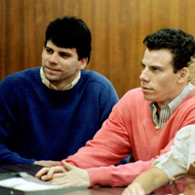
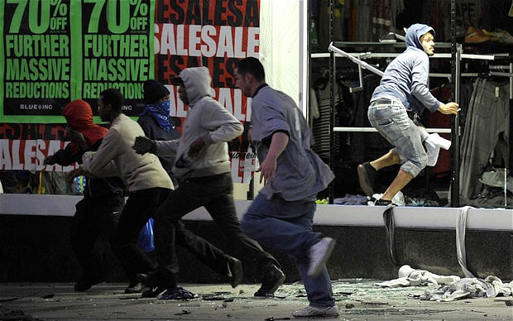
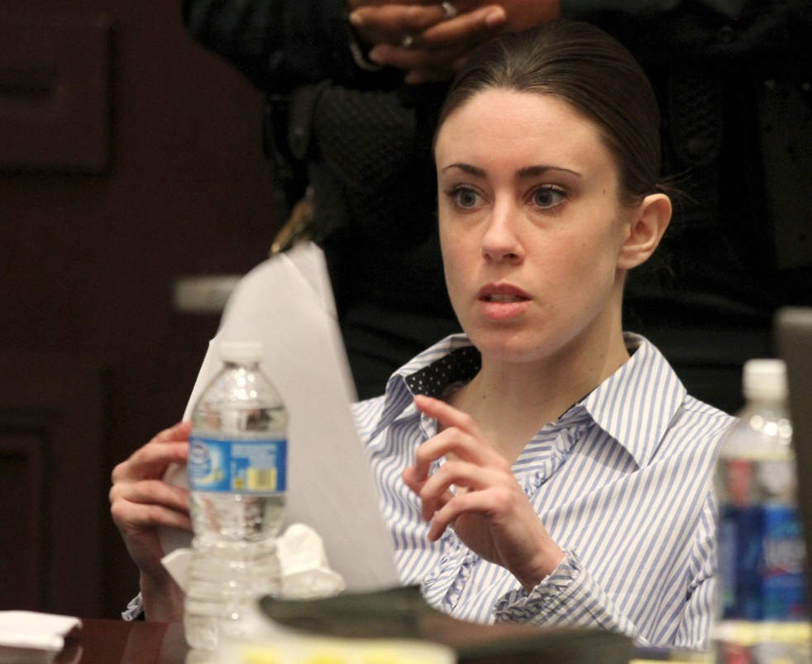
Casey Anthony
Erik & Lyle Menendez
Rioting and Looting
DON’T BLAME ME—IT’S NOT MY FAULT

Slide 6
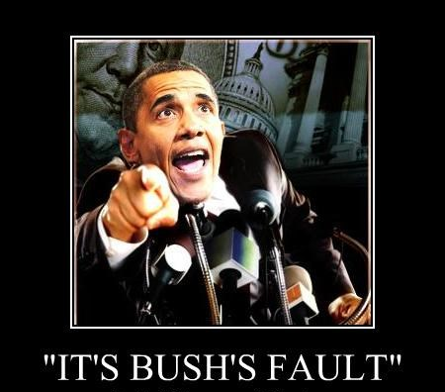
DON’T BLAME ME—IT’S BUSH’S FAULT

Slide 7
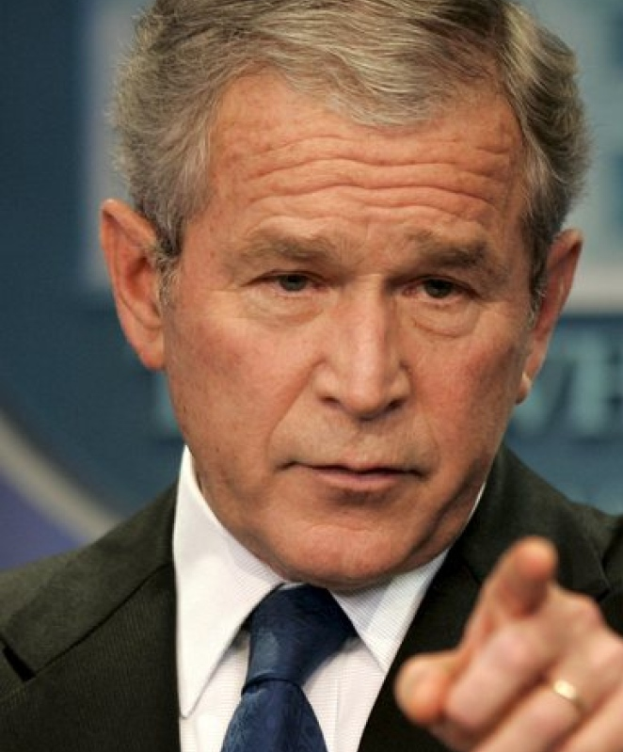
DON’T BLAME ME—IT’S CLINTON’S FAULT

Slide 8
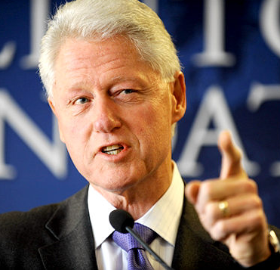
DON’T BLAME ME—IT’S REAGAN’S FAULT

Slide 9
Personal Accountability
Sin/Consequences
Forgiveness
The soul who sins shall die.
(Ezek 18:20)
I am the door. If anyone enters by Me, he will be saved . . .
(John 10:9)
as you have always obeyed . . . work out your own salvation with fear and trembling
(Phil 2:12)
Faithfulness

