Slide 2
Matthew 21:28-32
²⁸ But what do you think? A man had two sons, and he came to the first and said, Son, go, work today in my vineyard. ²⁹ He answered and said, I will not, but afterward he regretted it and went. ³⁰ Then he came to the second and said likewise. And he answered and said, I go, sir, but he did not go. ³¹ Which of the two did the will of his father? They said to Him, the first. Jesus said to them, assuredly, I say to you that tax collectors and harlots enter the kingdom of God before you. ³² For John came to you in the way of righteousness, and you did not believe him; but tax collectors and harlots believed him; and when you saw it, you did not afterward relent and believe him.

Slide 4
A Tale of Two Sons
To both sons:
“Son, go, work today in my vineyard.”

Slide 5
A Tale of Two Sons
One Son:
“I will not.”
. . . but afterward he regretted it and went.

Slide 6
A Tale of Two Sons
One Son:
“I go, sir.”
. . . but he did not go.

Slide 7
A Tale of Two Sons
Jesus’ Penetrating Question:
“Which of the two did the will of his father?”

Slide 8
. . . The baptism of John—where was it from? From heaven or from men? And they reasoned among themselves, saying, if we say, from heaven, He will say to us, why then did you not believe him? But if we say, from men, we fear the multitude, for all count John as a prophet. So they answered Jesus and said, we do not know. And He said to them, neither will I tell you by what authority I do these things. (Matt 21:23-27)
A Tale of Two Sons
Jesus said to them, assuredly, I say to you that tax collectors and harlots enter the kingdom of God before you. For John came to you in the way of righteousness, and you did not believe him; but tax collectors and harlots believed him; and when you saw it, you did not afterward relent and believe him. (Matt 21:31-32)

Slide 9
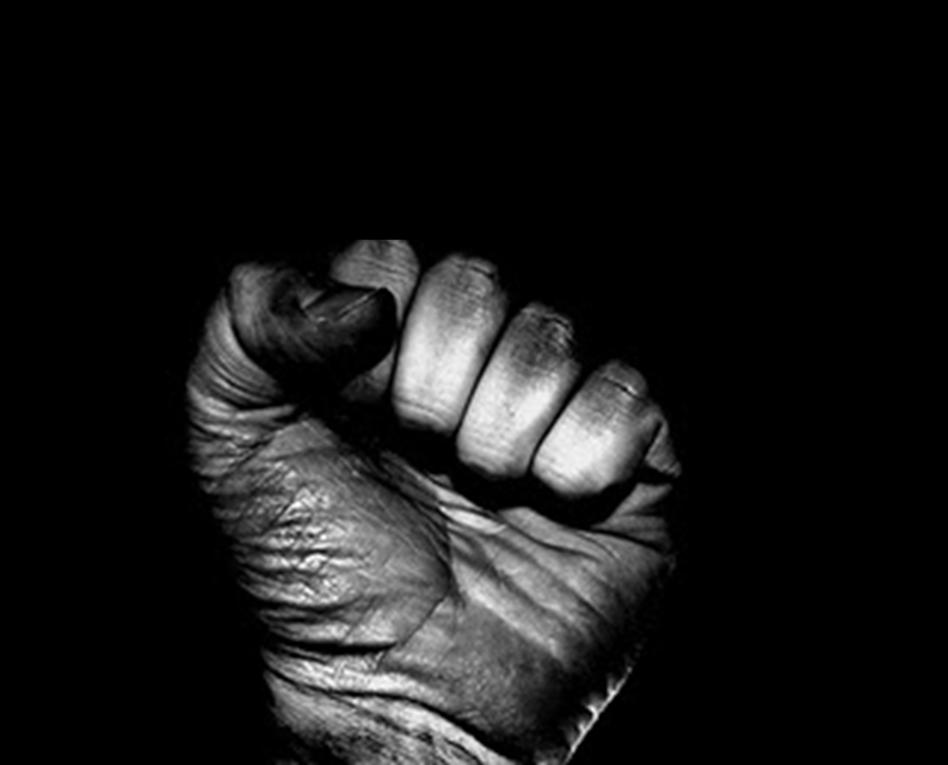
A Tale of Two Sons
. . . but afterward he regretted it and went.
“I will not.”

Slide 10
“I go, sir.”
. . . but he did not go.
. . . to be pure and holy, reflecting Your holiness
. . . to worship You
. . . to grow in Your grace and in Your knowledge
. . . to be Your servant and to serve others

Slide 11
Which of the two did the will of his father?
The rebel who repented?
The pretender who perjured?

