Slide 2
Nehemiah 2:1-5
¹ And it came to pass in the month of Nisan, in the twentieth year of King Artaxerxes, when wine was before him, that I took the wine and gave it to the king. Now I had never been sad in his presence before. ² Therefore the king said to me, why is your face sad, since you are not sick? This is nothing but sorrow of heart. So I became dreadfully afraid, ³ and said to the king, may the king live forever! Why should my face not be sad, when the city, the place of my fathers’ tombs, lies waste, and its gates are burned with fire? ⁴ Then the king said to me, what do you request? So I prayed to the God of heaven. ⁵ And I said to the king, if it pleases the king, and if your servant has found favor in your sight, I ask that you send me to Judah, to the city of my fathers’ tombs, that I may rebuild it.

Slide 4
A Profile in Leadership
From Cupbearer to Governor

Slide 5
Nehemiah 6:15

Slide 6
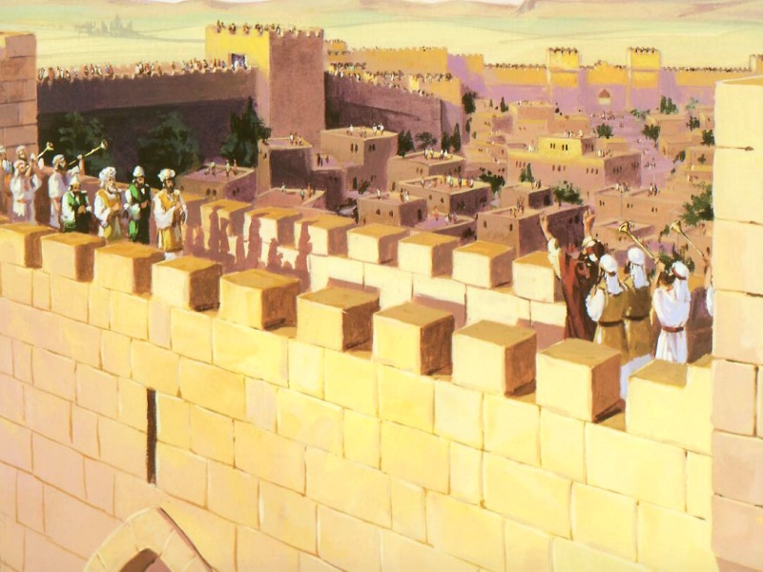
Nehemiah 12:27-43
“Also that day they offered great sacrifices, and rejoiced, for God had made them rejoice with great joy; the women and the children also rejoiced, so that the joy of Jerusalem was heard afar off” (Neh 12:43).

Slide 7
A Leader: Is Burdened about the Conditions (Neh 1:4).
A Leader: Is Devoted to Prayer (Neh 1:4; 2:4; 4:4).
A Leader: Responds to the Need (Neh 1:11; 2:5-6).
A Leader: Sets an Excellent Example (Neh 5:6-13).
A Leader: Endures until the Job is Done (Neh 5:14).
A Leader: Resists all Opposition (Neh 4:1-3).
A Leader: Gives all the Credit/Glory to God (Neh 2:20).
A Profile in Leadership

