Slide 2
Nehemiah 2:17-20
¹⁷ Then I said to them, you see the distress that we are in, how Jerusalem lies waste, and its gates are burned with fire. Come and let us build the wall of Jerusalem, that we may no longer be a reproach. ¹⁸ And I told them of the hand of my God which had been good upon me, and also of the king’s words that he had spoken to me. So they said, let us rise up and build. Then they set their hands to this good work. ¹⁹ But when Sanballat the Horonite, Tobiah the Ammonite official, and Geshem the Arab heard of it, they laughed at us and despised us, and said, what is this thing that you are doing? Will you rebel against the king? ²⁰ So I answered them, and said to them, the God of heaven Himself will prosper us; therefore we His servants will arise and build, but you have no heritage or right or memorial in Jerusalem.

Slide 4
A Profile in Leadership

Slide 5
Not a Prophet
Not a Priest
Not a King
Nehemiah received word of the deplorable condition—1:3
He obtained permission to go to Jerusalem—2:6-9
After arriving in Jerusalem he relaxes for three days—2:11
A Cupbearer for the Persian King Artaxerxes—Neh 1:11

Slide 6
Nehemiah surveyed the pathetic condition of the wall—2:12-18
Nehemiah organized the work force—3:1-32

Slide 7
“So we built the wall, and the entire wall was joined together up to half its height, for the people had a mind to work”
(Neh 4:6).

Slide 8
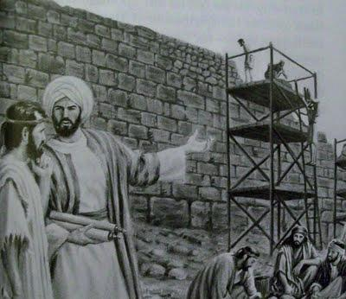
“Whatever they build, if even a fox goes up on it, he will break down their stone wall.”
Enemies from without (Sanballat, Tobiah & others) tried to stop the work:
Ridicule/laughing at—2:19
Mockery—4:1
Attack—4:8
Compromise & Threats—6:1-12
Problems from within (Economic hardships 5:1-13).
Difficulties Surface

Slide 9
“So the wall was finished on the twenty-fifth day of Elul, in fifty-two days. And it happened, when all our enemies heard of it, and all the nations around us saw these things, that they were very disheartened in their own eyes; for they perceived that this work was done by our God” (Neh 6:15-16)

Slide 10
A Leader: Is Burdened about the Conditions (Neh 1:4).
A Leader: Is Devoted to Prayer (Neh 1:4; 2:4; 4:4).
A Leader: Responds to the Need (Neh 1:11; 2:5-6).
A Profile in Leadership

