Slide 2
2 Corinthians 5:12-17
¹² For we do not commend ourselves again to you, but give you opportunity to boast on our behalf, that you may have an answer for those who boast in appearance and not in heart. ¹³ For if we are beside ourselves, it is for God; or if we are of sound mind, it is for you. ¹⁴ For the love of Christ compels us, because we judge thus: that if One died for all, then all died; ¹⁵ and He died for all, that those who live should live no longer for themselves, but for Him who died for them and rose again. ¹⁶ Therefore, from now on, we regard no one according to the flesh. Even though we have known Christ according to the flesh, yet now we know Him thus no longer. ¹⁷ Therefore, if anyone is in Christ, he is a new creation; old things have passed away; behold, all things have become new.

Slide 4
Christian
Jewish Rabbi
Tormentor
Apostle of Christ
⁷ But what things were gain to me, these I have counted loss for Christ. ⁸ Yet indeed I also count all things loss for the excellence of the knowledge of Christ Jesus my Lord, for whom I have suffered the loss of all things, and count them as rubbish, that I may gain Christ ⁹ and be found in Him, not having my own righteousness, which is from the law, but that which is through faith in Christ, the righteousness which is from God by faith; ¹⁰ that I may know Him and the power of His resurrection, and the fellowship of His sufferings, being conformed to His death, ¹¹ if, by any means, I may attain to the resurrection from the dead. (Philippians 3)
⁷ But what things were gain to me, these I have counted loss for Christ. ⁸ Yet indeed I also count all things loss for the excellence of the knowledge of Christ Jesus my Lord, for whom I have suffered the loss of all things, and count them as rubbish, that I may gain Christ ⁹ and be found in Him, not having my own righteousness, which is from the law, but that which is through faith in Christ, the righteousness which is from God by faith; ¹⁰ that I may know Him and the power of His resurrection, and the fellowship of His sufferings, being conformed to His death, ¹¹ if, by any means, I may attain to the resurrection from the dead. (Philippians 3)
MOTIVATION

Slide 5
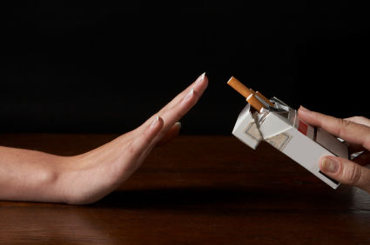
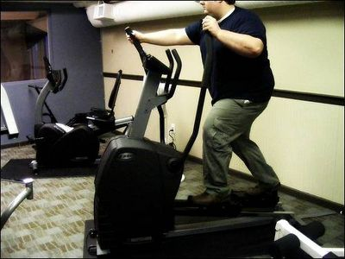
1 a: the act or process of motivating b: the condition of being motivated
2 : a motivating force, stimulus, or influence: incentive, drive
MOTIVATION
As a Believer, what is my Spiritual Motivation?

Slide 6
“For which of you, intending to build a tower, does not sit down first and count the cost, whether he has enough to finish it”
Luke 14:28
“Jesus said to him, if you want to be perfect, go, sell what you have and give to the poor, and you will have treasure in heaven; and come, follow Me.”
Matt 19:23
Challenging
Our
Motivation
Challenging
Our
Motivation
“Then He said to another, follow Me. But he said, Lord, let me first go and bury my father. Jesus said to him, let the dead bury their own dead, but you go and preach the kingdom of God. And another also said, Lord, I will follow You, but let me first go and bid them farewell who are at my house. But Jesus said to him, no one, having put his hand to the plow, and looking back, is fit for the kingdom of God.” (Luke 9:59-62)
Challenging Our Motivation
MOTIVATION
As a Believer, what is my Spiritual Motivation?

Slide 7
How do we motivate believers to:
Worship more fervently?
Become Bible class teachers?
Invite people to Services?
Teach the Lost?
Give more Generously?
Live morally?
MOTIVATION
As a Believer, what is my Spiritual Motivation?

Slide 8
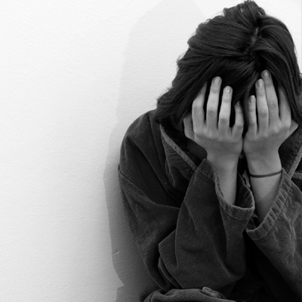
Fear
Matthew 10:28
Luke 3:7
2 Corinthians 5:11
MOTIVATION
As a Believer, what is my Spiritual Motivation?

Slide 9
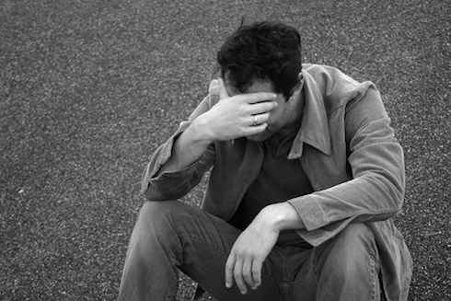
Guilt
1 Timothy 1:13-15
Romans 3:23
Matthew 27:3-5
MOTIVATION
As a Believer, what is my Spiritual Motivation?

Slide 10
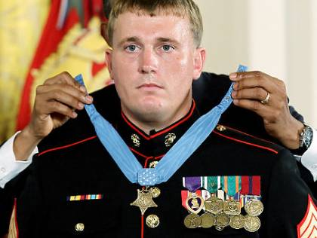
Reward
Matthew 25:34
2 Timothy 4:7-8
John 14:1-3
MOTIVATION
As a Believer, what is my Spiritual Motivation?

Slide 11
Convenience
Philippians 3:7
2 Timothy 2:9
Acts 26:24
2 Timothy 4:6
MOTIVATION
As a Believer, what is my Spiritual Motivation?

Slide 12
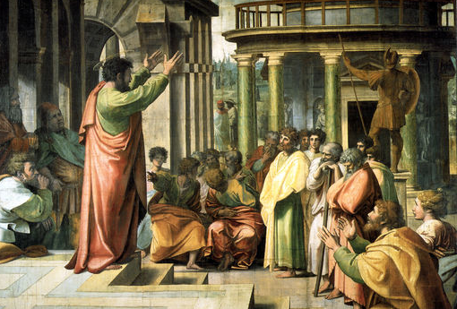
For we do not commend ourselves again to you, but give you opportunity to boast on our behalf, that you may have an answer for those who boast in appearance and not in heart. For if we are beside ourselves, it is for God; or if we are of sound mind, it is for you. For the love of Christ compels us, because we judge thus: that if One died for all, then all died; and He died for all, that those who live should live no longer for themselves, but for Him who died for them and rose again.
2 Corinthians 5:12-15
For we do not commend ourselves again to you, but give you opportunity to boast on our behalf, that you may have an answer for those who boast in appearance and not in heart. For if we are beside ourselves, it is for God; or if we are of sound mind, it is for you. For the love of Christ compels us, because we judge thus: that if One died for all, then all died; and He died for all, that those who live should live no longer for themselves, but for Him who died for them and rose again.
2 Corinthians 5:12-15
MOTIVATION
As a Believer, what is my Spiritual Motivation?

Slide 13
The love of Christ Compels us
But God demonstrates His own love toward us, in that while we were still sinners, Christ died for us (Romans 5:8).
I live by faith in the Son of God, who loved me and gave Himself for me (Galatians 2:20).
And the grace of our Lord was exceedingly abundant, with faith and love which are in Christ Jesus.
(1 Timothy 1:14).
We love Him because He first loved us (1 John 4:19).

Slide 14
Fear w/out Love = Cynicism / Bitterness
Guilt w/out means of Escape = Despondency
Prize Driven Christianity = Loss of Focus
A Convenient Christianity = No Staying Power
“And now abide faith, hope, love, these three; but the greatest of these is love” (1 Cor 13:13).
MOTIVATION
As a Believer, what is my Spiritual Motivation?

