Slide 2
2 Samuel 6:16-23
¹⁶ Now as the ark of the Lord came into the City of David, Michal, Saul’s daughter, looked through a window and saw King David leaping and whirling before the Lord; and she despised him in her heart. ¹⁷ So they brought the ark of the Lord, and set it in its place in the midst of the tabernacle that David had erected for it. Then David offered burnt offerings and peace offerings before the Lord. ¹⁸ And when David had finished offering burnt offerings and peace offerings, he blessed the people in the name of the Lord of hosts. ¹⁹ Then he distributed among all the people, among the whole multitude of Israel, both the women and the men, to everyone a loaf of bread, a piece of meat, and a cake of raisins. So all the people departed, everyone to his house. ²⁰ Then David returned to bless his household. And Michal the daughter of Saul came out to meet David, and said, how glorious was the king of Israel today, uncovering himself today in the eyes of the maids of his servants, as one of the base fellows shamelessly uncovers himself! ²¹ So David said to Michal, it was before the Lord, who chose me instead of your father and all his house, to appoint me ruler over the people of the Lord, over Israel. Therefore I will play music before the Lord. ²² And I will be even more undignified than this, and will be humble in my own sight. But as for the maidservants of whom you have spoken, by them I will be held in honor.
²³ Therefore Michal the daughter of Saul had no children to the day of her death.

Slide 3
chump

Slide 4
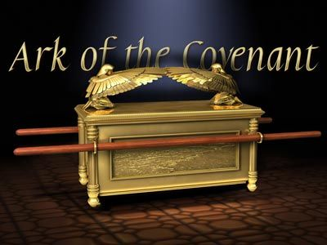
Again David gathered all the choice men of Israel, thirty thousand . . . So they set the ark of God on a new cart, and brought it out of the house of Abinadab . . .
(2 Sam 6:1-3).

Slide 5
And when they came to Nachon’s threshing floor, Uzzah put out his hand to the ark of God and took hold of it, for the oxen stumbled. Then the anger of the Lord was aroused against Uzzah, and God struck him there for his error; and he died there by the ark of God. (2 Sam 6:6-7).

Slide 6
No one may carry the ark of God but the Levites, for the Lord has chosen them to carry the ark of God . . . So the priests and the Levites sanctified themselves to bring up the ark of the Lord God of Israel. And the children of the Levites bore the ark of God on their shoulders, by its poles, as Moses had commanded according to the word of the Lord.
(1 Chron 15:2, 14-15).

Slide 7
Then David danced before the Lord with all his might; and David was wearing a linen ephod. So David and all the house of Israel brought up the ark of the Lord with shouting and with the sound of the trumpet.
(2 Sam 6:14-15).

Slide 8
Michal, Saul’s daughter, looked through a window and saw King David leaping and whirling before the Lord . . . (2 Sam 6:16).

Slide 9
Michal, Saul’s daughter, looked through a window and saw King David leaping and whirling before the Lord; and she despised him in her heart . . . (2 Sam 6:16).
Now Michal, Saul’s daughter, loved David
(1 Sam 18:20.

Slide 10
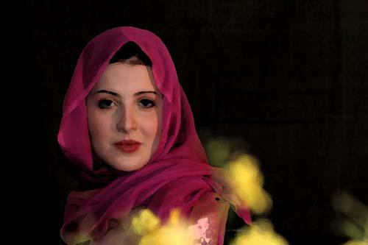
Michal
David was first promised Saul’s daughter Merab (1 Sam 18:17)
Michal loved David (1 Sam 18:20) [David a handsome hero in Israel]
Michal was used (exploited) by her father (1 Sam 18:21)
Instead of a dowry for Michal David was to kill 100 Philistines (1 Sam 18:25-27)
Michal protected David from her father (1 Sam 19:10-16)
David fled and became a fugitive (1 Sam 20:1)
David had time to see Jonathan, but apparently not Michal (1 Sam 20)
David and Michal’s months of separation turned to years
Michal was taken by Saul and given to Patiel as his wife (1 Sam 25:44)
During their separation David married several wives [7 are named] (1 Sam 25:39,43; 2 Sam 3:3-5)
Michal & Patiel settled in to a relationship (perhaps with genuine love)

Slide 11
Michal
Saul and three sons died in battle against Philistines (1 Sam 31)
Now Saul’s son Ishbasheth [Michal’s brother] becomes king (2 Sam 2:8-11)
David reigns as king over Judah [in Hebron for 7 ½ years] (2 Sam 2:11)
Abner, commander of Israel’s army, decides to defect (2 Sam 3:12)
David agrees—with one condition, return Michal (2 Sam 3:14)
Question is WHY? (Most think to “reconcile” the houses of David & Saul)
Michal’s husband Patiel weeps for his wife (2 Sam 3:16)
I don’t know if David ever loved Michal as she once loved him
Michal never had children [Bible does not say this was her punishment]
She did raise her sister’s children (2 Sam 21:8)

Slide 12
Michal, Saul’s daughter, looked through a window and saw King David leaping and whirling before the Lord; and she despised him in her heart . . . (2 Sam 6:16).

Slide 13
Sin: Can Turn Love To Hate
Failing to dwell with them with understanding (1 Peter 3:7)

Slide 14
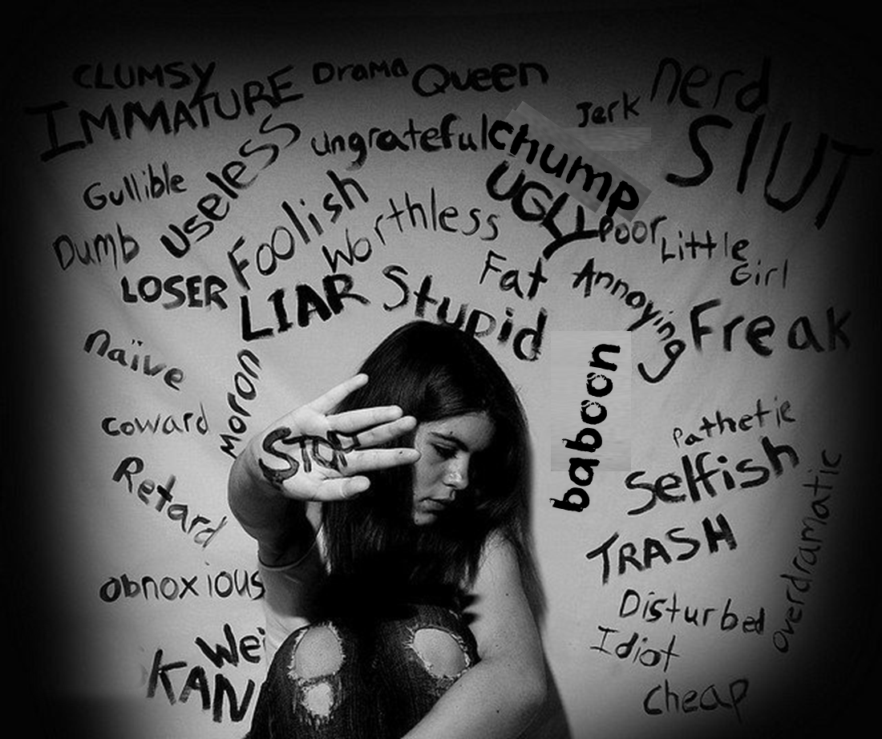
Sin: Can Turn Love To Hate
Verbal, Emotional and Physical Cruelty (Ephesians 4:29-32)

Slide 15
Sin: Can Turn Love To Hate
Misunderstanding one’s marital role (Ephesians 5:22-33)

Slide 16
Sin: Can Turn Love To Hate
Unlawful Desire [Pornography]
(Matthew 5:28; 2 Peter 2:14)

Slide 17
Sin: Can Turn Love To Hate
Phony Christianity [Hypocrisy]
(Matthew 15:8; 2 Peter 2:1)

Slide 18
Sin: Can Turn Love To Hate
Michal, Saul’s daughter, looked through a window and saw King David leaping and whirling before the Lord; and she despised him in her heart . . . (2 Sam 6:16).

