Slide 2
2 Corinthians 12:7-10
⁷ And lest I should be exalted above measure by the abundance of the revelations, a thorn in the flesh was given to me, a messenger of Satan to buffet me, lest I be exalted above measure. ⁸ Concerning this thing I pleaded with the Lord three times that it might depart from me. ⁹ And He said to me, My grace is sufficient for you, for My strength is made perfect in weakness. Therefore most gladly I will rather boast in my infirmities, that the power of Christ may rest upon me. ¹⁰ Therefore I take pleasure in infirmities, in reproaches, in needs, in persecutions, in distresses, for Christ’s sake. For when I am weak, then I am strong.

Slide 4
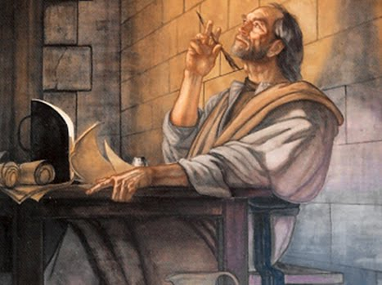
. . . a thorn in the flesh was given to me, a messenger of Satan to buffet me . . .
THORN:
something causing pain, annoyance . . .
PHYSICAL: (chronic malaria, migraine headaches, epilepsy, speech impediment, poor eyesight)
EMOTIONAL: “. . . what comes upon me daily: my deep concern for all the churches” (2 Cor 11:28).
ADVERSARIAL: (persecutions) 2 Cor 11:23-27
DISCOURAGEMENT: (Acts 18:5-6)
MESSENGER of SATAN:
“angel of agony” intending to defeat Paul
Devil is the source of all suffering
Suffering is the passage into the heart of every believer
Any message of the devil is a lie (Jn 8:44)
BUFFET:
Strike, beat, torment (NASB); a continual source of . . .
But if you do not drive out the inhabitants of the land from before you, then it shall be that those whom you let remain shall be irritants in your eyes and thorns in your sides, and they shall harass you in the land where you dwell. (Numbers 33:55)

Slide 5
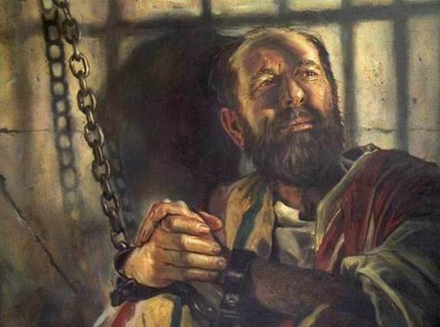
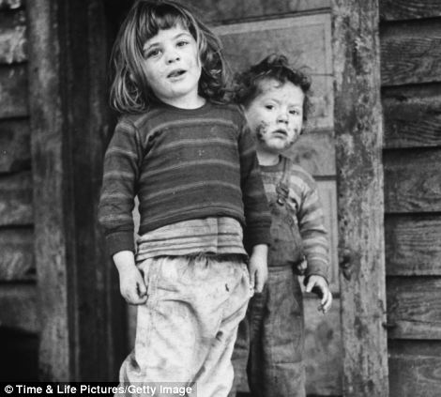
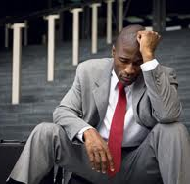
Concerning this thing I pleaded with the Lord three times that it might depart from me. And He said to me, My grace is sufficient for you . . .
Concerning this thing I pleaded with the Lord three times that it might depart from me. And He said to me, My grace is sufficient for you . . .
Broken
Needy
No
Lonely
Desperate

Slide 6
Reject Satan’s Lying Messages
Revive Your Prayer Life
Resist Bitterness
Reestablish Spiritual Relationships
Rely On God

