Slide 2
Galatians 5:22-26
²² But the fruit of the Spirit is love, joy, peace, longsuffering, kindness, goodness, faithfulness, ²³ gentleness, self-control. Against such there is no law. ²⁴ And those who are Christ’s have crucified the flesh with its passions and desires. ²⁵ If we live in the Spirit, let us also walk in the Spirit. ²⁶ Let us not become conceited, provoking one another, envying one another.

Slide 3
22 But the fruit of the Spirit is love, joy, peace, longsuffering, kindness, goodness, faithfulness,
23 gentleness, self-control. Against such there is no law.
24 And those who are Christ's have crucified the flesh with its passions and desires.
25 If we live in the Spirit, let us also walk in the Spirit.
22 But the fruit of the Spirit is love, joy, peace, longsuffering, kindness, goodness, faithfulness,
23 gentleness, self-control. Against such there is no law.
24 And those who are Christ's have crucified the flesh with its passions and desires.
25 If we live in the Spirit, let us also walk in the Spirit.

Slide 4
“And now abide faith, hope, love, these three; but the greatest of these is love.”
(1 Corinthians 13:13)

Slide 5
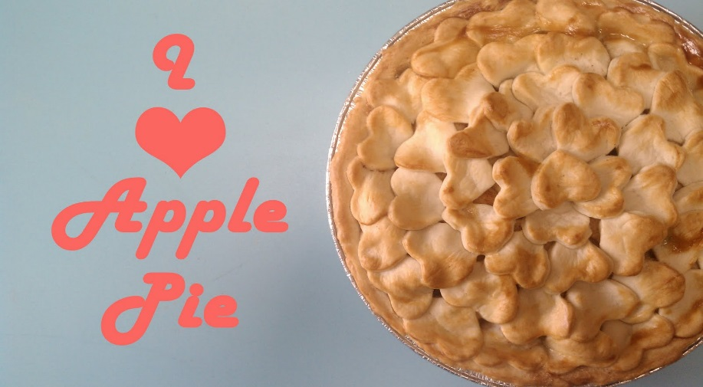
In Language of N.T. four different words translated . . .

Slide 6
EROS (Love between the sexes/genders)

Slide 7
PHILEO (A family kind of love)

Slide 8
STORGE (Parent-Child love)

Slide 9
Commanded Love: Enables us to “love” those for whom we have no affection – it springs from the
will / mind.
This is the love that is the
“Fruit of the Spirit.”
AGAPE (Benevolence, Charity)

Slide 10
A new commandment I give to you, that you love one another; as I have loved you, that you also love one another. By this all will know that you are My disciples, if you have love for one another.
John 13:34-35
I will love the Brotherhood ~ 1 Pet 2:17
I will love those who are Lost ~ Rom 10:1
I will love the weak brother ~ 1 Cor 8:1
I will love my Enemies ~ Matt 5:44
I will love my Neighbor ~ Mk 12:31
I will love each Christian ~ Jn 13:34-35

Slide 11
A new commandment I give to you, that you love one another; as I have loved you, that you also love one another. By this all will know that you are My disciples, if you have love for one another.
John 13:34-35
The Motive for all we do ~ 1 Cor 16:14
The Great Unifier ~ Col 2:2; Col 3:14
Is Sacrificial ~ Jn 13:34; Eph 5:25
Is Incredibly Mercifully ~ Eph 4:32
Environment of Believer ~ Eph 5:1-2

Slide 12
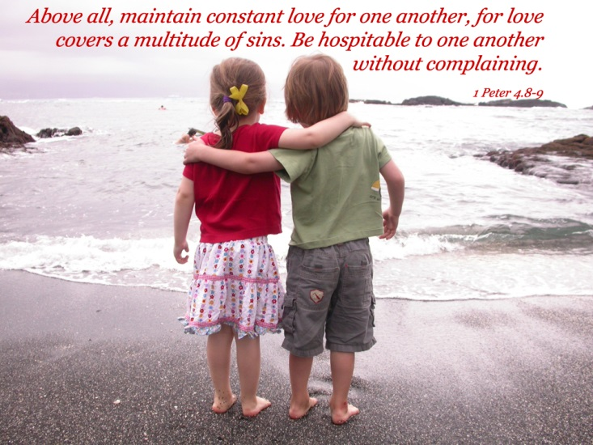
4 Love suffers long (patient) and is kind (to all); love does not envy (Jealous); love does not parade itself (arrogant), is not puffed up (proud; egotistical); 5 does not behave rudely (discourteously), does not seek its own (self-serving), is not provoked (easily angered), thinks no evil (does not keep a record of wrongs); 6 does not rejoice in iniquity (finds no pleasure in sinful things), but rejoices in the truth (of God); 7 bears all things (forgets an injustice done), believes all things (the best), hopes all things (for the best), endures all things (refuses to give up).
8 Love never fails.
1 Corinthians 13

