Slide 2
Ephesians 3:8-13
⁸ To me, who am less than the least of all the saints, this grace was given, that I should preach among the Gentiles the unsearchable riches of Christ, ⁹ and to make all see what is the fellowship of the mystery, which from the beginning of the ages has been hidden in God who created all things through Jesus Christ; ¹⁰ to the intent that now the manifold wisdom of God might be made known by the church to the principalities and powers in the heavenly places, ¹¹ according to the eternal purpose which He accomplished in Christ Jesus our Lord, ¹² in whom we have boldness and access with confidence through faith in Him. ¹³ Therefore I ask that you do not lose heart at my tribulations for you, which is your glory.

Slide 4
For What Purpose Are We Here?

Slide 5
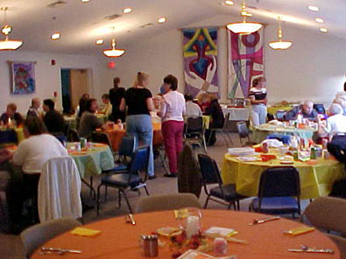
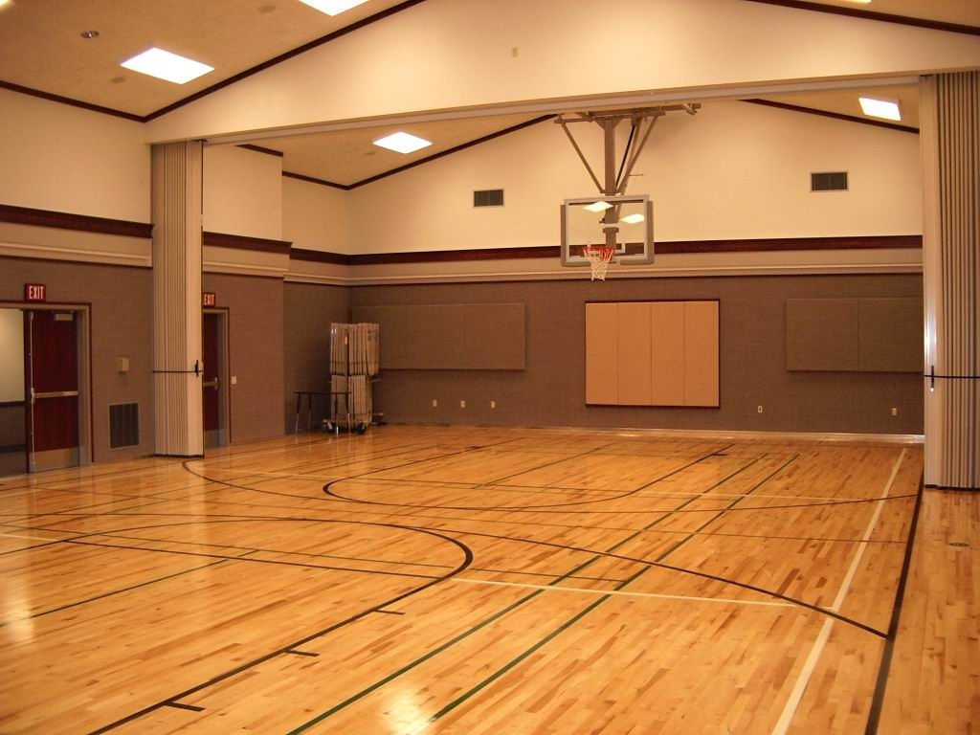
I wonder! Why don’t we have . . .
Danville church of Christ
Danville church of Christ
Danville church of Christ
Danville church of Christ
Serving Hendricks County
Danville church of Christ

Slide 6
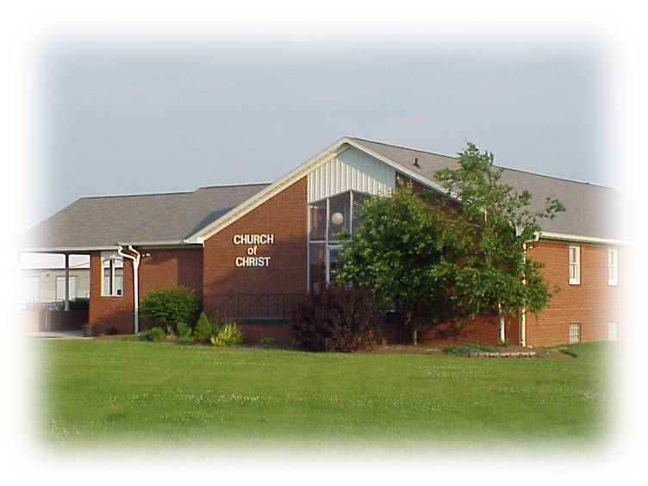
Luke 4:40-43
John 6:15-40
Now when it was day, He departed and went into a deserted place. And the crowd sought Him and came to Him, and tried to keep Him from leaving them; but He said to them, I must preach the kingdom of God to the other cities also, because for this purpose I have been sent. (Lk 4:42-43)
For What Purpose Did The Lord Come?
Matt 18:11
Jesus answered them and said, most assuredly, I say to you, you seek Me, not because you saw the signs, but because you ate of the loaves and were filled. Do not labor for the food which perishes, but for the food which endures to everlasting life, which the Son of Man will give you, because God the Father has set His seal on Him. (John 6:26-27)
Luke 19:10
Mission of the church is Spiritual
Mission of Jesus was Spiritual

Slide 7
Eph 4:11-12
The church’s Work/Mission
Acts 14:27
Equipping the Saints (Bringing Christians to spiritual maturity—Matt 28:20; Heb 5:12-14).
Work of Ministry (Serving/helping the needs of believers—Acts 11:27-30; Rom 15:25-27).
Edifying of the body of Christ (Building up the church/kingdom through preaching the gospel—Acts 2:40, 47; Acts 8:1-4; Matt 28:19; Acts 13:1-4).
Now when they had come and gathered the church together, they reported all that God had done with them, and that He had opened the door of faith to the Gentiles.
And He Himself gave some to be apostles, some prophets, some evangelists, and some pastors and teachers, for the equipping of the saints for the work of ministry, for the edifying of the body of Christ . . .
Mission of the church is Spiritual

Slide 8
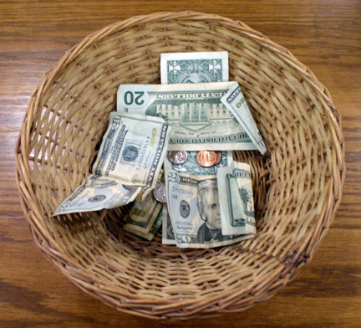
C
H
R
I
S
T
I
A
N
S
Acts 4:34-37
Now concerning the collection for the saints, as I have given orders to the churches of Galatia, so you must do also: On the first day of the week let each one of you lay something aside, storing up as he may prosper, that there be no collections when I come. (1 Cor 16:1-2)
Mission of the church is Spiritual

Slide 9
To Him be glory in the church by Christ Jesus to all generations, forever and ever. Amen.
(Ephesians 3:21)

