Slide 2
1 Corinthians 2:6-13
⁶ However, we speak wisdom among those who are mature, yet not the wisdom of this age, nor of the rulers of this age, who are coming to nothing. ⁷ But we speak the wisdom of God in a mystery, the hidden wisdom which God ordained before the ages for our glory, ⁸ which none of the rulers of this age knew; for had they known, they would not have crucified the Lord of glory. ⁹ But as it is written: Eye has not seen, nor ear heard, nor have entered into the heart of man the things which God has prepared for those who love Him. ¹⁰ But God has revealed them to us through His Spirit. For the Spirit searches all things, yes, the deep things of God. ¹¹ For what man knows the things of a man except the spirit of the man which is in him? Even so no one knows the things of God except the Spirit of God.

Slide 3
1 Corinthians 2:6-13
¹² Now we have received, not the spirit of the world, but the Spirit who is from God, that we might know the things that have been freely given to us by God. ¹³ These things we also speak, not in words which man’s wisdom teaches but which the Holy Spirit teaches, comparing spiritual things with spiritual. ¹⁴ But the natural man does not receive the things of the Spirit of God, for they are foolishness to him; nor can he know them, because they are spiritually discerned. ¹⁵ But he who is spiritual judges all things, yet he himself is rightly judged by no one. ¹⁶ For who has known the mind of the Lord that he may instruct Him? But we have the mind of Christ.

Slide 5
CONTROVERSIES
What About This So-Called:
“Law of Silence”?

Slide 6
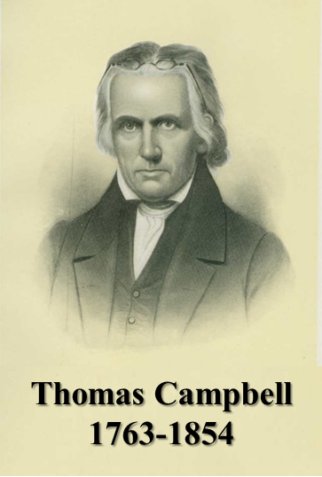
“Where the Scriptures speak, we speak; where the Scriptures are silent, we are silent.”
1 Peter 4:11

Slide 7
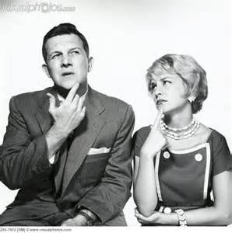
“Within Churches of Christ, the traditional understanding of silence is that it is prohibitive . . . We have conveniently ignored a number of examples that would complicate our simplistic approach . . . I have no personal problems with trying to adhere, however inconsistently, to our ‘Law of Silence’ concept. But when we condemn other people to eternal damnation for not following it, I fear we are ‘teaching for doctrine the commandments of men.’”
Silence of Scripture
“This is ultimately a discussion immersed in legalism, I believe. God gave us both his word and our brains. I think he expects us to use both, and not necessarily to wind up with the same conclusions. Think and go, God will bless us.”
“I’m back to think and go. We have God’s Word and we have brains, God expects us to use both. If you look at some examples in the biblical narrative then you’ll begin to see that ‘think and go’ is pretty much normative for God's people. God will bless us, I believe. He's surely blessed me, even though I don’t have specific word for most of what I do.”

Slide 8
It could communicate approval.
It could communicate disapproval.
It could mean nothing at all.
Silence: “Making no Utterance”
“The Absence of information”

Slide 9
And truly Jesus did many other signs in the presence of His disciples, which are not written in this book; but these are written that you may believe that Jesus is the Christ, the Son of God, and that believing you may have life in His name, (John 20:30-31).
And there are also many other things that Jesus did, which if they were written one by one, I suppose that even the world itself could not contain the books that would be written, (John 21:25).
Unknown because they are unrevealed (1 Cor 2:10-13)

Slide 10
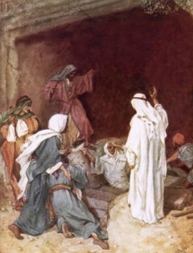
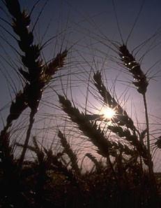
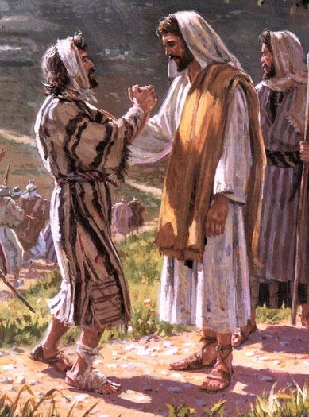
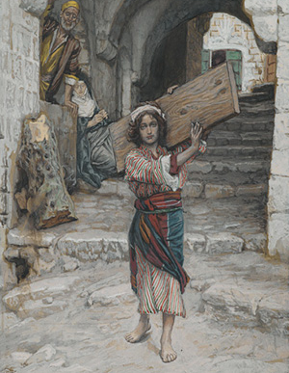
Did some of these unrecorded miracles include . . .
Numbers 22:18
1 Cor 4:2
Deut 4:2
Raise rich young man from the dead?
Make birds of clay and brought them to life?
Resurrected his dead playmate Zeno?
Healed a woodcutter’s injured foot?
Harvested 100 bushels of wheat from a single seed?
Stretched a board that was too short for carpentry?
Healed James’ viper bite?
“Now these things, brethren, I have figuratively transferred to myself and Apollos for your sakes, that you may learn in us not to think beyond what is written . . .”
“You shall not add to the word which I command you, nor take from it, that you may keep the commandments of the Lord your God which I command you.”
“Though Balak were to give me his house full of silver and gold, I could not go beyond the word of the Lord my God, to do less or more.”
The law of the LORD is perfect converting the soul . . .
The testimony of the LORD is sure . . .
The statutes of the LORD are right . . .
The commandment of the LORD is pure . . .
The judgments of the LORD are true . . .
By them Your servant is warned . . .
And in keeping them there is great reward.
(Psalm 19:7-11)
Keep back Your servant also from presumptuous sins; let them not have dominion over me. Then I shall be blameless, and I shall be innocent of great transgression.”
(Psalm 19:13)
Prov 30:5-6
2 John 9-10
Deut 12:32
“Every word of God is pure; He is a shield to those who put their trust in Him. Do not add to His words, lest He rebuke you, and you be found a liar.”
“Whoever transgresses and does not abide in the doctrine of Christ does not have God. He who abides in the doctrine of Christ has both the Father and the Son. If anyone comes to you and does not bring this doctrine, do not receive him into your house nor greet him,”
“Whatever I command you, be careful to observe it; you shall not add to it nor take away from it.”

Slide 11
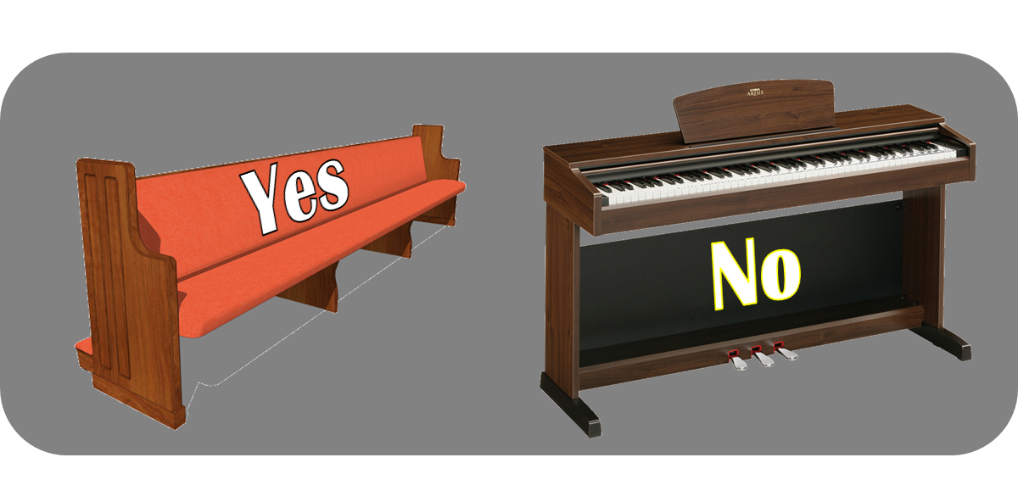
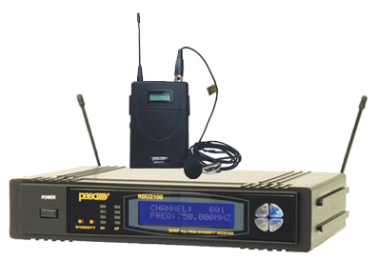
Why does silence permit a pew
but prohibit a piano?
“If this so-called ‘law of silence’ were to be followed ‘religiously,’ then our PA systems, PowerPoint usage, song books, and other things which we commonly use in worship would all be outlawed. It really is time to apply some common sense to this ‘law,’ and the way it is applied by so many . . .”

Slide 12
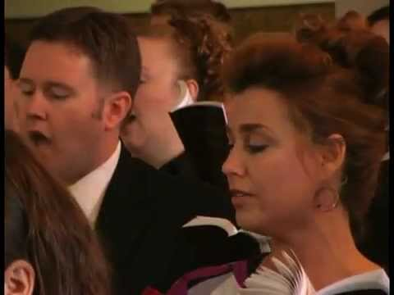
Silence does not authorize,
only Revelation authorizes.
Do you respect
revelation?
“Speaking to one another in psalms and hymns and spiritual songs, singing and making melody in your heart to the Lord” (Ephesians 5:29).
God is NOT Silent!

Slide 13
Silence does not authorize,
only Revelation authorizes.
Do you respect
revelation?
“Then Peter said to them, repent, and let every one of you be baptized in the name of Jesus Christ for the remission of sins; and you shall receive the gift of the Holy Spirit.” (Acts 2:38).
God is NOT Silent!

Slide 14
Silence does not authorize,
only Revelation authorizes.
Do you respect
revelation?
“Now concerning the collection for the saints, as I have given orders to the churches of Galatia, so you must do also: On the first day of the week let each one of you lay something aside, storing up as he may prosper . . .”
(1 Corinthians 16:1-2).
God is NOT Silent!

Slide 15
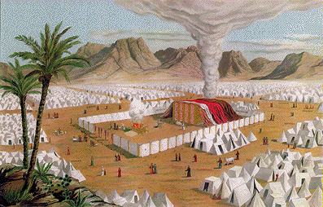
God, David & Silence
¹ Now it came to pass when the king was dwelling in his house, and the Lord had given him rest from all his enemies all around, ² that the king said to Nathan the prophet, see now, I dwell in a house of cedar, but the ark of God dwells inside tent curtains. ³ Then Nathan said to the king, go, do all that is in your heart, for the Lord is with you. ⁴ But it happened that night that the word of the Lord came to Nathan, saying, ⁵ go and tell My servant David, thus says the Lord: Would you build a house for Me to dwell in? ⁶ For I have not dwelt in a house since the time that I brought the children of Israel up from Egypt, even to this
¹ Now it came to pass when the king was dwelling in his house, and the Lord had given him rest from all his enemies all around, ² that the king said to Nathan the prophet, see now, I dwell in a house of cedar, but the ark of God dwells inside tent curtains. ³ Then Nathan said to the king, go, do all that is in your heart, for the Lord is with you. ⁴ But it happened that night that the word of the Lord came to Nathan, saying, ⁵ go and tell My servant David, thus says the Lord: Would you build a house for Me to dwell in? ⁶ For I have not dwelt in a house since the time that I brought the children of Israel up from Egypt, even to this
Silence does not authorize,
only Revelation authorizes.
day, but have moved about in a tent and in a tabernacle. ⁷ Wherever I have moved about with all the children of Israel, have I ever spoken a word to anyone from the tribes of Israel, whom I commanded to shepherd My people Israel, saying, why have you not built Me a house of cedar?
day, but have moved about in a tent and in a tabernacle. ⁷ Wherever I have moved about with all the children of Israel, have I ever spoken a word to anyone from the tribes of Israel, whom I commanded to shepherd My people Israel, saying, why have you not built Me a house of cedar?
2 Samuel 7:1-7

Slide 16
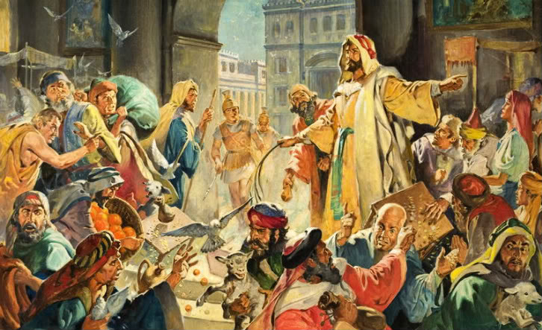
Jesus, money changers & Silence
¹⁵ So they came to Jerusalem. Then Jesus went into the temple and began to drive out those who bought and sold in the temple, and overturned the tables of the money changers and the seats of those who sold doves. ¹⁶ And He would not allow anyone to carry wares through the temple. ¹⁷ Then He taught, saying to them, is it not written, My house shall be called a house of prayer for all nations? But you have made it a den of thieves.
Silence does not authorize,
only Revelation authorizes.
Even them I will bring to My holy mountain, and make them joyful in My house of prayer. (Isaiah 56:7)
Has this house, which is called by My name, become a den of thieves in your eyes? (Jeremiah 7:11)
Mark 11:15-17

Slide 17
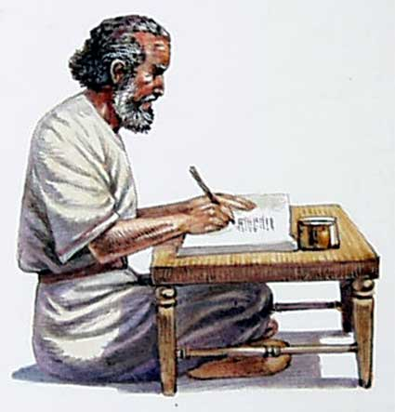
James, Gentiles & Silence
¹ And certain men came down from Judea and taught the brethren, unless you are circumcised according to the custom of Moses, you cannot be saved.
⁶ Now the apostles and elders came together to consider this matter.
Silence does not authorize,
only Revelation authorizes.
They wrote this letter by them: The apostles, the elders, and the brethren, to the brethren who are of the Gentiles in Antioch, Syria, and Cilicia: Greetings. Since we have heard that some who went out from us have troubled you with words, unsettling your souls, saying, you must be circumcised and keep the law—to whom we gave no such commandment—
(Acts 15:23-24)
Acts 15:1, 6

Slide 18
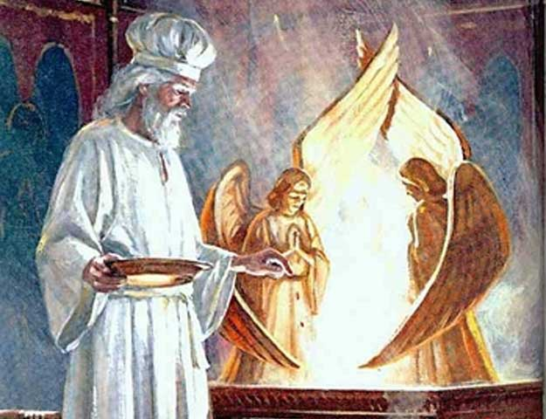
Jesus, Priesthood & Silence
¹¹ Therefore, if perfection were through the Levitical priesthood (for under it the people received the law), what further need was there that another priest should rise according to the order of Melchizedek, and not be called according to the order of Aaron? ¹² For the priesthood being changed, of necessity there is also a change of the law. ¹³ For He of whom these things are spoken belongs to another tribe, from which no man has officiated at the altar. ¹⁴ For it is evident that our Lord arose from Judah, of which tribe Moses spoke nothing concerning priesthood.
Silence does not authorize,
only Revelation authorizes.
Numbers 1:50-51
Numbers 3:6-10
Numbers 16:1-17:13
Numbers 18:1-7 (⁶ Behold, I Myself have taken your brethren the Levites from among the children of Israel; they are a gift to you, given by the Lord, to do the work of the tabernacle of meeting)
Heb 7:11-14

Slide 19
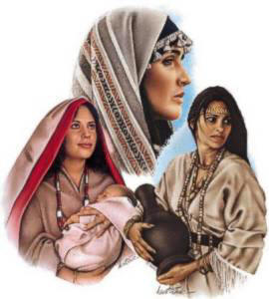
But didn’t Silence Authorize
³ Or if a woman makes a vow to the Lord, and binds herself by some agreement while in her father’s house in her youth, ⁴ and her father hears her vow and the agreement by which she has bound herself, and her father holds his peace, then all her vows shall stand, and every agreement with which she has bound herself shall stand.
⁶ If indeed she takes a husband, while bound by her vows or by a rash utterance from her lips by which she bound herself, ⁷ and her husband hears it, and makes no response to her on the day that he hears, then her vows shall stand, and her agreements by which she bound herself shall stand.
God was NOT silent
Numbers 30:3-7

Slide 20
The revealed Word of God serves as our boundary (Rev 22:18-19; 2 Jn 9)
Acting on Silence=Acting on Ignorance (1 Cor 2:12)
Acting on Silence=Seeking Our Own Will (Matt 6:10)
Acting on Silence=Legalism (establishing our own righteousness, Rom 10:3)
Now these things, brethren, I have figuratively transferred to myself and Apollos for your sakes, that you may learn in us not to think beyond what is written
(1 Corinthians 4:6).

