Slide 2
Jonah 4:5-11
⁵ So Jonah went out of the city and sat on the east side of the city. There he made himself a shelter and sat under it in the shade, till he might see what would become of the city. ⁶ And the Lord God prepared a plant and made it come up over Jonah, that it might be shade for his head to deliver him from his misery. So Jonah was very grateful for the plant. ⁷ But as morning dawned the next day God prepared a worm, and it so damaged the plant that it withered. ⁸ And it happened, when the sun arose, that God prepared a vehement east wind; and the sun beat on Jonah’s head, so that he grew faint. Then he wished death for himself, and said, it is better for me to die than to live. ⁹ Then God said to Jonah, is it right for you to be angry about the plant? And he said, it is right for me to be angry, even to death! ¹⁰ But the Lord said, you have had pity on the plant for which you have not labored, nor made it grow, which came up in a night and perished in a night. ¹¹ And should I not pity Nineveh, that great city, in which are more than one hundred and twenty thousand persons who cannot discern between their right hand and their left—and much livestock?

Slide 4
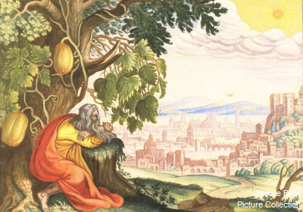
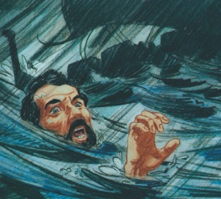
Now the word of the Lord came to Jonah the son of Amittai, saying, arise, go to Nineveh, that great city, and cry out against it; for their wickedness has come up before Me. But Jonah arose to flee to Tarshish from the presence of the Lord. He went down to Joppa, and found a ship going to Tarshish; so he paid the fare, and went down into it, to go with them to Tarshish from the presence of the Lord. (Jonah 1:1-3)
But the Lord sent out a great wind on the sea, and there was a mighty tempest on the sea, so that the ship was about to be broken up. . . And he said to them, pick me up and throw me into the sea; then the sea will become calm for you. For I know that this great tempest is because of me . . . So they picked up Jonah and threw him into the sea . . . (Jonah 1:5-15)

Slide 5
So the Lord spoke to the fish, and it vomited Jonah onto dry land. (Jonah 2:10)
Now the word of the Lord came to Jonah the second time, saying, arise, go to Nineveh, that great city, and preach to it the message that I tell you. So Jonah arose and went to Nineveh, according to the word of the Lord . . . Then he cried out and said, yet forty days, and Nineveh shall be overthrown! So the people of Nineveh believed God, proclaimed a fast, and put on sackcloth, from the greatest to the least of them . . . Then God saw their works, that they turned from their evil way; and God relented from the disaster that He had said He would bring upon them, and He did not do it.
(Jonah 3:1-10)
Thousands of people were spared because of their repentance and God’s grace (Jonah 4:11).

Slide 6
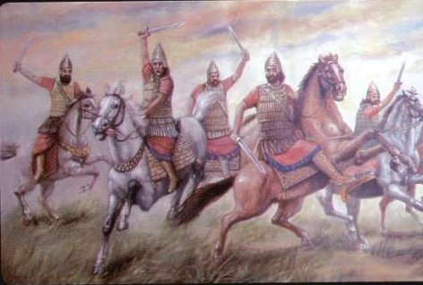
Was He Afraid?
An ancient monument discovered in the ruins of ancient Assyria has this inscription by King Ashurnasirpal II (reign began in 883 BC.) of a conquered city:
"Their men, young and old, I took as prisoners. Of some I cut off the feet and hands; of others I cut off the noses, ears, and lips; of the young men's ears I made a heap; of the old men's heads I built a minaret."
Why does Jonah Run Away?

Slide 7
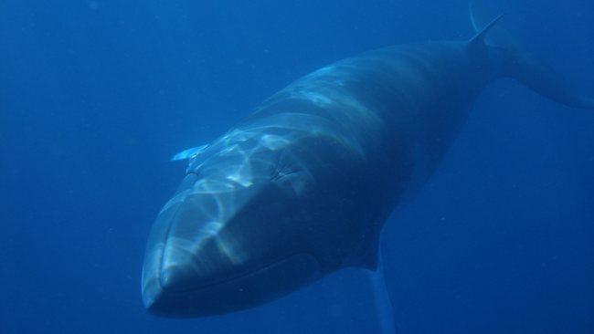
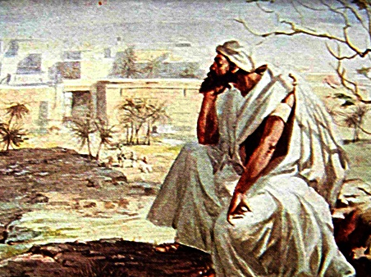
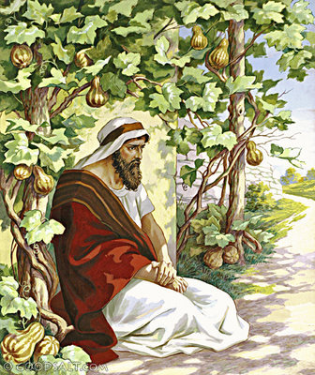
Lord have mercy on me
Jonah 2:1-10
Jonah resented God’s Mercy
Jonah 4:1-5
Jonah Loved the shading vine
Jonah 4:6
Jonah wanted the vine to live
Jonah 4:7-10

Slide 8
If I am “Indifferent” to the Lost
If I am more Concerned for Things
If my interest is social not spiritual
If I pick recreation over evangelism
If I Feed my prejudices

