Slide 2
Habakkuk 3:16-19
¹⁶ When I heard, my body trembled; my lips quivered at the voice; rottenness entered my bones; and I trembled in myself, that I might rest in the day of trouble. When he comes up to the people, He will invade them with his troops. ¹⁷ Though the fig tree may not blossom, nor fruit be on the vines; Though the labor of the olive may fail, and the fields yield no food; Though the flock may be cut off from the fold, and there be no herd in the stalls—¹⁸ Yet I will rejoice in the Lord, I will joy in the God of my salvation. ¹⁹ The Lord God is my strength; He will make my feet like deer’s feet, and He will make me walk on my high hills.

Slide 4
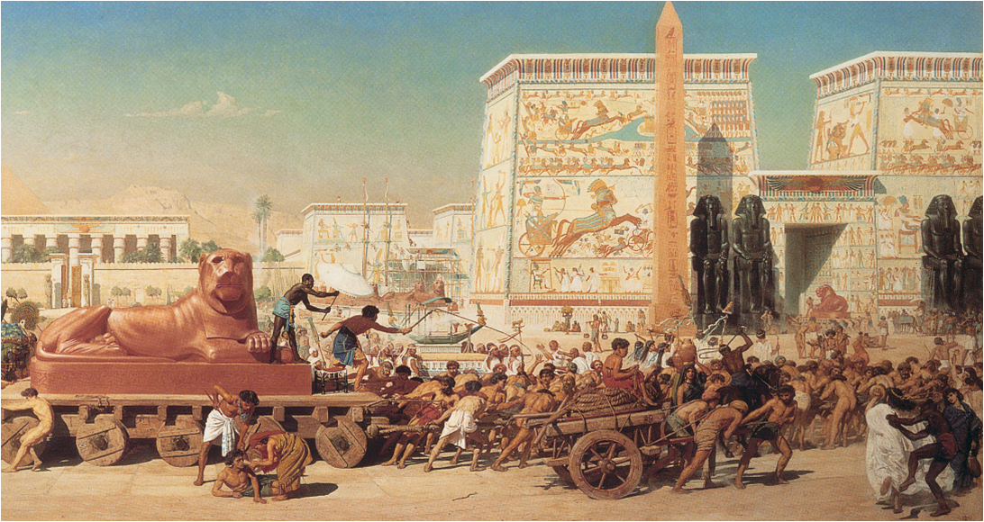
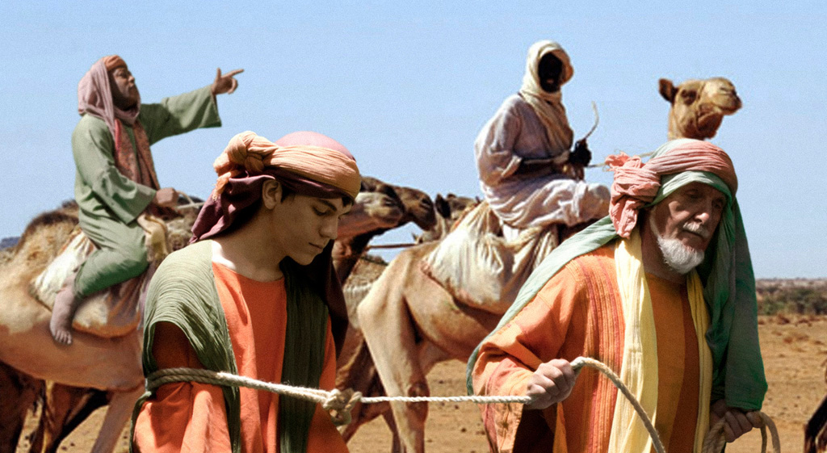
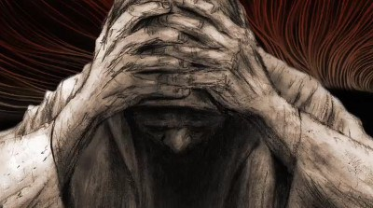
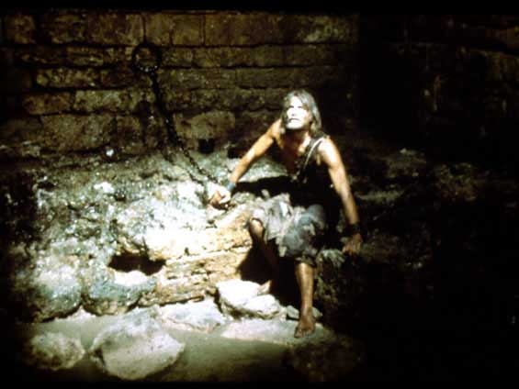
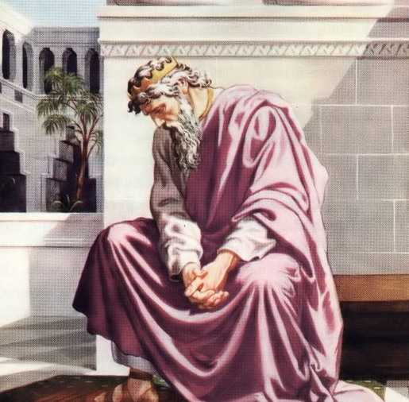
Exodus 5:21-22
Genesis 50:20
Psalms 13:1-2
Matthew 11:3
Job 23:2-9
Lord, This Doesn’t Make Sense!

Slide 5
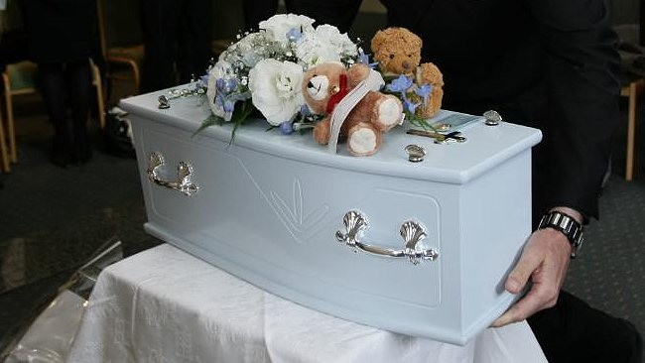
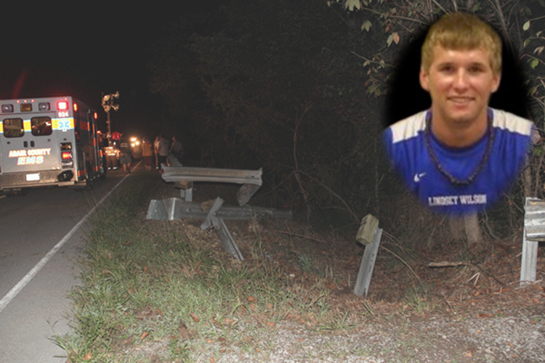
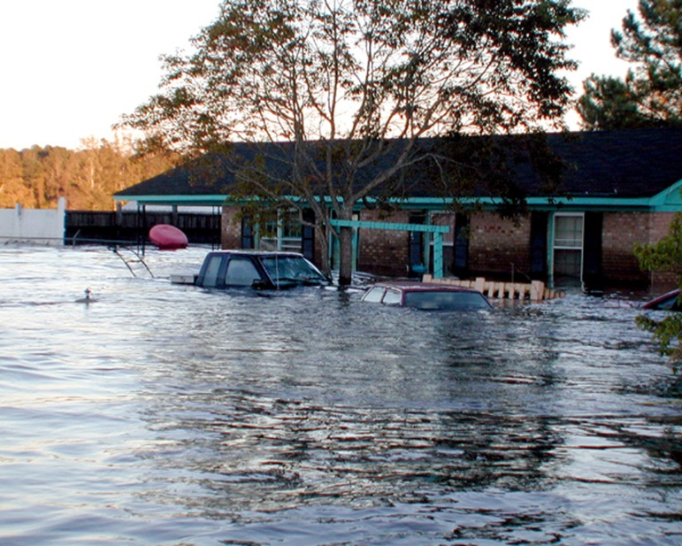
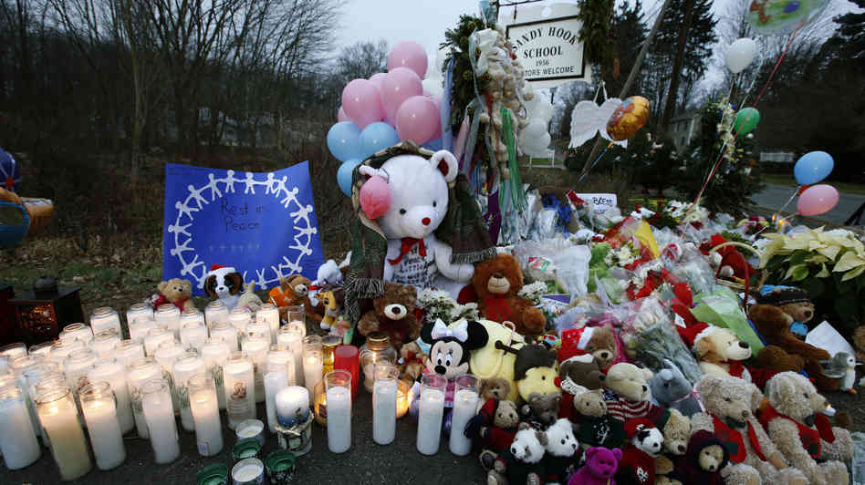
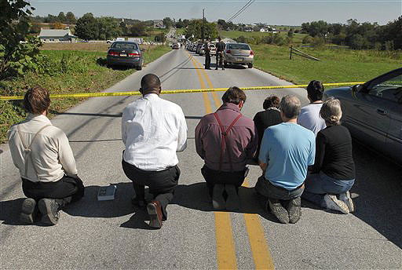
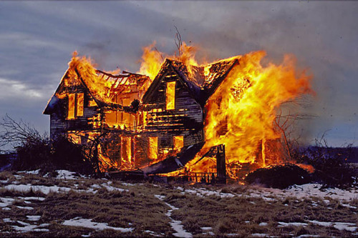
It Doesn’t Make Sense

Slide 6
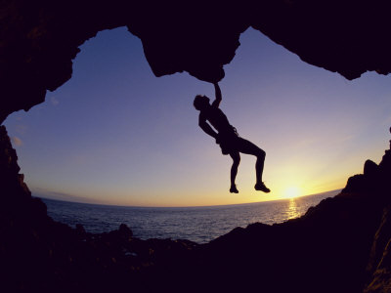
But the just shall live by his faith. (Hab 2:4)
Faith is trusting God when life doesn’t make sense!
Prov 3:5 ~ Trust in the Lord with all your heart, and lean not on your own understanding;
Psa 37:40 ~ And the Lord shall help them and deliver them; He shall deliver them from the wicked, and save them, because they trust in Him.
Phil 4:6-7 ~ Be anxious for nothing, but in everything by prayer and supplication, with thanksgiving, let your requests be made known to God; and the peace of God, which surpasses . . .

Slide 7
Though the fig tree may not blossom, nor fruit be on the vines; Though the labor of the olive may fail, and the fields yield no food; Though the flock may be cut off from the fold, and there be no herd in the stalls—yet I will rejoice in the Lord, I will joy in the God of my salvation. The Lord God is my strength; He will make my feet like deer’s feet, and He will make me walk on my high hills.
(Habakkuk 3:17-19)

