Slide 2
Judges 17:1-6
¹ Now there was a man from the mountains of Ephraim, whose name was Micah. ² And he said to his mother, the eleven hundred shekels of silver that were taken from you, and on which you put a curse, even saying it in my ears—here is the silver with me; I took it. And his mother said, may you be blessed by the Lord, my son! ³ So when he had returned the eleven hundred shekels of silver to his mother, his mother said, I had wholly dedicated the silver from my hand to the Lord for my son, to make a carved image and a molded image; now therefore, I will return it to you. ⁴ Thus he returned the silver to his mother. Then his mother took two hundred shekels of silver and gave them to the silversmith, and he made it into a carved image and a molded image; and they were in the house of Micah. ⁵ The man Micah had a shrine, and made an ephod and household idols; and he consecrated one of his sons, who became his priest. ⁶ In those days there was no king in Israel; everyone did what was right in his own eyes.

Slide 4
How do you Feel about . . .
Those who have never heard about Jesus—will they be lost or saved?
Same-sex marriage between two very loving & committed men (women)?
Divorce when a couple is so hateful and unhappy, and the kids are miserable. Should they stay together?
Sex outside of marriage (adultery, or between two loving, devoted people)?
Drinking alcoholic beverages moderately (an infrequent beer, or cocktail)?
The occasional use of social drugs such as marijuana, opiate drugs (Oxycontin, Percocet)?
Obtaining an abortion when the pregnancy occurred as a result of rape?
Suicide because one is suffering a painful and terminal illness?

Slide 5
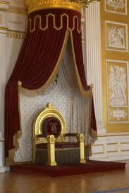
Judges 17:6, In those days there was no king in Israel; everyone did what was right in his own eyes.
Judges 21:25, In those days there was no king in Israel; everyone did what was right in his own eyes.
Everyone did what he/she felt like doing.
Micah & his mother formed idols and he appointed his son as priest (Judges 17).
The Danites adopted Micah’s idolatry (Judges 18).
Fornication (homosexuality, heterosexuality) the order of the day (Judges 19).
Self-Governance will never work
Proverbs 14:12
Jeremiah 10:23

Slide 6
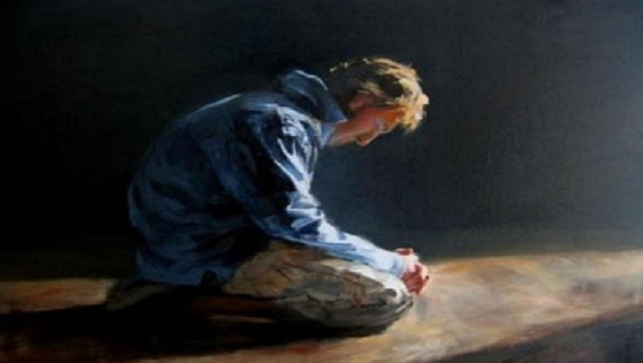
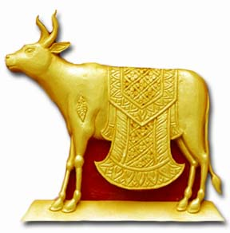
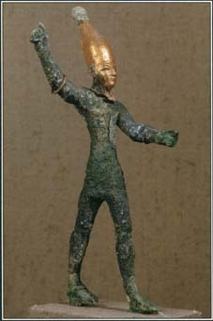
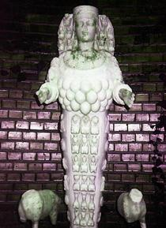
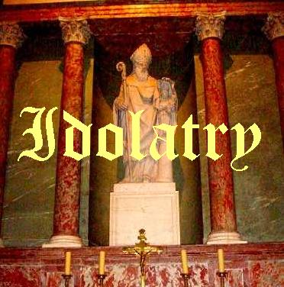
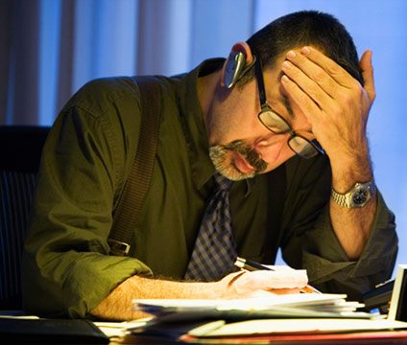
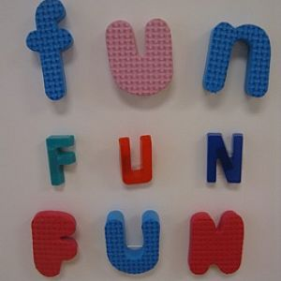
Little children, keep yourselves from idols. Amen. (1 John 5:21).
1 Kings 12:28
Colossians 3:5
1 Kings 18:19
Acts 19:34
Catholicism

Slide 7
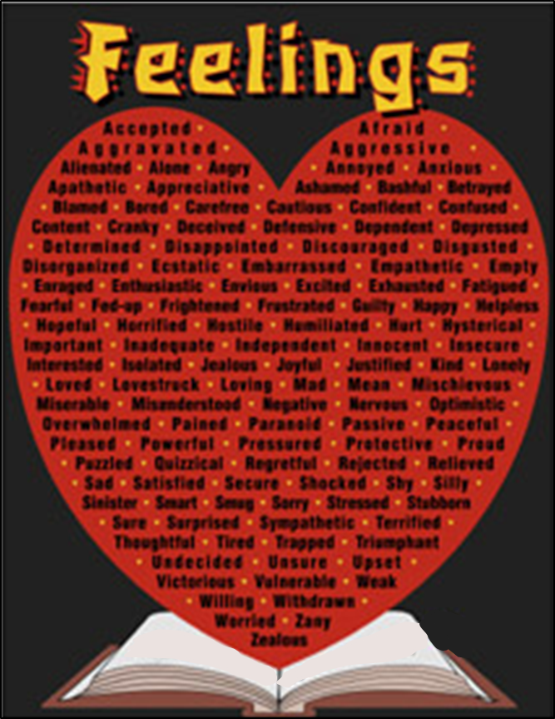
This is:
Ethics Neutral
Moral Relativism
Making a god out of our emotions
This rejects any standard of authority (absolutes).
“Truth” is what gratifies our feelings (emotions).
No one can refute how we “feel.”
This elevates anyone’s “values” to be equal with everyone’s.
Idol

Slide 8
“There is one thing a professor can be absolutely certain of, almost every student entering the university believes, or says he believes, that truth is relative . . . The students, of course, cannot defend their opinion. It is something with which they have been indoctrinated.”
“I don’t feel that I’m doing anything wrong.”
Sexting
Living with boyfriend

Slide 9
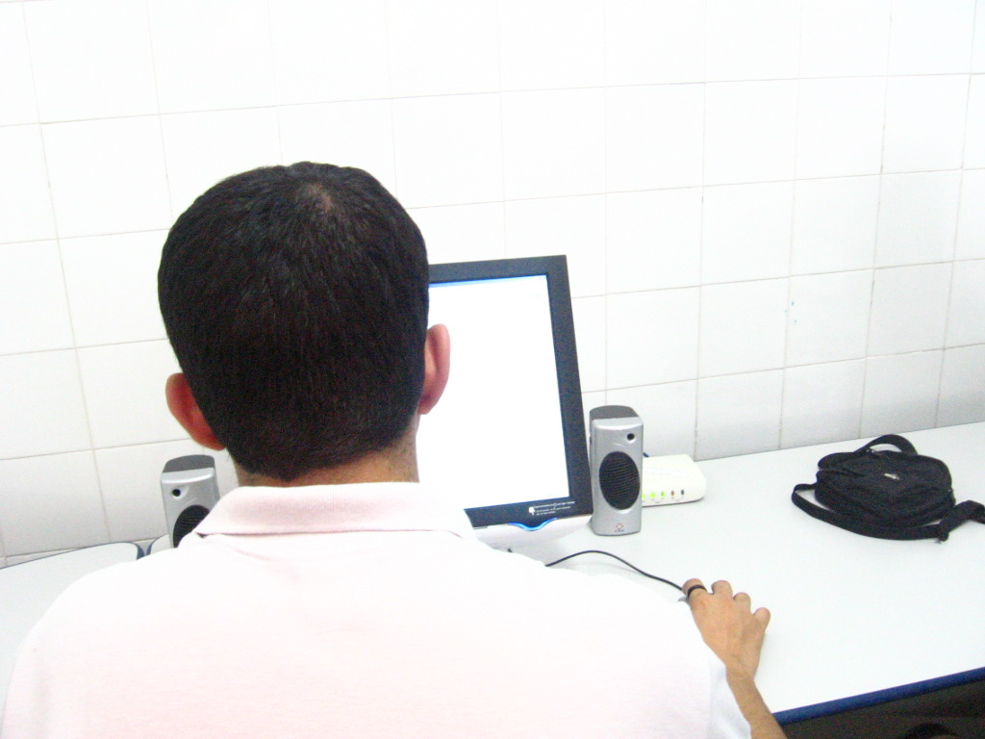
“I don’t feel that I’m doing anything wrong.”
Viewing Pornography
Pilfering from Employer

Slide 10
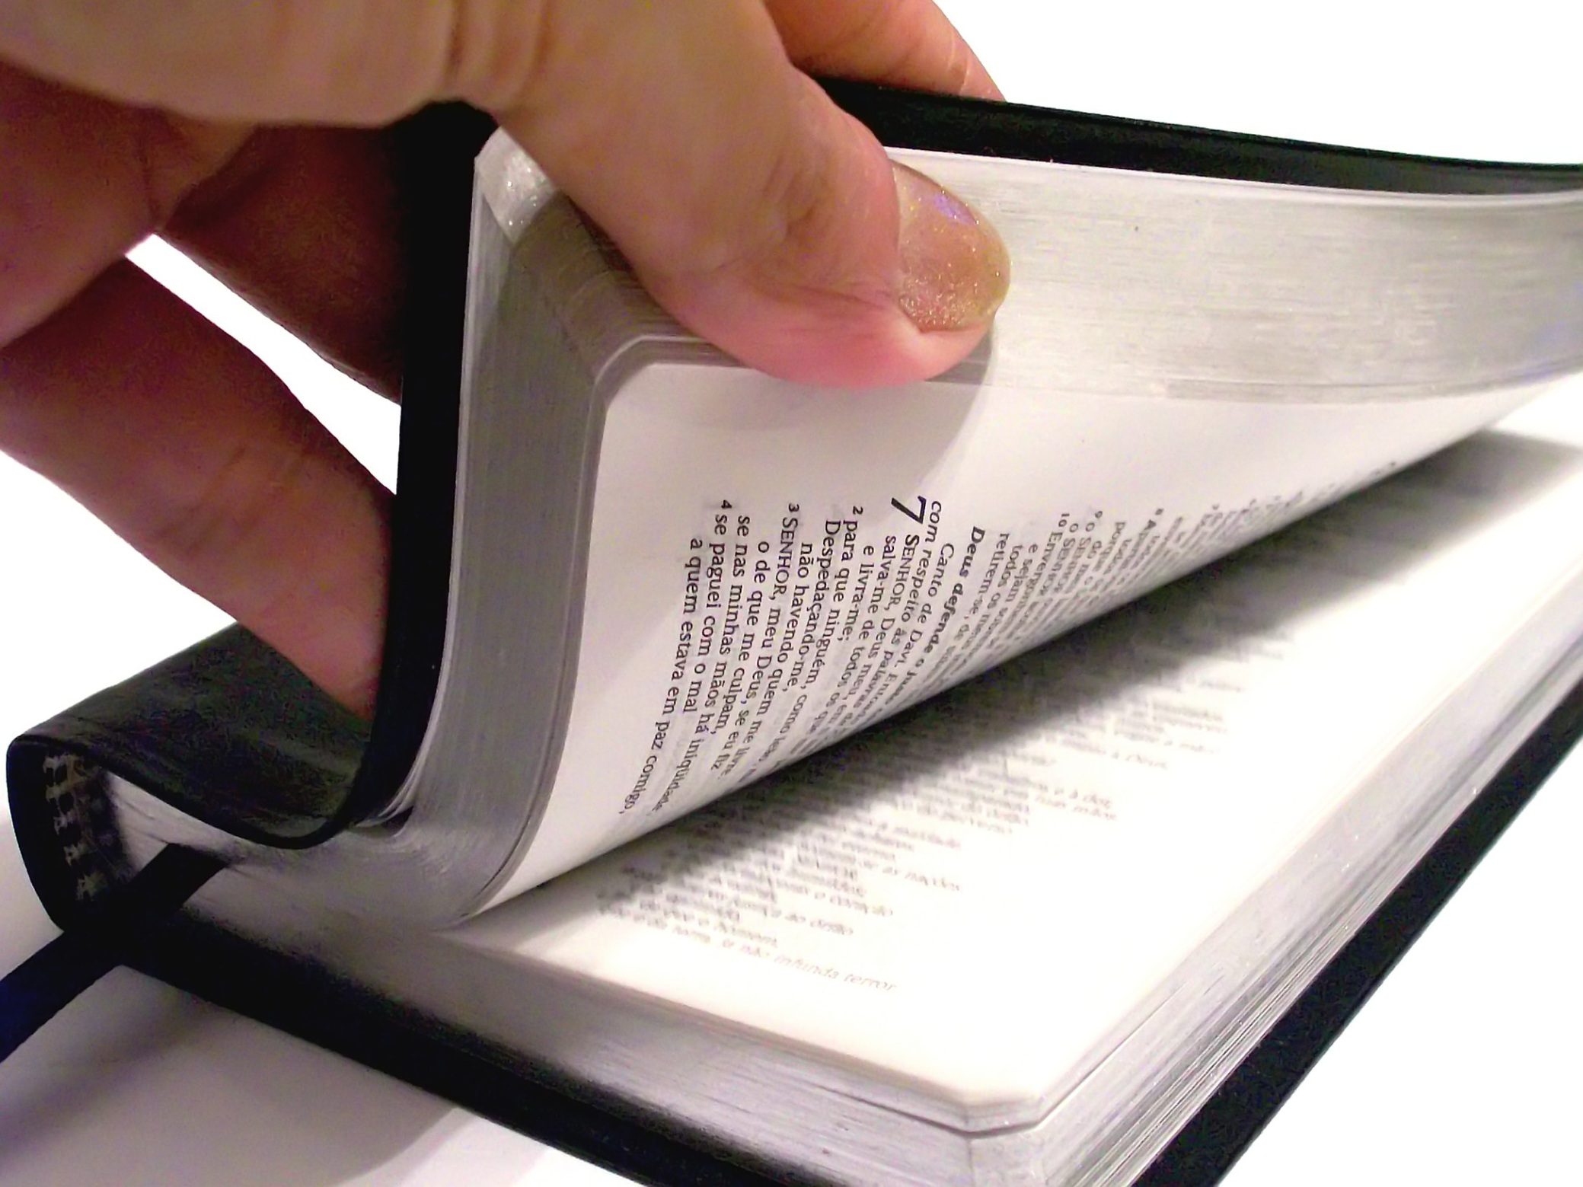
Idol
Luke 10:26
2 Timothy 3:15-17
Romans 12:2

Slide 11
What does the Bible say about . . .
How do you Feel about . . .
Those who have never heard about Jesus—will they be lost or saved?
Same-sex marriage between two very loving & committed men (women)?
Divorce when a couple is so hateful and unhappy, and the kids are miserable. Should they stay together?
Sex outside of marriage (adultery, or between two loving, devoted people)?
Drinking alcoholic beverages moderately (an infrequent beer, or cocktail)?
The occasional use of social drugs such as marijuana, opiate drugs (Oxycontin, Percocet)?
Obtaining an abortion when the pregnancy occurred as a result of rape?
Suicide because one is suffering a painful and terminal illness?
Romans 3:23; John 8:24; John 14:6; 2 Thessalonians 1:7-9
Romans 1:26-28
Matthew 19:9
1 Corinthians 6:18; Hebrews 13:4
1 Peter 4:3 “drinking parties”
Galatians 5:19 “sorcery” “pharmakeia”
Romans 13:9; Luke 1:44; Luke 2:16; Matthew 1:18 “with child”
Suicide: “self-murder” Romans 13:9; Acts 16:27-28

Slide 12
John 12:48

