Slide 2
Psalm 90:10-12
¹⁰ The days of our lives are seventy years; and if by reason of strength they are eighty years, yet their boast is only labor and sorrow; for it is soon cut off, and we fly away. ¹¹ Who knows the power of Your anger? For as the fear of You, so is Your wrath. ¹² So teach us to number our days, that we may gain a heart of wisdom.

Slide 5
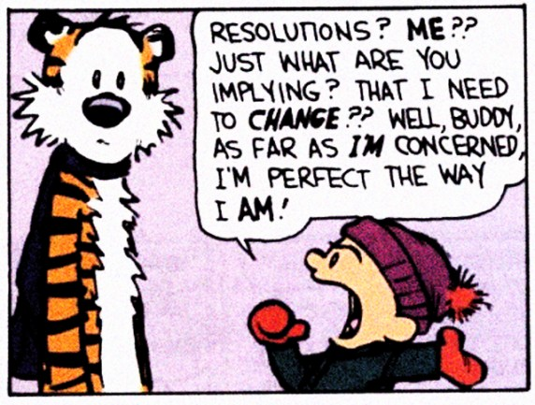

Slide 6
Resolutions for 2013
Read through the Bible
Get more involved in church
Become a better Steward
Bring a friend to church
Be a help to others

Slide 7
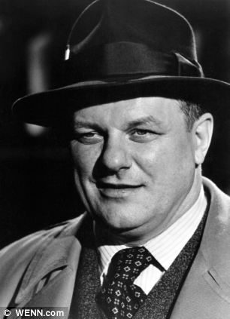
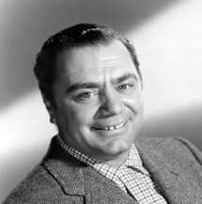
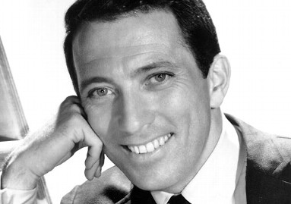
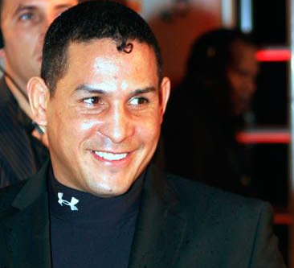
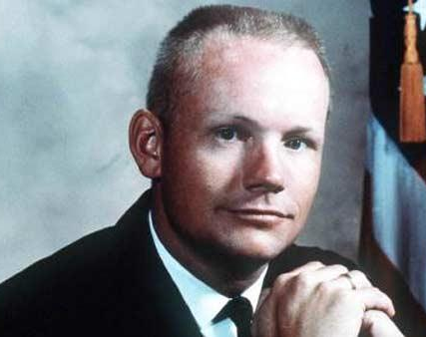
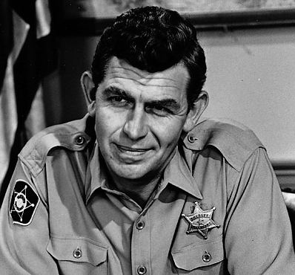
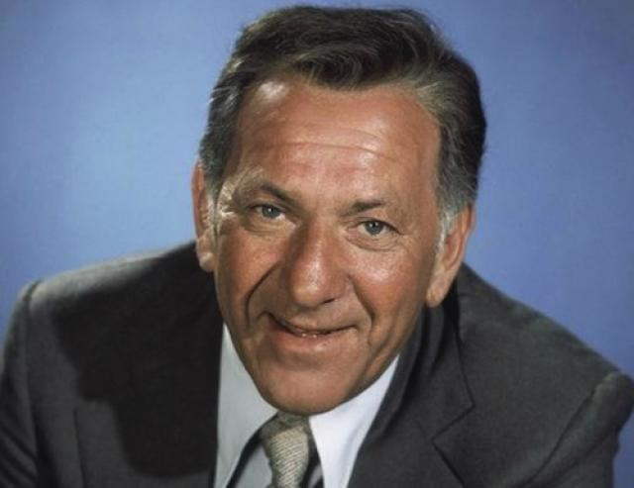
In 2013 I will Resolve to . . .
Understand life on earth is Limited & Fleeting
Take Advantage of every Opportunity
Choose to Serve God above everything else

Slide 8
When as a child, I laughed and wept, Time crept.
When as a youth, I dreamt and talked, Time walked.
When I became a full-grown man, Time ran.
When older still I daily grew, Time flew.
Soon I shall find on travelling on - Time gone.
O Christ, wilt Thou have saved me then? Amen!
Henry Twills

