Slide 2
John 4:19-24
¹⁹ The woman said to Him, Sir, I perceive that You are a prophet. ²⁰ Our fathers worshiped on this mountain, and you Jews say that in Jerusalem is the place where one ought to worship. ²¹ Jesus said to her, woman, believe Me, the hour is coming when you will neither on this mountain, nor in Jerusalem, worship the Father. ²² You worship what you do not know; we know what we worship, for salvation is of the Jews. ²³ But the hour is coming, and now is, when the true worshipers will worship the Father in spirit and truth; for the Father is seeking such to worship Him. ²⁴ God is Spirit, and those who worship Him must worship in spirit and truth.

Slide 4
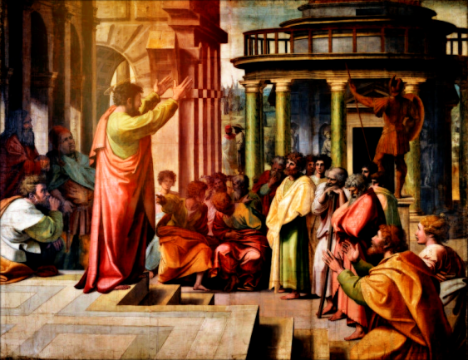
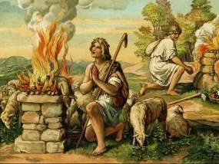
And in the process of time it came to pass that Cain brought an offering of the fruit of the ground to the Lord. Abel also brought of the firstborn of his flock and of their fat, (Genesis 4:3-4).
Then Paul stood in the midst of the Areopagus and said, men of Athens, I perceive that in all things you are very religious; for as I was passing through and considering the objects of your worship, I even found an altar with this inscription: TO THE UNKNOWN GOD. Therefore, the One whom you worship without knowing, Him I proclaim to you, (Acts 17:22-23).
Worship: “Connecting to God”

Slide 5
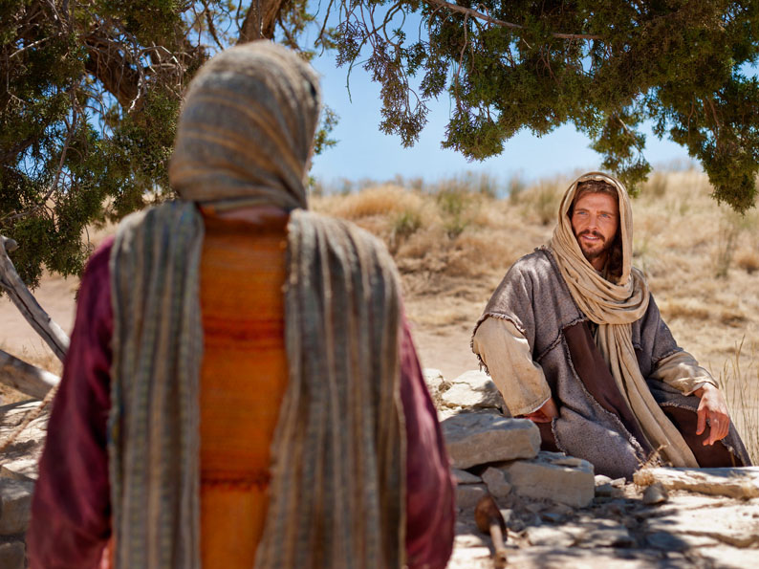
Worshiping God
Samaritan Woman
Sitting in a church building,
doing certain prescribed things,
three times per week.
The woman said to Him, Sir, I perceive that You are a prophet. Our fathers worshiped on this mountain, and you Jews say that in Jerusalem is the place where one ought to worship.
(John 4:19-20)

Slide 6
Samaritan Temple: Mt Gerizim
Place where the children of Israel built a stone altar after crossing the Jordan River (Deut 27:4-13).
Later, during the time of Nehemiah, the Samaritans built a temple there, according to Josephus.
In the view of the Samaritans—Mt. Gerizim was the scriptural location for worship.

Slide 7
Jewish Temple: Jerusalem
Worship was to be in the designated place God had chosen (Deut 12:5-26).
The temple was built under God’s direction, in Jerusalem (1 Kings 5-8).
In the view of the Jews—Jerusalem was the scriptural location for worship.

Slide 8
Worshiping God
Samaritan Woman
Sitting in a church building,
doing certain prescribed things,
three times per week.
The woman said to Him, Sir, I perceive that You are a prophet. Our fathers worshiped on this mountain, and you Jews say that in Jerusalem is the place where one ought to worship.
(John 4:19-20)
Jesus said to her, woman, believe Me, the hour is coming when you will neither on this mountain, nor in Jerusalem, worship the Father. You worship what you do not know; we know what we worship, for salvation is of the Jews. But the hour is coming, and now is, when the true worshipers will worship the Father in spirit and truth; for the Father is seeking such to worship Him. God is Spirit, and those who worship Him must worship in spirit and truth.
(John 4:21-24)

Slide 10
Truth

Slide 11
Dignity

Slide 13
Reverence

Slide 15
Holiness

