Slide 2
Revelation 22:1-5
¹ And he showed me a pure river of water of life, clear as crystal, proceeding from the throne of God and of the Lamb. ² In the middle of its street, and on either side of the river, was the tree of life, which bore twelve fruits, each tree yielding its fruit every month. The leaves of the tree were for the healing of the nations. ³ And there shall be no more curse, but the throne of God and of the Lamb shall be in it, and His servants shall serve Him. ⁴ They shall see His face, and His name shall be on their foreheads. ⁵ There shall be no night there: They need no lamp nor light of the sun, for the Lord God gives them light. And they shall reign forever and ever.

Slide 4
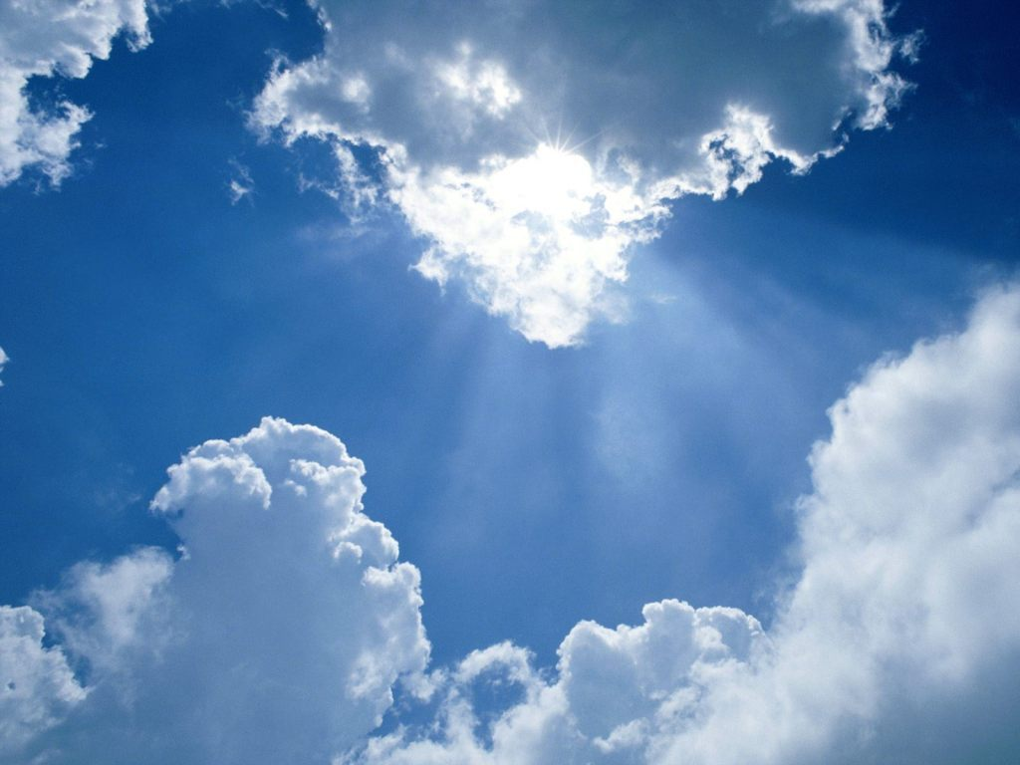
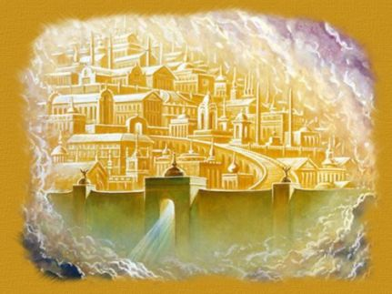
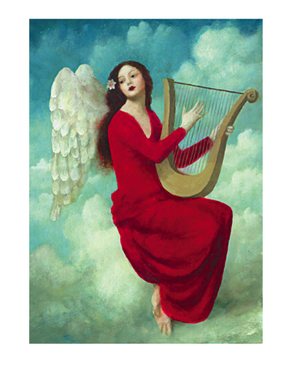
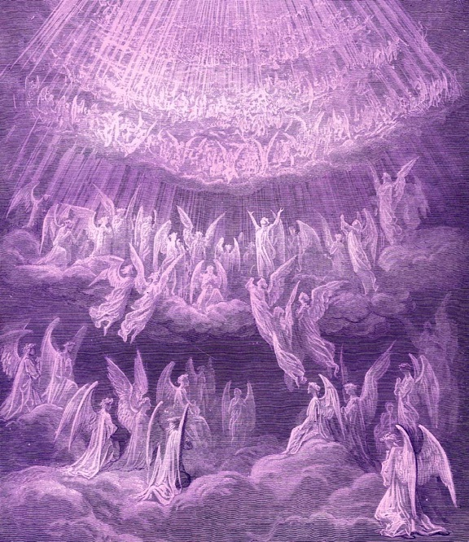
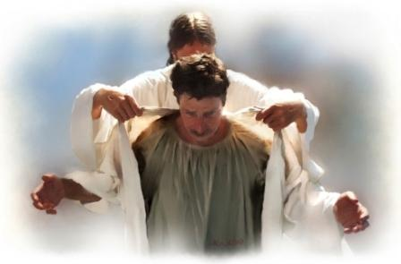
What do You See?
What do You See?

Slide 5
You also go into the vineyard, and whatever is right I will give you (Matthew 20:4)
A New Body
A New Reality
A New Home
A New Service
A New Relationship

