Slide 2
Colossians 3:1-4
¹ If then you were raised with Christ, seek those things which are above, where Christ is, sitting at the right hand of God. ² Set your mind on things above, not on things on the earth. ³ For you died, and your life is hidden with Christ in God. ⁴ When Christ who is our life appears, then you also will appear with Him in glory.

Slide 4
Colossians 3:1-4
¹ If then you were raised with Christ, seek those things which are above, where Christ is, sitting at the right hand of God. ² Set your mind on things above, not on things on the earth. ³ For you died, and your life is hidden with Christ in God. ⁴ When Christ who is our life appears, then you also will appear with Him in glory.

Slide 5
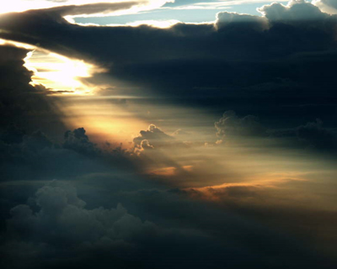
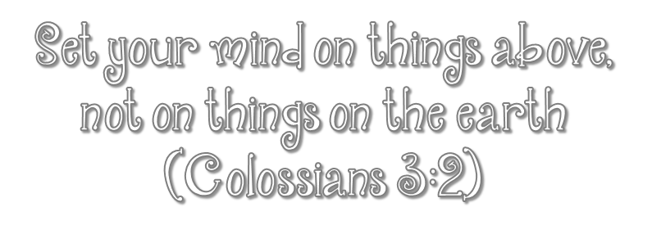
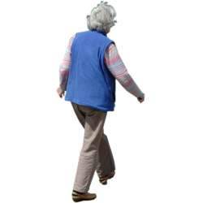
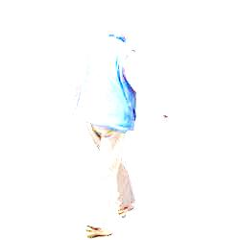

Slide 6
Keeps A Proper Perspective on Life
Helps us lay up Treasures in Heaven
Keeps us Zealous about Serving God
Helps us Preserve a Pure Life
Keeps us from Fearing Death
Helps us Maintain a Living Hope

Slide 7
Set your mind on things above, not on things on the earth
(Colossians 3:2)

