Slide 2
Matthew 26:36-39
³⁶ Then Jesus came with them to a place called Gethsemane, and said to the disciples, sit here while I go and pray over there. ³⁷ And He took with Him Peter and the two sons of Zebedee, and He began to be sorrowful and deeply distressed. ³⁸ Then He said to them, My soul is exceedingly sorrowful, even to death. Stay here and watch with Me. ³⁹ He went a little farther and fell on His face, and prayed, saying, O My Father, if it is possible, let this cup pass from Me; nevertheless, not as I will, but as You will.

Slide 4
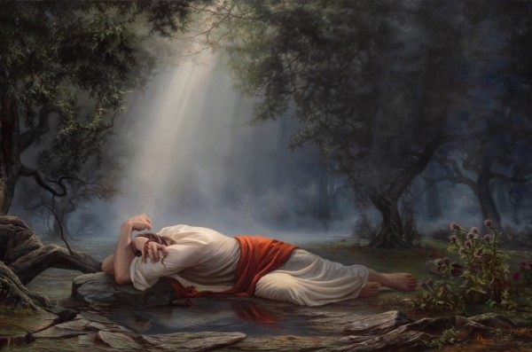
He Went A Little Farther
He went a little farther and fell on His face, and prayed . . . (Matthew 26:39).

Slide 5
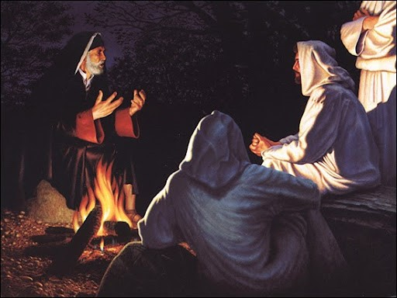
He Went A Little Farther
Jesus answered and said to him, most assuredly, I say to you, unless one is born again, he cannot see the kingdom of God (John 3:3).

Slide 6
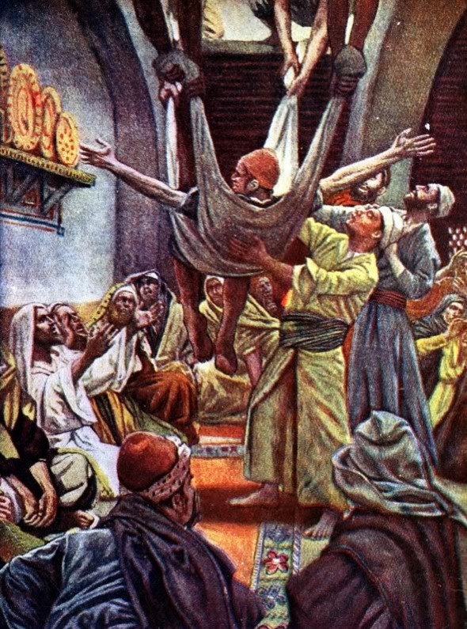
He Went A Little Farther
He said to the paralytic, son your sins are forgiven you
(Mark 2:5).

Slide 7
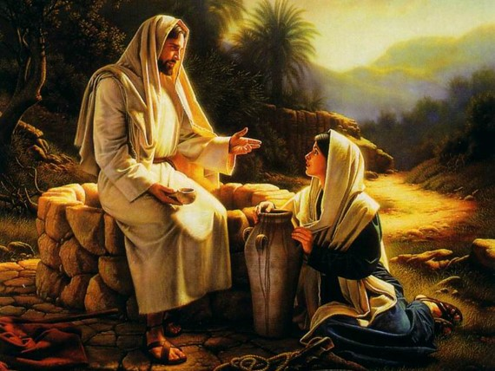
He Went A Little Farther
But the water that I shall give him will become in him a fountain of water springing up into everlasting life
(John 4:14).

Slide 8
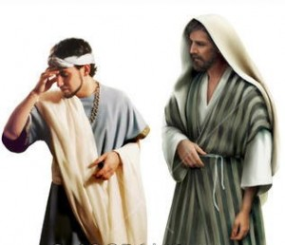
He Went A Little Farther
If you want to be perfect, go, sell what you have and give to the poor, and you will have treasure in heaven; and come follow Me
(Matthew 19:21).

Slide 9
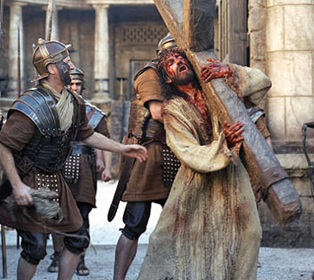
He Went A Little Farther
Now My soul is troubled, and what shall I say? Father, save Me from this hour? But for this purpose I came to this hour
(John 12:27).
Or do you think that I cannot now pray to My Father, and He will provide Me with more than twelve legions of angels?
(Matthew 26:53).

Slide 10

Going A Little Farther
Elders Must Go A Little Farther
Preachers Must Go A Little Farther
You have heard that it was said, an eye for an eye and a tooth for a tooth. But I tell you not to resist an evil person. But whoever slaps you on your right cheek, turn the other to him also. If anyone want to sue you and take away your tunic, let him have your cloak also. And if anyone compels you to go one mile, go with him two
(Matthew 5:38-41).
Deacons Must Go A Little Farther
Teachers Must Go A Little Farther
Disciples Must Go A Little Farther
Families Must Go A Little Farther

Slide 11

Going A Little Farther
But for this very reason, giving all diligence, add to your faith virtue, to virtue knowledge, to knowledge self-control, to self-control perseverance, to perseverance godliness, to godliness brotherly kindness, and to brotherly kindness love. For if these things are yours and ABOUND, you will be neither barren nor unfruitful in the knowledge of our Lord Jesus Christ
(2 Peter 1:5-8).

