Slide 2
Ecclesiastes 12:1-7
¹ Remember now your Creator in the days of your youth, before the difficult days come, and the years draw near when you say, I have no pleasure in them: ² while the sun and the light, the moon and the stars, are not darkened, and the clouds do not return after the rain; ³ in the day when the keepers of the house tremble, and the strong men bow down; when the grinders cease because they are few, and those that look through the windows grow dim; ⁴ when the doors are shut in the streets, and the sound of grinding is low; when one rises up at the sound of a bird, and all the daughters of music are brought low. ⁵ Also they are afraid of height, and of terrors in the way; when the almond tree blossoms, the grasshopper is a burden, and desire fails. For man goes to his eternal home, and the mourners go about the streets. ⁶ Remember your Creator before the silver cord is loosed, or the golden bowl is broken, or the pitcher shattered at the fountain, or the wheel broken at the well. ⁷ Then the dust will return to the earth as it was, and the spirit will return to God who gave it.

Slide 4
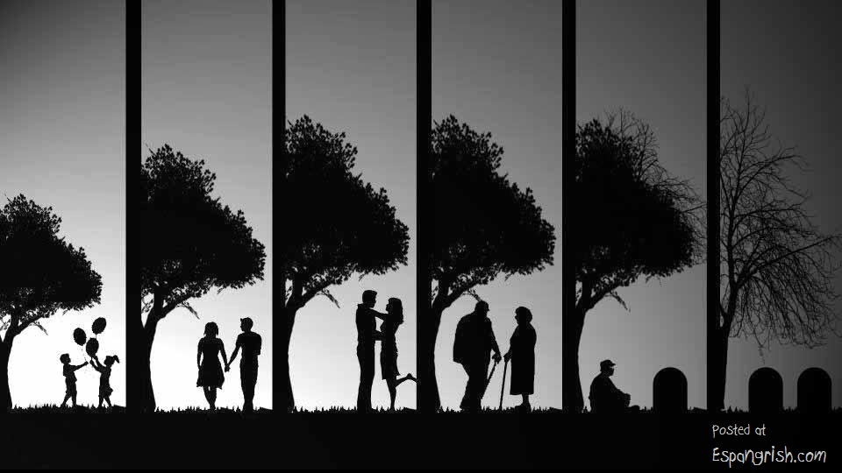
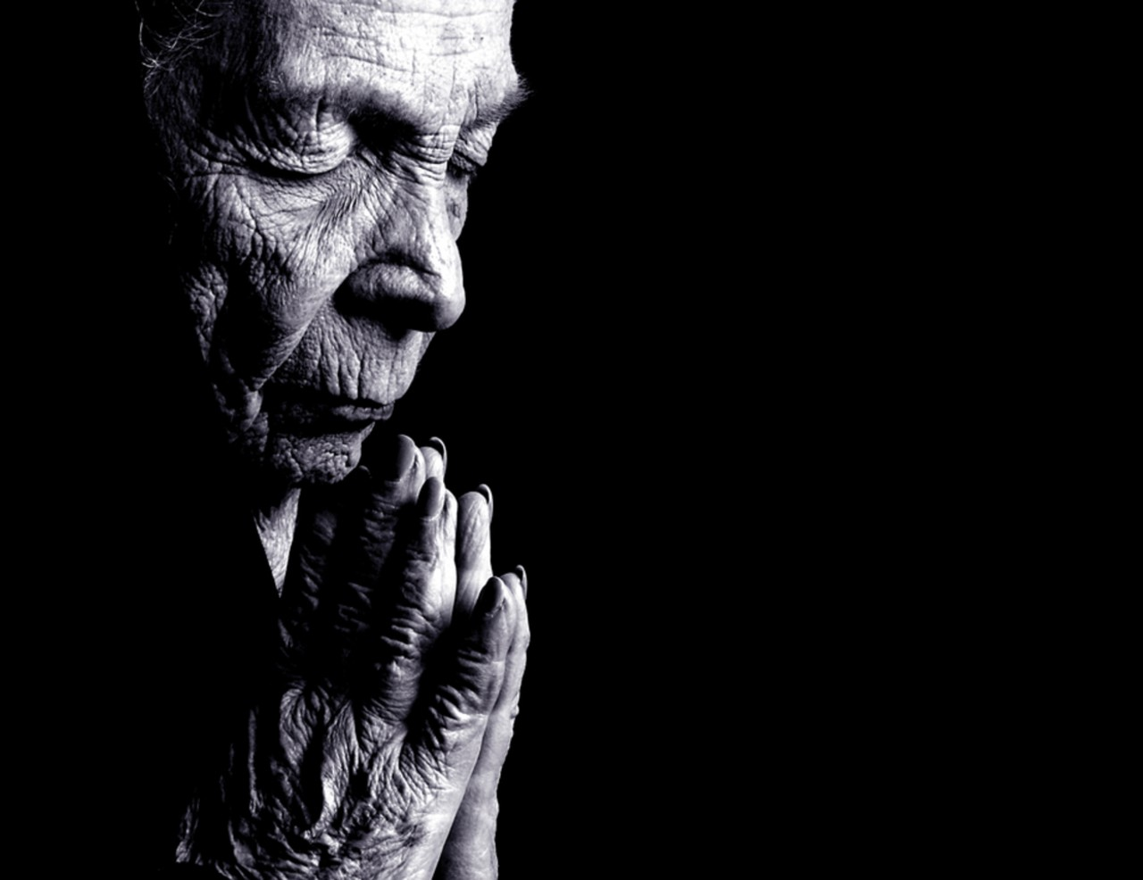
Remember now your Creator
in the days of your youth,
before the difficult days
come, and the years draw
near when you say, I have
no pleasure in them . . .
Therefore remove sorrow from your heart, and put away evil from your flesh, for childhood and youth are vanity. (Eccl 11:10)

Slide 5
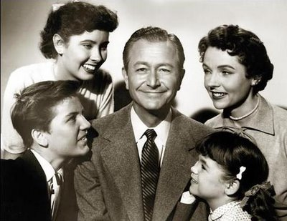
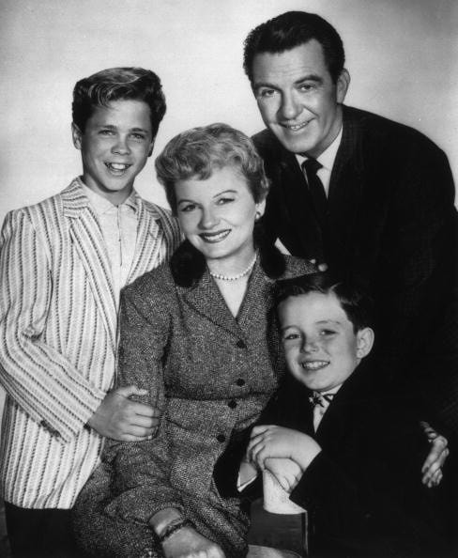
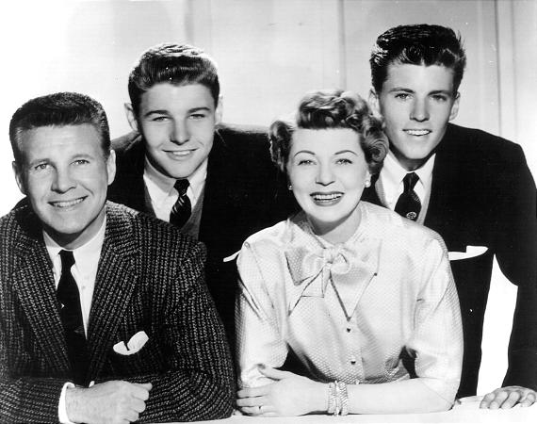
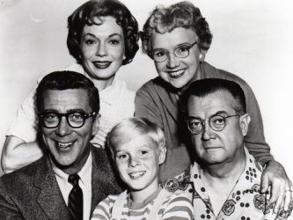
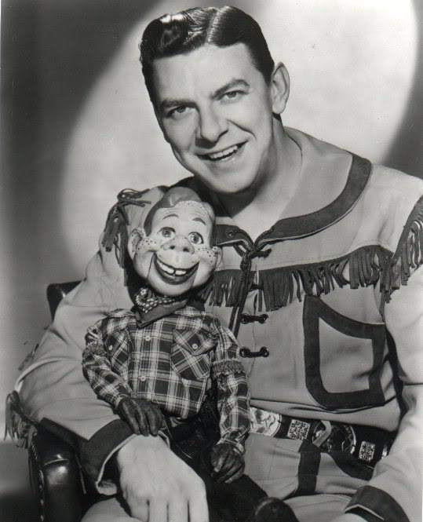
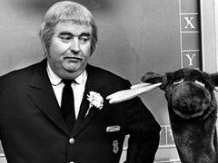
IF YOU CAN REMEMBER THESE—THEN THIS SERMON APPLIES TO YOU

Slide 6
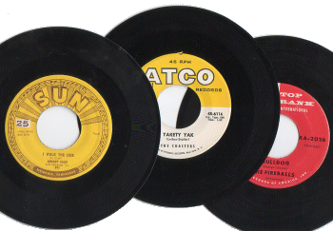
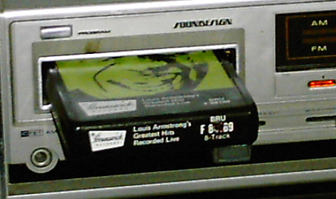
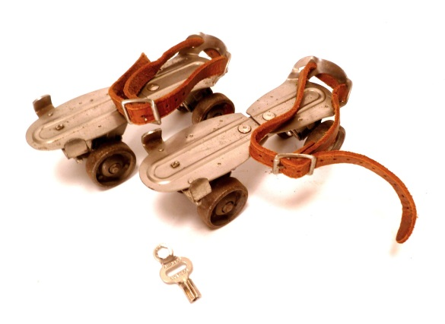
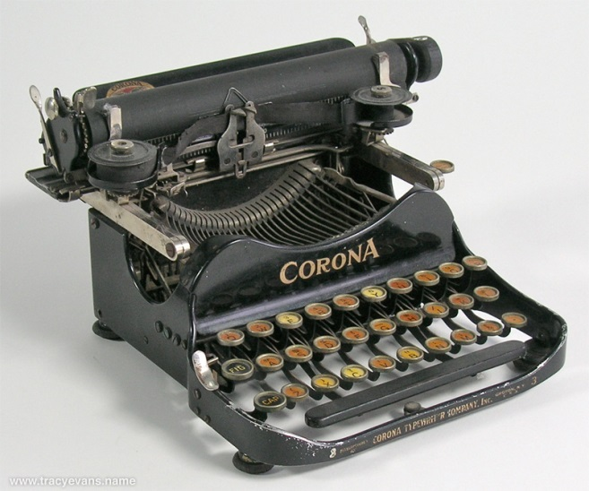
IF YOU CAN REMEMBER THESE—THEN THIS SERMON APPLIES TO YOU

Slide 7
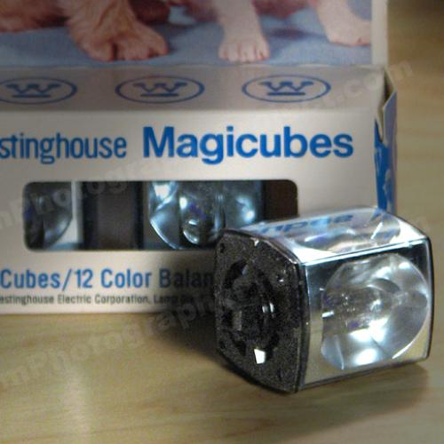
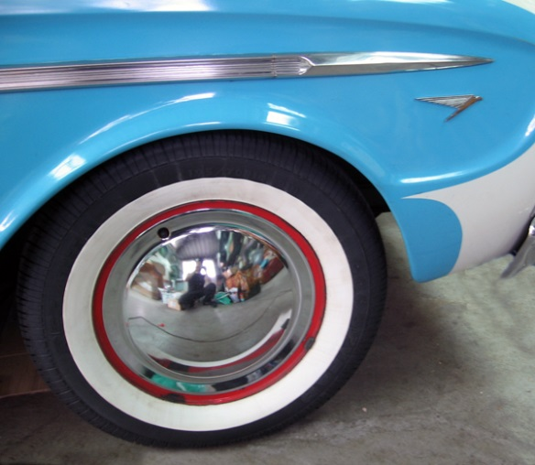
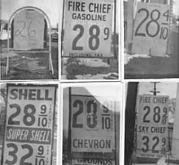
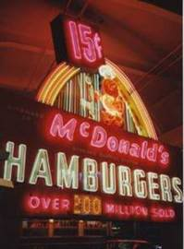
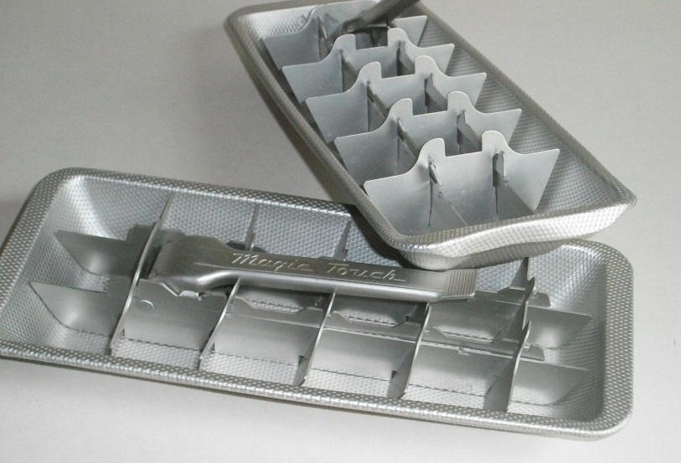
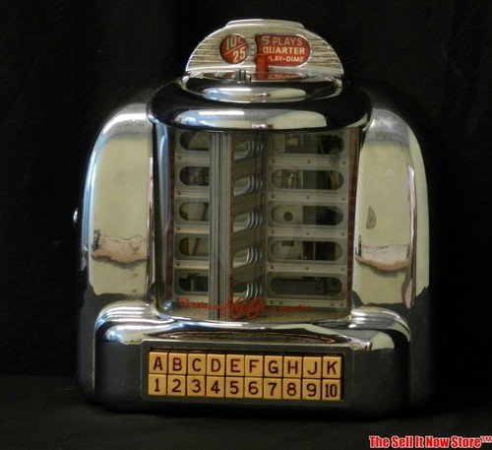
IF YOU CAN REMEMBER THESE—THEN THIS SERMON APPLIES TO YOU

Slide 8
Growing Old
Accept Growing Old
“I have been young, and now am old” (Psa 37:25)

Slide 9
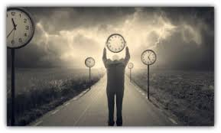
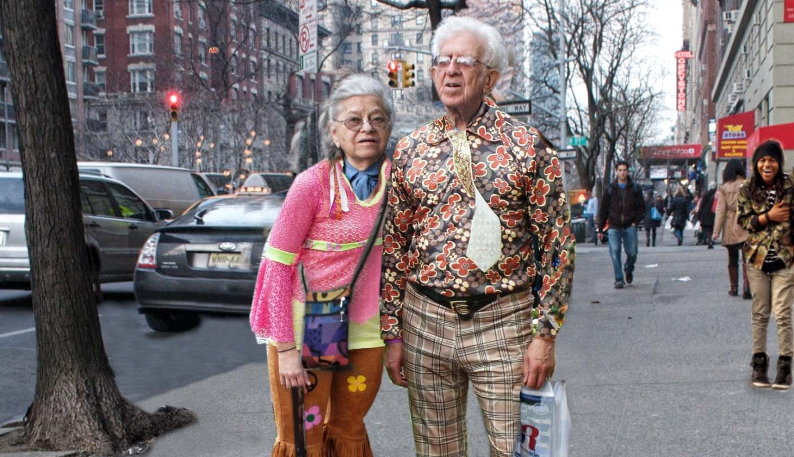
It’s time now to let go of the past and embrace all that awaits you!

Slide 10
Growing Old
Accept Growing Old
Do Not Quit Living
Maintain Spiritual Passion
“The silver-haired head is a crown of glory,
if it is found in the way of righteousness.”
(Prov 16:31)
“Moses was one hundred and twenty years old when he died. His eyes were not dim nor his natural vigor diminished.” (Deut 34:7)
“I have been young, and now am old” (Psa 37:25)

Slide 11
23%
43%
13%
No one has power over the spirit to retain the spirit, and no one has power in the day of death. There is no release from that war . . . (Eccl 8:8).
Remember now your Creator in the days of your youth, before the difficult days come, and the years draw near when you say, I have no pleasure in them . . . (Eccl 12:1).

