Slide 2
1 Peter 1:3-9
³ Blessed be the God and Father of our Lord Jesus Christ, who according to His abundant mercy has begotten us again to a living hope through the resurrection of Jesus Christ from the dead, ⁴ to an inheritance incorruptible and undefiled and that does not fade away, reserved in heaven for you, ⁵ who are kept by the power of God through faith for salvation ready to be revealed in the last time. ⁶ In this you greatly rejoice, though now for a little while, if need be, you have been grieved by various trials, ⁷ that the genuineness of your faith, being much more precious than gold that perishes, though it is tested by fire, may be found to praise, honor, and glory at the revelation of Jesus Christ, ⁸ whom having not seen you love. Though now you do not see Him, yet believing, you rejoice with joy inexpressible and full of glory, ⁹ receiving the end of your faith—the salvation of your souls.

Slide 4
“For all have sinned and fall short of the glory of God” (Romans 3:23).
“If we say that we have not sinned, we make Him a liar . . .” (1 John 1:10).
“But we are all like an unclean thing, and all our righteousnesses are like filthy rags” (Isaiah 64:6).

Slide 5
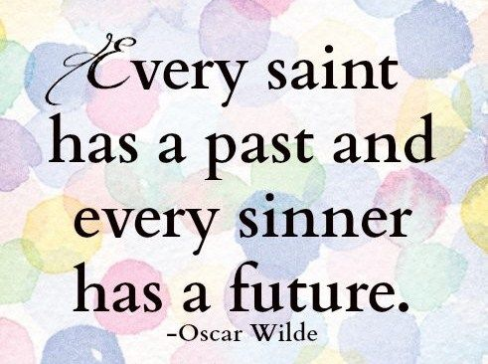
O wretched man that I am! Who will deliver me from this body of death? I thank God—through Jesus Christ our Lord!
(Romans 7:24-25)

Slide 6
Abundant
Mercy

Slide 8
Begotten us Again

Slide 9
Living

Slide 10
Kept . . . through faith

