Slide 2
Matthew 20:1-16
1 For the kingdom of heaven is like a landowner who went out early in the morning to hire laborers for his vineyard. 2 Now when he had agreed with the laborers for a denarius a day, he sent them into his vineyard. 3 And he went out about the third hour and saw others standing idle in the marketplace, 4 and said to them, you also go into the vineyard, and whatever is right I will give you. So they went. 5 Again he went out about the sixth and the ninth hour, and did likewise. 6 And about the eleventh hour he went out and found others standing idle, and said to them, why have you been standing here idle all day? 7 They said to him, because no one hired us. He said to them, you also go into the vineyard, and whatever is right you will receive. 8 So when evening had come, the owner of the vineyard said to his steward, call the laborers and give them their wages, beginning with the last to the first.

Slide 3
Matthew 20:1-16
9 And when those came who were hired about the eleventh hour, they each received a denarius. 10 But when the first came, they supposed that they would receive more; and they likewise received each a denarius. 11 And when they had received it, they complained against the landowner, 12 saying, these last men have worked only one hour, and you made them equal to us who have borne the burden and the heat of the day. 13 But he answered one of them and said, friend, I am doing you no wrong. Did you not agree with me for a denarius? 14 Take what is yours and go your way. I wish to give to this last man the same as to you. 15 Is it not lawful for me to do what I wish with my own things? Or is your eye evil because I am good? 16 So the last will be first, and the first last. For many are called, but few chosen.

Slide 5
Then all the tax collectors and the sinners drew near to Him to hear Him. And the Pharisees and scribes complained, saying, this Man receives sinners and eats with them. (Luke 15:1-2)

Slide 6
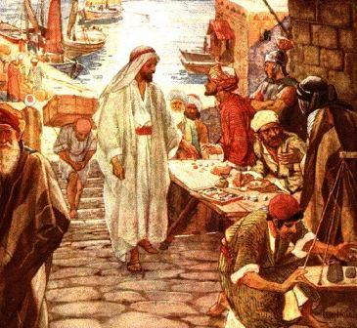
Scandalous
As Jesus passed on from there, He saw a man named Matthew sitting at the tax office. And He said to him, follow Me. So he arose and followed Him. Now it happened, as Jesus sat at the table in the house, that behold, many tax collectors and sinners came and sat down with Him and His disciples. And when the Pharisees saw it, they said to His disciples, why does your Teacher eat with tax collectors and sinners? When Jesus heard that, He said to them, those who are well have no need of a physician, but those who are sick. But go and learn what this means: I desire mercy and not sacrifice. For I did not come to call the righteous, but sinners, to repentance.
Calling of Matthew
Matt 9:9-13

Slide 7
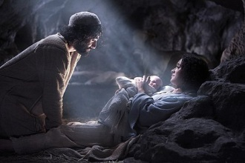
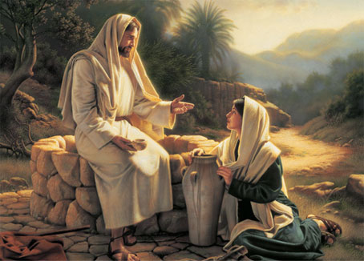
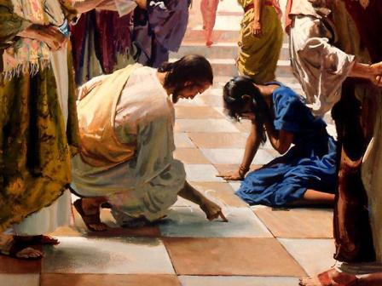
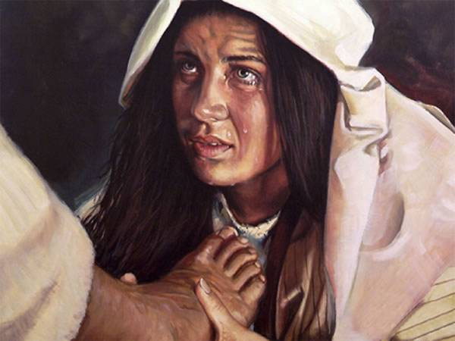
Scandalous
Pregnant & Unmarried
Samaritan Woman
Adulterous Woman
Sinful Woman

Slide 8
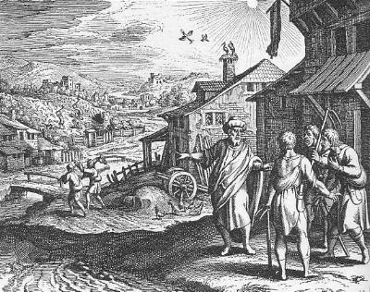
“Grace” is Scandalous
Probably at 6:00 AM (1st Hour) {Jn 11:9}
“Unskilled laborers”
These readily agreed to work for a Denarius
Went to work
For the kingdom of heaven is like a landowner who went out early in the morning to hire laborers for his vineyard. Now when he had agreed with the laborers for a denarius a day, he sent them into his vineyard. (Matt 20:1-2)

Slide 9
“Grace” is Scandalous
Third hour is 9:00 AM
Not yet hired for the day
Agreed to work for what is right
Went to work
And he went out about the third hour and saw others standing idle in the marketplace, and said to them, you also go into the vineyard, and whatever is right I will give you. So they went. (Matt 20:3-4)

Slide 10
“Grace” is Scandalous
Sixth hour is Noon
Ninth hour is 3:00 PM
Eleventh hour is 5:00 PM
No one had hired them
Agreed to work for what is right
Went to work
Again he went out about the sixth and the ninth hour, and did likewise. And about the eleventh hour he went out and found others standing idle, and said to them, why have you been standing here idle all day? They said to him, because no one hired us. He said to them, you also go into the vineyard, and whatever is right you will receive. (Matt 20:5-7)

Slide 11
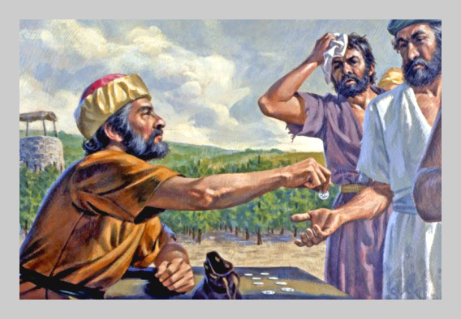
“Grace” is Scandalous
Reversed the method of pay
Those hired at the eleventh, ninth, sixth, and third hour received a denarius
First hired assumed they would receive more (Why?)
But they were also paid a denarius
So when evening had come, the owner of the vineyard said to his steward, call the laborers and give them their wages, beginning with the last to the first. And when those came who were hired about the eleventh hour, they each received a denarius. But when the first came, they supposed that they would receive more; and they likewise received each a denarius. (Matt 20:8-9)

Slide 12
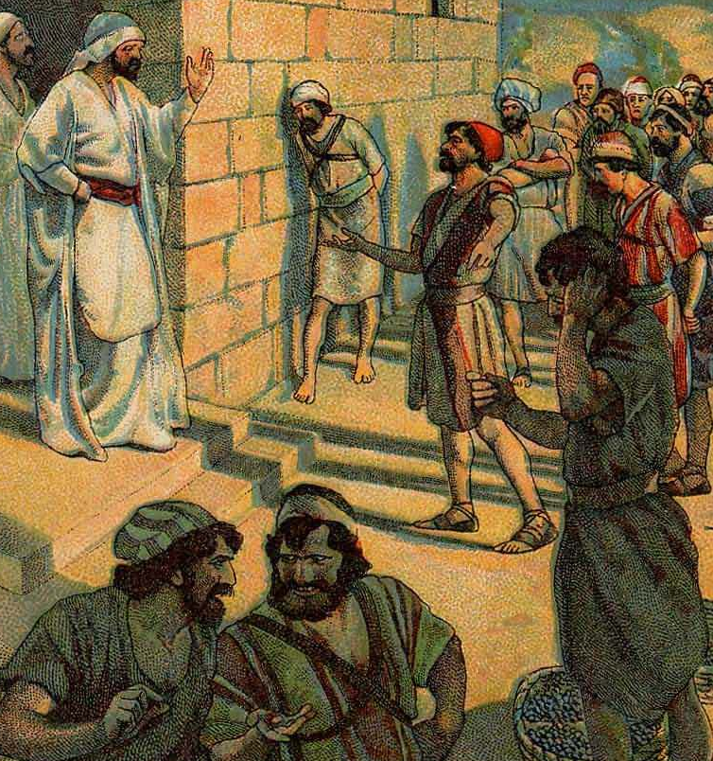
“Grace” is Scandalous
The first hired were aggrieved
“This is not fair”
They were upset because the landowner made all workers in his vineyard EQUAL
“We deserve more because we worked longer and harder” they supposed
And when they had received it, they complained against the landowner, saying, these last men have worked only one hour, and you made them equal to us who have borne the burden and the heat of the day.
(Matt 20:10-12)

Slide 13
“Grace” is Scandalous
I did not do you an injustice, “Pal”
You agreed before going to work that you would receive a denarius
It is lawful to pay these other workers what I wish (GRACE)
Those who think they are great are ranked no higher than any other in Christ’s kingdom
But he answered one of them and said, friend, I am doing you no wrong. Did you not agree with me for a denarius? Take what is yours and go your way. I wish to give to this last man the same as to you. Is it not lawful for me to do what I wish with my own things? Or is your eye evil because I am good? So the last will be first, and the first last. For many are called, but few chosen. (Matt 20:13-16)

Slide 14
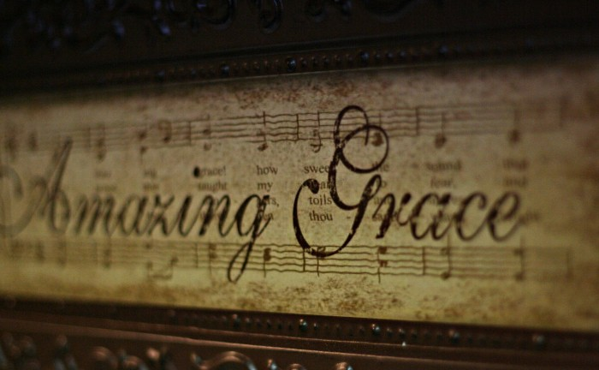
Grace reminds us that Salvation is a gift of God
Grace prevents us from looking down on ourselves
Grace makes us all Equal
Grace means we Matter to God

