Slide 2
Galatians 5:16-21
¹⁶ I say then: Walk in the Spirit, and you shall not fulfill the lust of the flesh. ¹⁷ For the flesh lusts against the Spirit, and the Spirit against the flesh; and these are contrary to one another, so that you do not do the things that you wish. ¹⁸ But if you are led by the Spirit, you are not under the law. ¹⁹ Now the works of the flesh are evident, which are: adultery, fornication, uncleanness, lewdness, ²⁰ idolatry, sorcery, hatred, contentions, jealousies, outbursts of wrath, selfish ambitions, dissensions, heresies, ²¹ envy, murders, drunkenness, revelries, and the like; of which I tell you beforehand, just as I also told you in time past, that those who practice such things will not inherit the kingdom of God.

Slide 5
Should a Young Christian go to the Prom?
Should Christian parents permit their teenagers to attend the Prom?
Going to the Prom

Slide 6
Promenade
In the United States, it came to be believed by parents and educators that a prom, or formal dinner-dance, would be an important lesson in social skills, especially in a theoretically classless society that valued behavior over breeding. The prom was seen as a way to instill manners into children, all under the watchful eye of adult chaperons.

Slide 7
Now the works of the flesh are evident, which are: adultery, fornication, uncleanness, lewdness, idolatry, sorcery, hatred, contentions, jealousies, outbursts of wrath, selfish ambitions, dissensions, heresies, envy, murders, drunkenness, revelries, and the like; of which I tell you beforehand, just as I also told you in time past, that those who practice such things will not inherit the kingdom of God. Galatians 5:19-21
Now the works of the flesh are evident, which are: adultery, fornication, uncleanness, lewdness, idolatry, sorcery, hatred, contentions, jealousies, outbursts of wrath, selfish ambitions, dissensions, heresies, envy, murders, drunkenness, revelries, and the like; of which I tell you beforehand, just as I also told you in time past, that those who practice such things will not inherit the kingdom of God. Galatians 5:19-21
aselgeia
(lasciviousness, KJV)
(sensuality, NASB)
(licentiousness, RSV)
“Unbridled lust . . . wantonness, outrageousness, shamelessness, insolence . . . wanton (acts or) manners, as filthy words, indecent bodily movements, unchaste handling of males and females.”

Slide 8
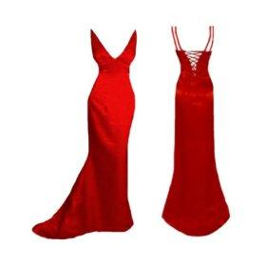
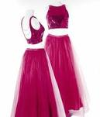
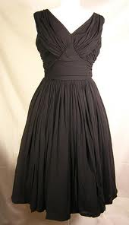
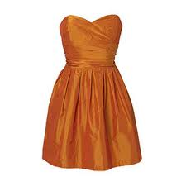
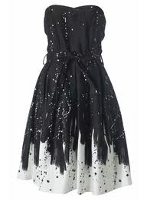
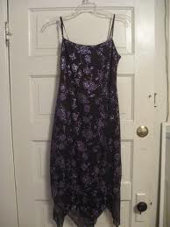
Our Daughter’s Clothing

Slide 9
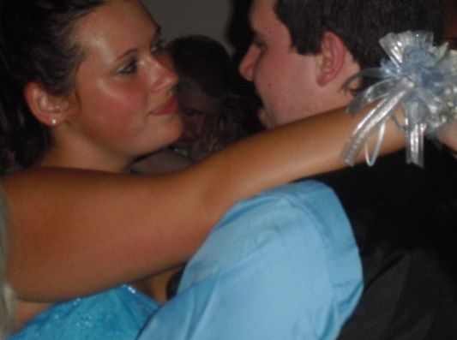
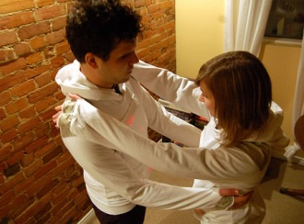
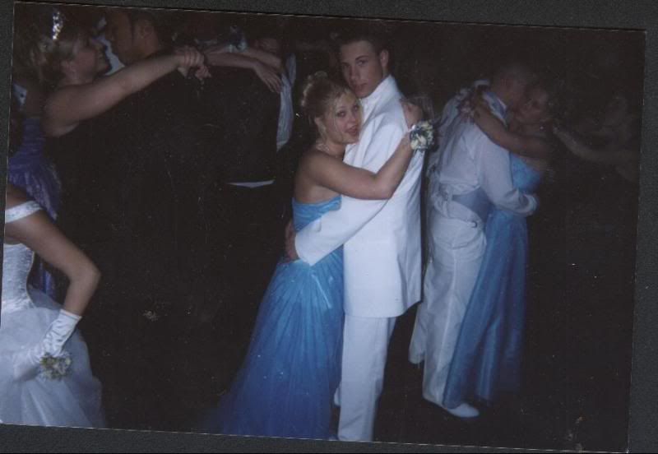
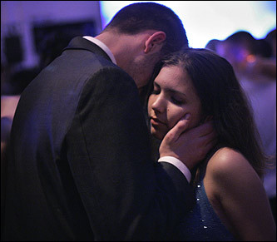
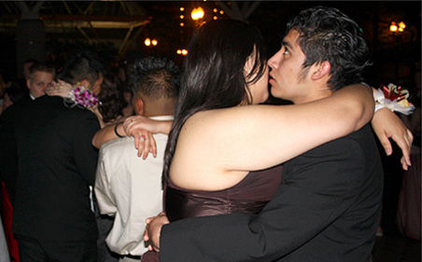
The Dancing

Slide 10
Now the works of the flesh are evident, which are: adultery, fornication, uncleanness, lewdness, idolatry, sorcery, hatred, contentions, jealousies, outbursts of wrath, selfish ambitions, dissensions, heresies, envy, murders, drunkenness, revelries, and the like; of which I tell you beforehand, just as I also told you in time past, that those who practice such things will not inherit the kingdom of God. Galatians 5:19-21
Now the works of the flesh are evident, which are: adultery, fornication, uncleanness, lewdness, idolatry, sorcery, hatred, contentions, jealousies, outbursts of wrath, selfish ambitions, dissensions, heresies, envy, murders, drunkenness, revelries, and the like; of which I tell you beforehand, just as I also told you in time past, that those who practice such things will not inherit the kingdom of God. Galatians 5:19-21
komos
(revelries, KJV)
(wild parties, NLT)
“A revel, carousel of guests (after banquets), music and frolic, dimmed lights, dance.” {A.T. Robinson}
“Festivities with music and dancing.” {Liddell & Scott}

Slide 11
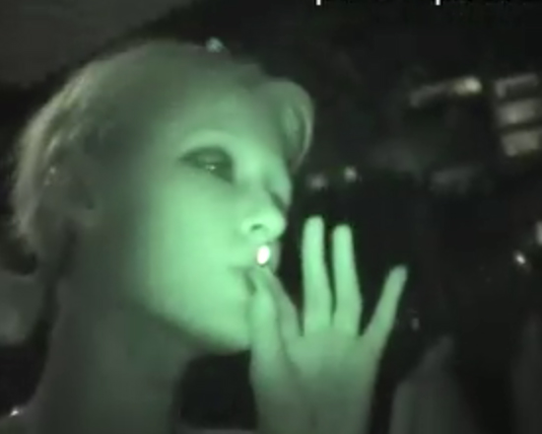
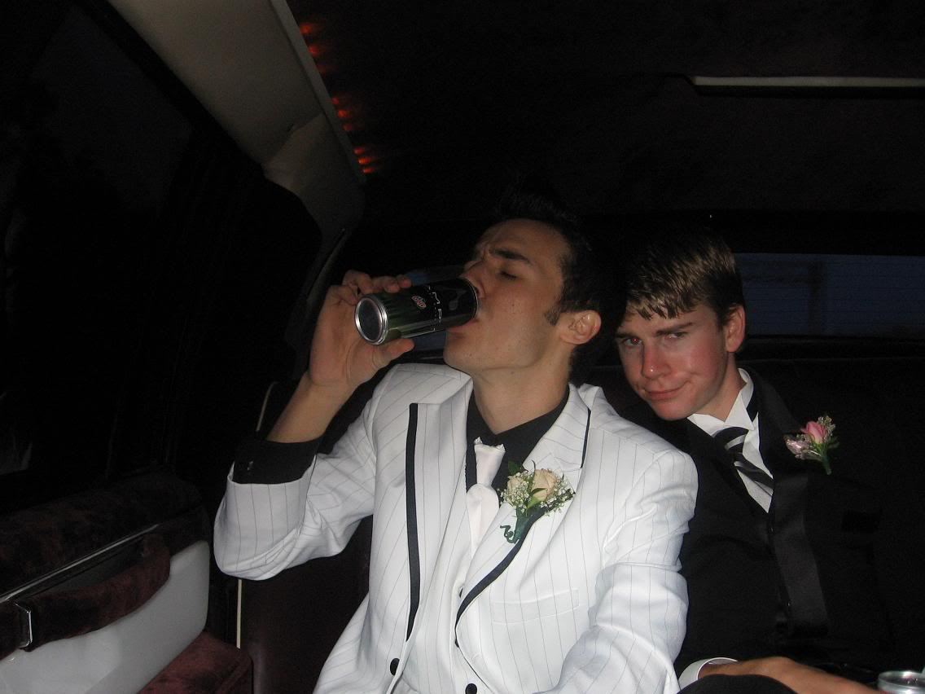
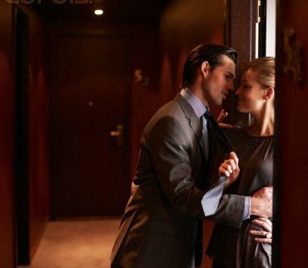
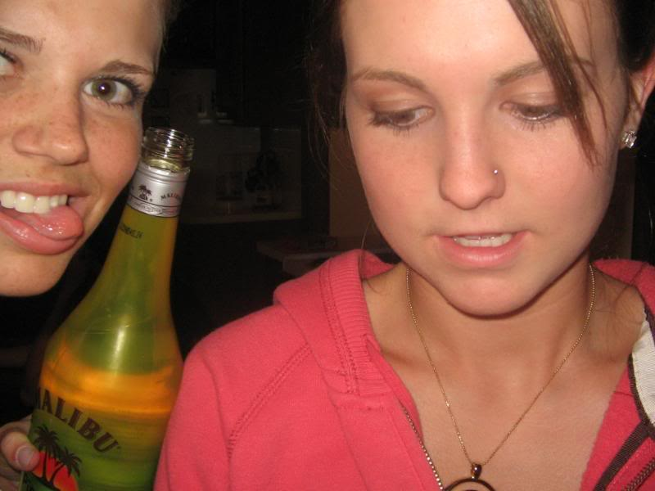
After The Dancing
Sex on prom night is so chic. You really plan on letting go your virginity so easily
Female contributor
Prom Blog
Yeah everyone has sex after or during prom, you are a loser if you don't . . .
Female Contributor
Prom Blog

Slide 12
The Bible and Dancing
Public Rejoicing
Victory over the Ammonites
When Jephthah came to his house at Mizpah, there was his daughter, coming out to meet him with timbrels and dancing; and she was his only child.
Judges 11:34
Successfully Crossing the Red Sea
Then Miriam the prophetess, the sister of Aaron, took the timbrel in her hand; and all the women went out after her with timbrels and with dances. And Miriam answered them: Sing to the LORD, for He has triumphed gloriously! The horse and its rider He has thrown into the sea!
Exodus 15:20-21
Return of the Ark of the Covenant
Then David danced before the LORD with all his might; and David was wearing a linen ephod.
2 Samuel 6:14

Slide 13
The Bible and Dancing
A Means of Worship
Let them praise His name with the Dance.
Psalms 149:3

Slide 14
The Bible and Dancing
Carnal / Erotic
In connection w/Golden Calf
So it was, as soon as he came near the camp, that he saw the calf and the dancing. So Moses’ anger became hot, and he cast the tablets out of his hands and broke them at the foot of the mountain.
Exodus 32:19
At Herod’s Birthday Celebration
And when Herodias’ daughter herself came in and danced, and pleased Herod and those who sat with him, the king said to the girl, ask me whatever you want, and I will give it to you.
Mark 6:22
The dancing most associated with our “modern dance” is the erotic—and it is condemned. The other “dancing” was a swaying, arm waving expression of spiritual rejoicing.

Slide 15
If you still wish to go,
then answer . . .
What is the REAL reason you want to go?
What kind of people will be there: worldly/spiritual?
What kind of activities will take place there: wholesome/unwholesome?
Even if I don’t dance will my presence there condone those who do?
Think of the most godly young person you know—would you expect to see him/her there?
If Christ should return that night—would I want Him to find me there?

