Slide 2
2 Corinthians 1:3-11
³ Blessed be the God and Father of our Lord Jesus Christ, the Father of mercies and God of all comfort, ⁴ who comforts us in all our tribulation, that we may be able to comfort those who are in any trouble, with the comfort with which we ourselves are comforted by God. ⁵ For as the sufferings of Christ abound in us, so our consolation also abounds through Christ. ⁶ Now if we are afflicted, it is for your consolation and salvation, which is effective for enduring the same sufferings which we also suffer. Or if we are comforted, it is for your consolation and salvation. ⁷ And our hope for you is steadfast, because we know that as you are partakers of the sufferings, so also you will partake of the consolation. ⁸ For we do not want you to be ignorant, brethren, of our trouble which came to us in Asia: that we were burdened beyond measure, above strength, so that we despaired even of life. ⁹ Yes, we had the sentence of death in ourselves, that we should not trust in ourselves but in God who raises the dead, ¹⁰ who delivered us from so great a death, and does deliver us; in whom we trust that He will still deliver us, ¹¹ you also helping together in prayer for us, that thanks may be given by many persons on our behalf for the gift granted to us through many.

Slide 4
Have you heard about brother Ralph—he quit the church?
Did you know our elders resigned?
I guess you knew brother Jones quit preaching?
Did you hear that Ted and Carla are divorcing?
Demas has forsaken me, having loved this present world.

Slide 5
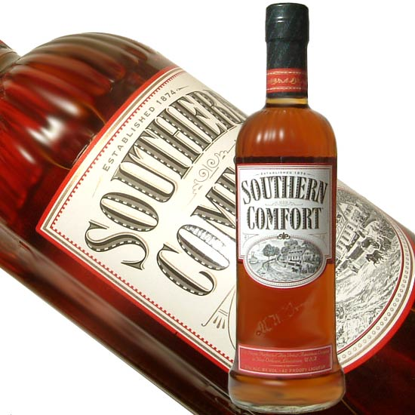
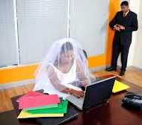
Believer’s Discouragement
Job – Job 2:11, “Why did I not die at birth? Why did I not perish when I came from the womb?”
Elijah – 1 Kings 19:3-10, “. . . He arose and ran for his life . . . And there he went into a cave . . .”
David – Psa 142:4, “Refuge has failed me; no one cares for my soul.”
Paul – 2 Cor 4:8-10, “We are hard-pressed on every side, yet not crushed; we are perplexed, but not in despair; persecuted, but not forsaken; struck down, but not destroyed . . .”
Each of us – 2 Cor 1:7, “. . . You are partakers of the sufferings . . .”
Difficulties of Life – Numbers 21:4, “Then they journeyed from Mount Hor by the Way of the Red Sea, to go around the land of Edom; and the soul of the people became very discouraged on the way.”
Prosperity of the Wicked – Psa 73:2-3, “But as for me, my feet had almost stumbled; my steps had nearly slipped. For I was envious of the boastful, when I saw the prosperity of the wicked.”
The Daily Journeying – Prov 13:12, “Hope deferred makes the heart sick . . .”
Repeated Tribulations – Jn 16:33, “In the world you will have tribulation . . .”

Slide 7
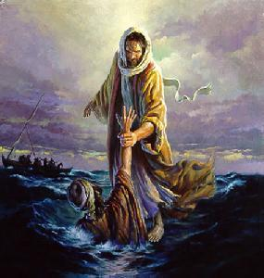
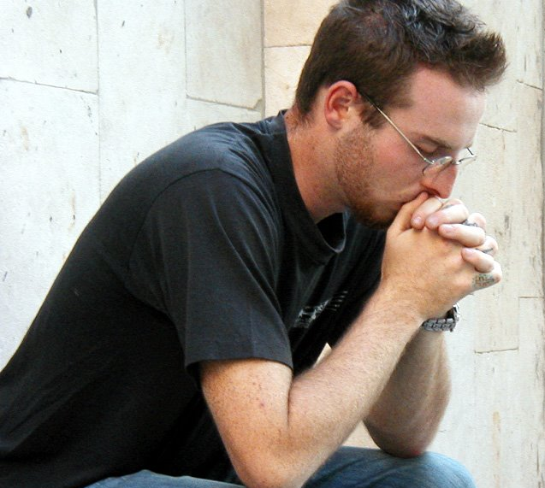
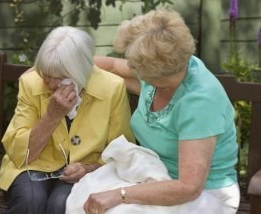
Paraklesis: “A calling near to help”
Comfort: “To give strength and hope to”
Barnabas: (Acts 4:36)
By Entering into our Suffering
By the Encouragement of Others
By the Prayers of Believers
By Looking Beyond the Sorrow

Slide 8
Adversities: Stepping Stones to Greatness
Job: “When he has tested me, I shall come forth as gold” (Job 23:10).
Joseph: “But as for you, you meant evil against me; but God meant it for good, in order to bring it about as it is this day, to save many people alive” (Gen 50:20).
Paul: “And He said to me, my grace is sufficient for you, for My strength is made perfect in weakness. Therefore most gladly I will rather boast in my infirmities, that the power of Christ may rest upon me. Therefore I take pleasure in infirmities, in reproaches, in needs, in persecutions, in distresses, for Christ’s sake. For when I am weak, then I am strong” (2 Cor 12:9-10).

