Slide 2
2 Corinthians 2:3-8
³ And I wrote this very thing to you, lest, when I came, I should have sorrow over those from whom I ought to have joy, having confidence in you all that my joy is the joy of you all. ⁴ For out of much affliction and anguish of heart I wrote to you, with many tears, not that you should be grieved, but that you might know the love which I have so abundantly for you.⁵ But if anyone has caused grief, he has not grieved me, but all of you to some extent—not to be too severe. ⁶ This punishment which was inflicted by the majority is sufficient for such a man, ⁷ so that, on the contrary, you ought rather to forgive and comfort him, lest perhaps such a one be swallowed up with too much sorrow. ⁸ Therefore I urge you to reaffirm your love to him.

Slide 4
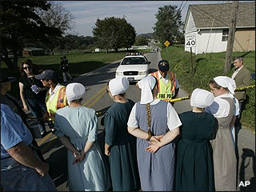
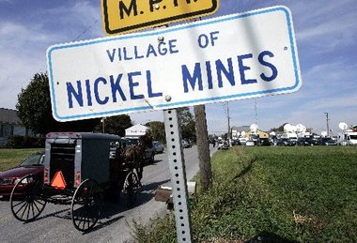
Ten girls were shot in an Amish school at Nickel Mines, Lancaster County, Pennsylvania on Oct. 2, 2006 by Charles Carl Roberts IV.
He entered an Amish one-room school at about 10 AM., and ushered 15 boys, one pregnant woman, and three other women with infants from the school. He bound 11 students who remained -- all girls, aged 6 to 15 -- with plastic flex ties, and prepared to shoot them.
Student Marian Fisher, 13, stepped forward and asked that he "shoot me first." in an apparent effort to buy time for the remaining students. Her younger sister, Barbie, allegedly asked Roberts to "shoot me second." He shot ten young girls. Three died immediately; two others died in hospital by the next morning.
Roberts committed suicide when the police stormed the school.

Slide 5
Two nights before Christmas 1982, Tommy Pigage drove from a party drunk. After pausing briefly at a Mini Mart to get his bearings, he pulled his Buick back onto the road. The last thing he remembers is approaching the Canton Street Bridge in Hopkinsville, Kentucky. "Then I blacked out," he says. Tommy never saw 18-year-old Ted Morris coming the other way in his '76 AMC Hornet.
Ted Morris died Christmas Eve morning, and Pigage was arrested for murder after his blood alcohol level registered almost three times the amount required to be legally intoxicated.
The grand jury reduced the murder charge to second-degree manslaughter. Pigage pleaded innocent, and trial was postponed again and again.
In October, 22 months after the accident, Pigage changed his plea to guilty and was freed on probation.

Slide 6
Have you Considered God’s Forgiveness?
In Him we have redemption through His blood, the forgiveness of sins, according to the riches of His grace
(Eph 1:7).

Slide 7
God’s Forgiveness is:
Undeserved
He has not dealt with us according to our sins, nor punished us according to our iniquities.
(Psalm 103:10).
But God demonstrates His own love toward us, in that while we were still sinners, Christ died for us. (Romans 5:8).
For by grace you have been saved through faith, and that not of yourselves; it is the gift of God (Ephesians 2:8).

Slide 8
God’s Forgiveness is:
Complete
Come now, and let us reason together, says the Lord, though your sins are like scarlet, they shall be as white as snow; though they are red like crimson, they shall be as wool. (Isaiah 1:8).
Therefore He is also able to save to the uttermost those who come to God through Him, since He always lives to make intercession for them
(Hebrews 7:25).
For I will be merciful to their unrighteousness, and their sins and their lawless deeds I will remember no more (Hebrews 8:12).

Slide 9
“No problem”
“It’s O K!”
“Don’t sweat it”
“I’ll Think About it”
“Forget about it”
“Absolutely Not”

Slide 10
Forgive One Another
“you . . . forgive and comfort him, lest perhaps such a one be swallowed up with too much sorrow . . . reaffirm your love to him” (2 Cor 2:7-8).
“(Forgive) up to seventy times seven” (Matt 18:22).
“And be kind to one another, tenderhearted, forgiving one another, just as God in Christ forgave you” (Eph 4:32).

Slide 11
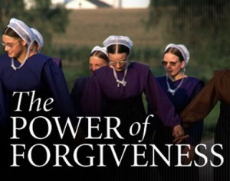
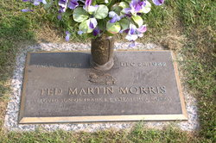
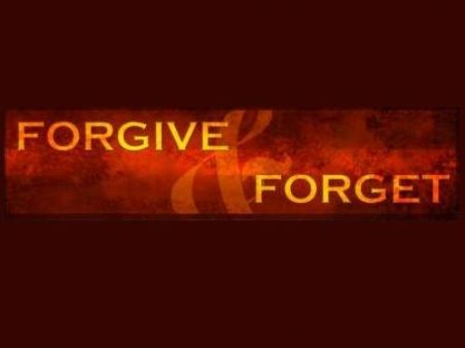
ISSUMAGIJOUJUNNAINERMIK
Issu-magi-jou-jun-nai-ner-mik
"I can't think about it anymore”
Frank Morris, a United Parcel Service driver began a conversation with Tommy about the Bible. “I said, 'If you're sincere in wanting to be baptized, I can stop this very night and baptize you.' About 10 that night we stopped at the Little River church of Christ, and I baptized him. He thanked me and asked if I'd forgive him for what he'd done. I said, 'Yes, I'll forgive you.' Elizabeth had already forgiven him.”
An unnamed Amish neighbor embraced the father of Charles Roberts and said “We will forgive you.”
Members of the Amish community went to the killer's burial service at the cemetery.
Several families who had buried their own daughters were in attendance and they hugged the widow, and hugged other members of the killer's family.
Hebrew 8:12
Colossians 3:13
Forgive Him
Comfort Him
Reaffirm your love to Him

